Slide 1
Artificial Insemination and its Social Implications.
By: Lohit Prasad
Nihaar Singh
Sai Shastry

Slide 2
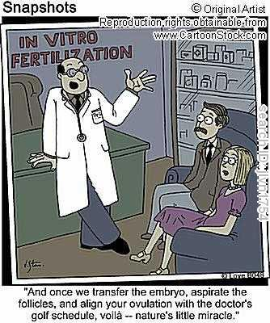
What is Artificial Insemination?
It is a procedure to treat infertility.
It is the deliberate introduction of semen into a female for the purpose of fertilization, by means other than ejaculation directly into the vagina or oviduct.
Humans & Animals

Slide 3
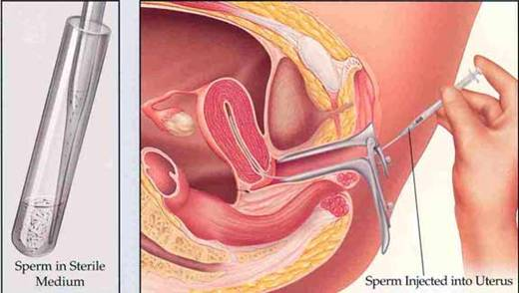
Artificial Insemination

Slide 4
Who uses Artificial Insemination?
Men with Erectile Dysfunction and who have very low sperm counts or sperm that aren't strong enough to swim through the cervix and up into the fallopian tubes.
Women with CFI, Endometriosis or abnormalities of any of their reproductive organs.

Slide 5
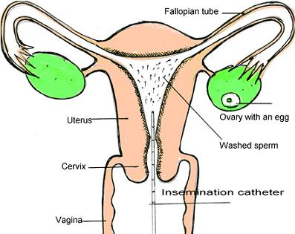

Slide 6
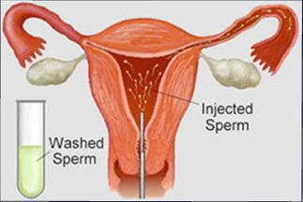
How is Artificial Insemination Done?
IUI (Intrauterine Insemination)
ICI (Intracervical Insemination)
ITI (Intratubal Insemination)

Slide 7
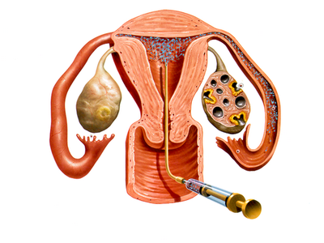

Slide 8
Advantages of Artificial Insemination
Artificial insemination makes selective breeding easier.
It is a painless process.
It is non invasive.
Success rate.
Traditional Intercourse

Slide 9
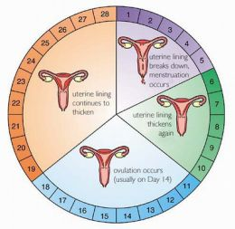
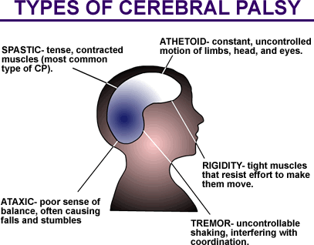
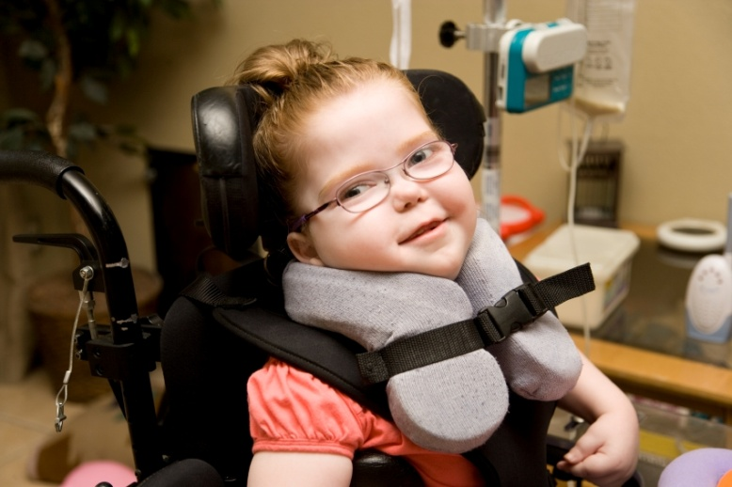
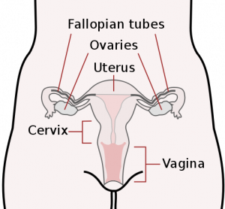
Disadvantages of Artificial Insemination
Timing
Cramps
Diseases
Catheter
Birth Defects
Accidental incest

Slide 10
Social Implications
Adultery.
Promotes Masturbation.
Religious restrictions by the Catholic Church and Islam.
Legal Status in some countries is banned.
Untraditional families.

Slide 11
Cost
The cost is about60 – 200 USD.
This process is cheap and accessible.

Slide 12
Success Rate
Age Group | Success Rate
18 – 30 | 5 – 20 %
30 – 35 | 15 – 20 %
35 – 40 | 10 – 15%
40 + | 10%

Slide 13
Bibliography
http://en.wikipedia.org/wiki/Artificial_insemination
http://www.webmd.com/infertility-and-reproduction/guide/artificial-insemination
http://www.nhs.uk/conditions/Artificial-insemination/Pages/Introduction.aspx
http://www.docshop.com/education/fertility/treatments/artificial-insemination
http://www.babycenter.com/0_fertility-treatment-artificial-insemination-iui_4092.bc
http://www.medicalnewstoday.com/articles/217986.php
http://www.insemination-help.com/
http://www.preservearticles.com/201012312131/advantages-of-artificial-insemination-over-natural-breeding.html
http://www.ehow.com/about_5054889_benefits-artificial-insemination.html
http://www.howtodothings.com/family-relationships/disadvantages-of-artificial-insemination
http://www.ask.com/questions-about/Disadvantages-of-Artificial-Insemination

Slide 14
Thank You!

