Slide 1
Birth Control – Natural and Chemical Methods
By Abhishek, Benjamin, Jay,Sahej,Nikhil, Rahool, Akashdeep,Anshul and Manoj

Slide 2
Abstinence
Abstinence is the act of not engaging in sexual intercourse. This is a method of birth control as there can be no fertilization without intercourse in the first place.
Advantages:
100% Effective
No Sexually Transmitted Diseases (STD) can be caught
Accepted by all religions
Disadvantages:
Can be regarded as lower class in some cultures
Can be scorned at in cultures where large families are promoted for wealth and labor

Slide 3
Rhythm Method
The method of Birth control which involves the female partner to understand and recognise the days during her menstrual cycle in which she is fertile, to have sexual intercourse. This prevents any sperm fertilizing an egg as the egg is not present at the time of intercourse.
Advantages:
75% to 87% effective
Allows sexual intercourse as well as birth control
Natural and accepted in mostly all religions and cultures
Disadvantages:
It cannot provide any protection against STD’s
There is still a chance of successful fertilization and then pregnancy

Slide 4
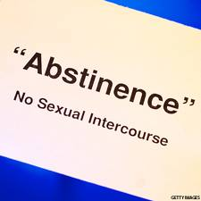
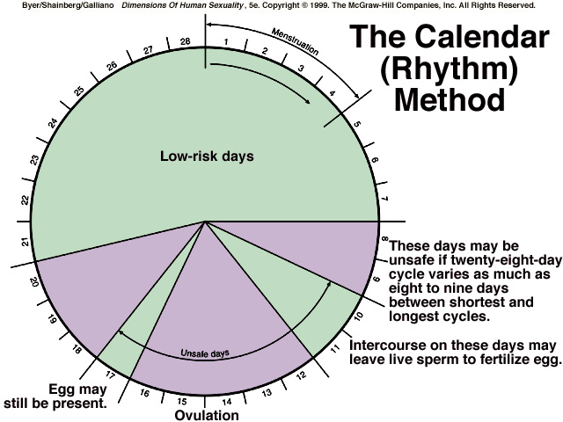
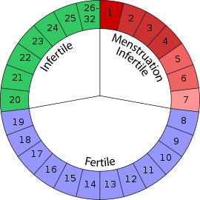
Natural Birth Control
Example of importance of Abstinence as well as implementation of it in the growing world today -Youtube.com/watch?v=N30H4jgFUs4
Important information about the Rhythm Method - Youtube.com/watch?v=6JxqUxKXDOY

Slide 5
Contraceptive pill
The method of contraception via hormones to control the Uterus and Ovaries.
1.
Contains Oestrogen and Progesterone
These hormones are released into the blood stream
2.
This prevents ovulation by simulating pregnancy in the uterus (implanted embryo and conditions replicated)
3.
The mucus of the cervix thickens
Sperm is prevented from entrance

Slide 6
Pros and Cons
Advantages | Disadvantages
Very successful in Birth Control | Cannot prevent STD’s
Allows Sexual Intercourse | Time consuming and expensive
Can be used as emergency contraceptives (abortives) | Religiously or culturally disallowed or banned
Easier to use and safer to use than other contraceptives, fertility not damaged

Slide 7
Spermicide
A method by which a chemical is used in a variety of forms which kills sperm cells
Using applicators the spermicide is placed near the Cervix
Spermicide can immobilize the sperm to prevent it from fertilizing the egg cell
Spermicide can aslo directly kill sperm cells

Slide 8
Pros and Cons
Advantages | Disadvantages
Not expensive to use | not Very useful
Does not damage the male or female organs | Not very convenient to apply for proper use
 | Cost for constant usage can be high
 | Restricted periods for intercourse after application

Slide 9
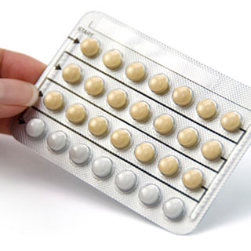
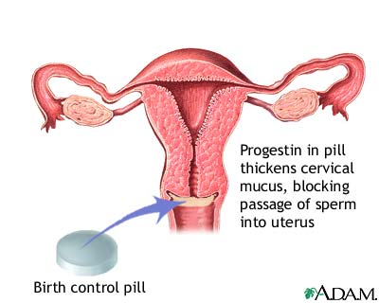
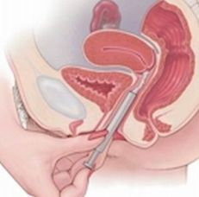
Chemical Birth Control
youtube.com/watch?v=RylypylEtoA
youtube.com/watch?v=jiCU46_lWeE

Slide 10
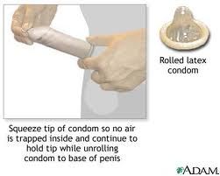

Slide 11
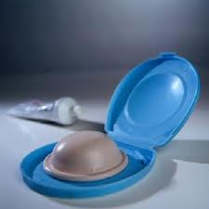
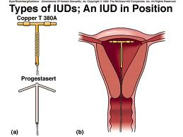
Mechanical
IUD
This is plastic copper coil which may be left in the uterus for months or lower end allow the coil to be removed via the vagina
Quite reliable, particularly for women who have already had children.
Irritates the lining of the uterus so that implantations of the zygote occur.
Diaphragm or cap
A thin rubber barrier with a springy outer ring to ensure a close fit. Prevents sperm from entering the uterus.
Very reliable
Correct size must be used
Fitted before inter course

Slide 12
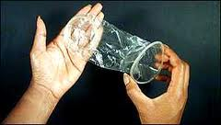
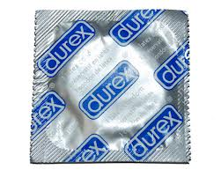
Mechanical
Female condom or femidom
A thin sheath which lines the vagina, and prevents entry of sperm .The closed end has a ring to make fitting easier and the ring at the open end lies flat against the labia.
Condom OR Sheath
this is a thin rubber covering that is fitted over the erect penis before intercourse. If it prevents sperm being released into the vagina and also protects against sexually transmitted diseases.

Slide 14
Condom
Barrier method of birth control, is a thin latex sheath placed on the male’s erect penis before intercourse.
The keep semen from entering the woman’s vagina and therefore prevents fertilization and pregnancy.
It has a high success rate and is the most common type of birth control used.
The condom can fail due to it slipping or breaking but this is unlikely.
These condoms are also helpful in the prevention of STD’s because sperm is not transferred.

Slide 15
Femidom
This is the female version of the condom but is not as popular as the male version.
It has two ends, a closed ring on one side and an open ring on the other. It is inserted into the vagina up to 8 hours before intercourse but must be removed immediately.
Male and female condoms should not be used together, because they can get stuck and one can slip.
Both types of condoms are relatively cheap and fairly effective not only for birth control but also preventing the spread of STD’s.

Slide 16
IUD (intrauterine device)
The intrauterine device (IUD) is a T-shaped piece of plastic that is placed inside the uterus to prevent pregnancy.
There are two types of IUD’s — one is covered with copper, the other releases the hormone progesterone.
It works by preventing the implantation of a fertilized egg.
For the progesterone IUD, it increases the mucus secreted by the cervix, and may also prevent ovulation.
It has a 98% success rate but is rendered useless if it is moved out of place.
It does not prevent STD’s.
Heavier periods with more cramps can occur while using the copper IUD
An IUD costs about $200 to $400 plus the cost of having a doctor insert and remove it

Slide 17
The diaphragm
A thin rubber disc placed in the vagina before intercourse,
This covers the cervix and stops the sperm from entering the uterus and fertilizing the egg.
When coated with spermicides they become about 95% effective.
The diaphragm is inserted up to 6 hours before having intercourse.
Spermicides may irritate the vagina and surrounding skin or cause an allergic reaction.
Diaphragms and spermicides may make urinary tract infections more likely.
Diaphragms DO NOT prevent the spread of STD’s unless they are used with a condom.

Slide 18
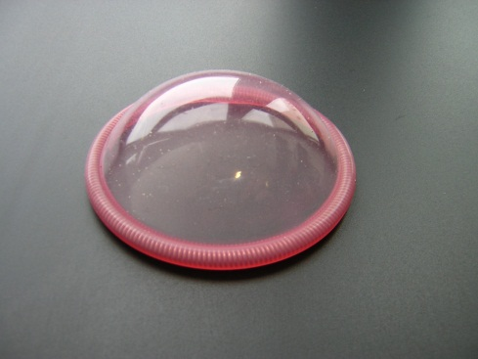
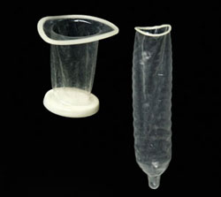
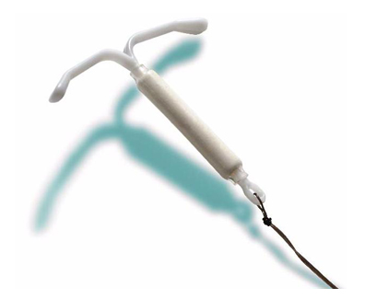
Mechanical methods
Female Condom
Diphragm
Male Condom
IUD

Slide 19
Vasectomy
Vasectomy is a surgical procedure for men and results in sterilization or the inability for a man to fertilize the ova of a woman.
It works by cutting and tying the vas deferens so sperm cannot travel to the urethra and be ejaculated.
This only inhibits the transfer of sperm but the seminal vesicle and prostate gland still secrete fluids so a man can still ejaculate but without the presence of sperm.
This method can be reversed but the success rate is low and it is expensive.
It can lead to swelling of the testes and long term pain in the genitals.
While this has no risk of unwanted pregnancies it is still possible to spread or receive STD’s to or from the sexual partner.
There is a 99% success rate with most unwanted pregnancies occurring because the patient engage in unprotected intercourse too soon after the operation.

Slide 20
Tubal Litigation
Tubal litigation is a surgical procedure for women and also results in sterilization.
It works by cutting and tying or clamping the fallopian tubes to prevent sperm from reaching and fertilizing the egg and to stop the egg from reaching and implanting in the uterus.
This does not disturb sexual drive or the menstrual cycle in women.
This method is sometimes reversible with a rate of 98%, in women were tubal reversal is not possible there is the option of in vitro, or a test tube baby.
This method is also 99% effective with failure occurring because the fallopian tubes rejoined and healed themselves. A failure can only be detected by a subsequent pregnancy.

Slide 21
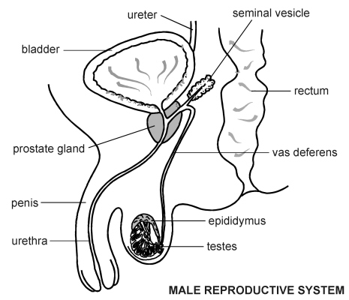
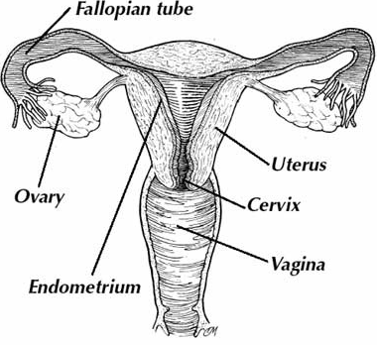
Surgical Methods
Tubal Litigation
Vasectomy

