Slide 1
Specialised Cells

Slide 2
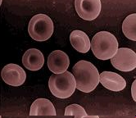
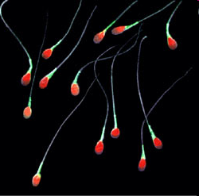
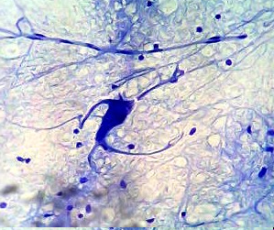
Specialised Animal Cells
Image 1 - Red Blood Cells
Image 2 - Sperm Cells
Image 3 - Nerve Cells

Slide 3
Image 1 - Red Blood Cells
Example of cell | Specific function | Specialised features suited to the function
Red blood cell | Contain haemoglobin to carry oxygen to the cells | 1. Thin outer membrane allows oxygen to diffuse through easily. 2. Bi-concave shape increases the surface area to allow more oxygen to be absorbed efficiently and gives cell a more flexible framework allows cells to squeeze through even the tiniest capillaries. 3. No nucleus means that the whole cell is full of haemoglobin which combines with and carries oxygen around the body.

Slide 4
Image 2 - Sperm Cells
Example of cell | Specific function | Specialised features suited to the function
Sperm cell (male gamete) | To fertilise the egg cell (female gamete) | 1. The head, containing genetic information and a nucleus, has an enzyme to help penetrate the egg cell membrane. 2. The middle section, immediately behind the head is packed with mitochondria for energy. 3. The tail or flagellum moves the sperm to the egg.

Slide 5
Image 3 - Nerve Cells
Example of cell | Specific function | Specialised features suited to the function
Nerve cell (motor neurone) | Pass sensory impulses from receptor to an effector | 1. Dendrites to make connections with other neurones. 2. Long axon or nerve fibre to carry the impulse to the target organ. 3. End plate forms a synapse with an effector (a muscle or a gland).

Slide 6
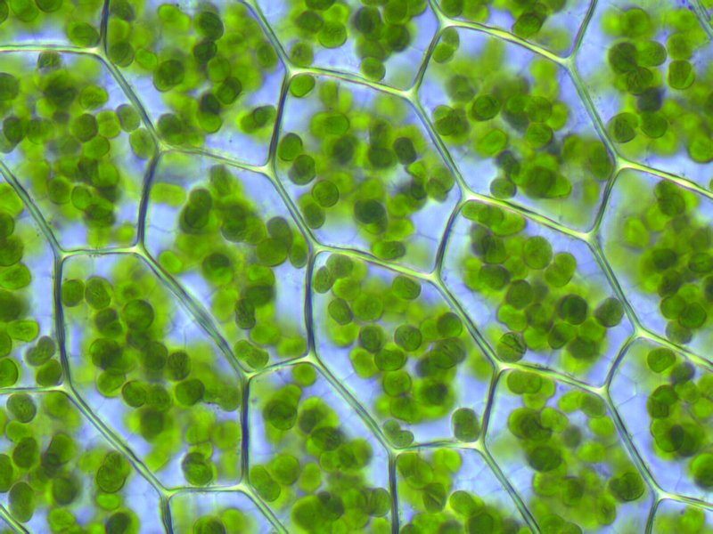
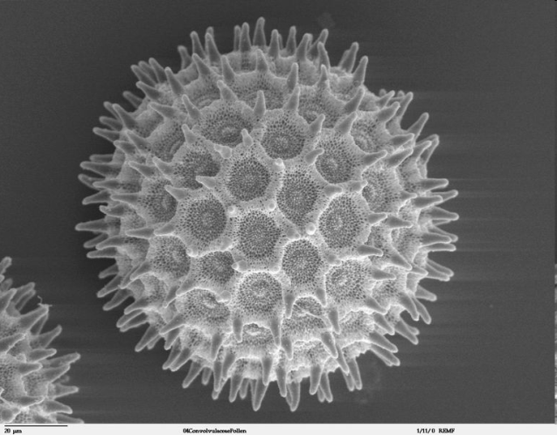
Specialised Plant Cells
Image 4- Leaf Cells
Image 6 - Guard Cells
Image 5- Pollen Cell

Slide 7
Image 4- Leaf Cells
Example of cell | Specific function | Specialised features suited to the function
Leaf palisade cell | Carries out photosynthesis | 1. Packed with chloroplasts containing the light absorbing pigment chlorophyll. 2. Regular shaped, closely packed cells forming a continuous layer for efficient absorption of sunlight.

Slide 8
Image 5 - Guard Cells
Example of cell | Specific function | Specialised features suited to the function
Guard cell | Opens and closes leaf pore | 1. Regulate the size of leaf pore 2. Change shape easily 3. Swell up when filled with water

Slide 9
Image 6- Pollen Cell
Example of cell | Specific function | Specialised features suited to the function
Pollen cell (male gametes) | Fertilise the ovules (female gametes) | 1. Tiny grain with half the genetic information having been formed by meiosis. 2. Have a hard protective outer coat to survive bad conditions. 3. Shape and surface of outer coat is adapted to method of dispersal - eg smooth and sticky for insect dispersal, larger surface area for wind dispersal. 4. Germinate on reaching the stigma of another flower of the same species.

Slide 10
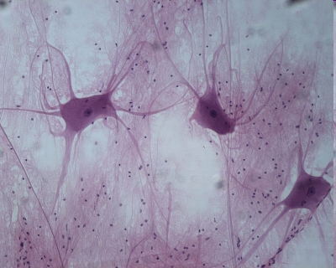
A tissue is a group of cell of similar structure that form a shared function
Tissues found in the leaf
Animal tissues:
muscle tissue
nervous tissue
upper epidermal
tissue
palisade mesophyll
tissue
spongy mesophyll tissue
lower epidermal
tissue
Cross-section of a leaf

Slide 11
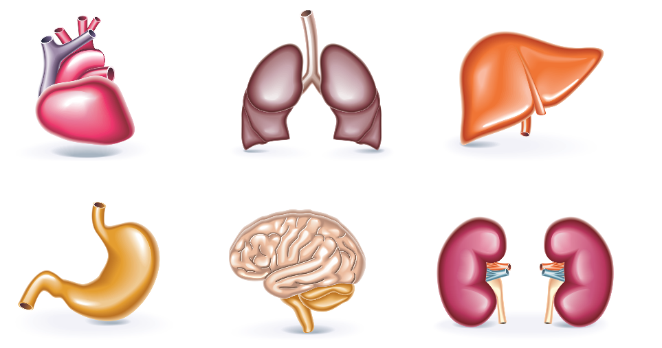
An organ is a structure made of a group of tissues working together to perform specific functions
heart
lungs
liver
stomach
brain
kidneys
Plant organs include the stem and the leaves

Slide 12
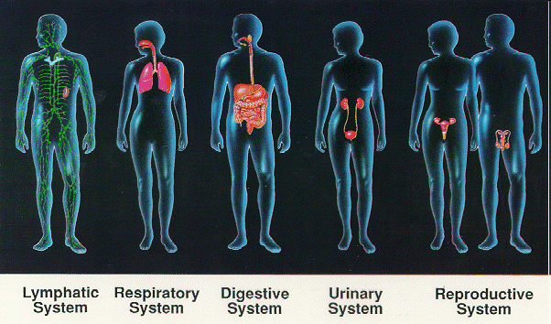
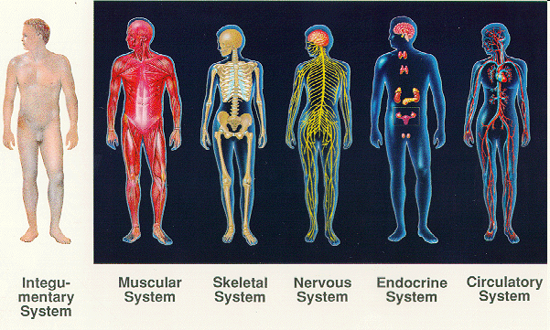
An organ system is a group of organs that coordinate to perform related functions
lymphatic
system
digestive
system
reproductive
system
skeletal
system
endocrine
system
respiratory
system
excretory
system
muscular
system
nervous
system
circulatory
system
In plants the shoot is an organ system consisting of leaves and the stem

