Slide 1
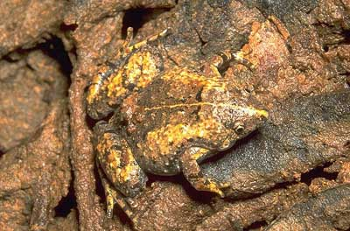
toad
Animal Adaptations

Slide 2
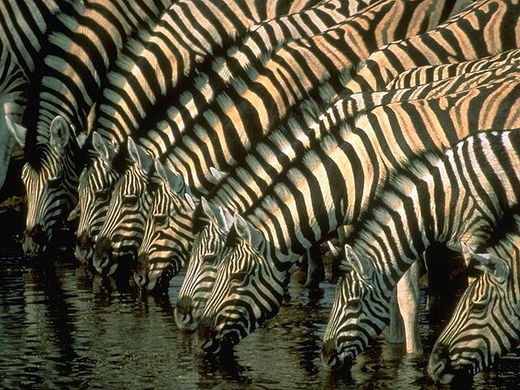
Have you ever wondered how animals are able to survive in the wild?
Animals have certain adaptations that help them to survive.

Slide 3

Think about the way you dress in the winter.
You don’t wear your shorts and bathing suit when it’s snowing outside!
You wear warm clothes, and maybe even a hat and mittens to protect yourself from the weather.

Slide 4
And what if you are having a snowball fight?
You probably run away from the person throwing at you, and maybe even try to sneak up on that person and throw some snowballs!

Slide 5
The way you dress in the winter, as well as the way that you run and hide from someone throwing snow at you are kinds of …
Adaptations.

Slide 6
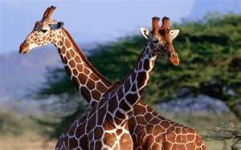
Giraffes
Longest necked animal

Slide 7
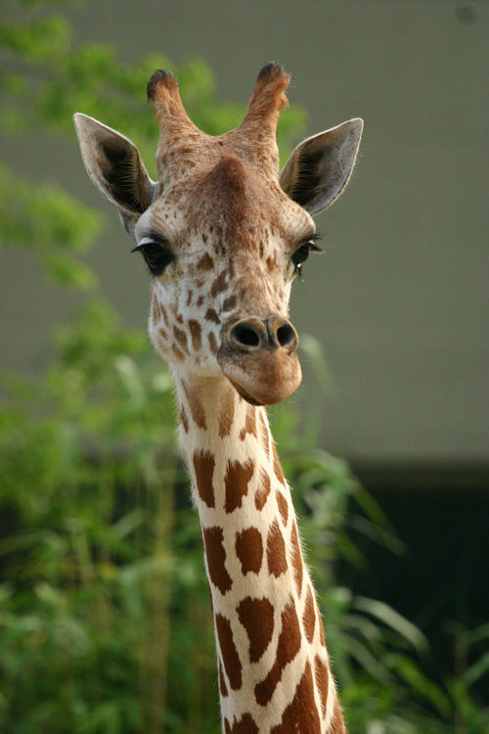
Introduction
A giraffe is a herbivore
Giraffes have a very long neck to help them get their food off of the trees

Slide 8
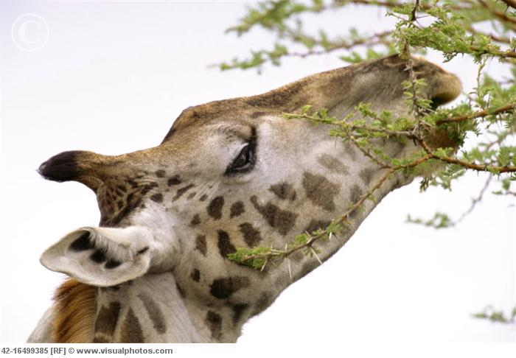
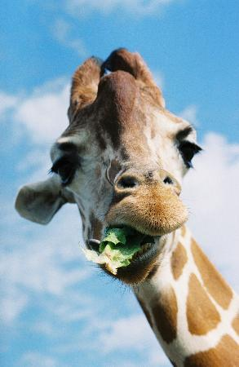
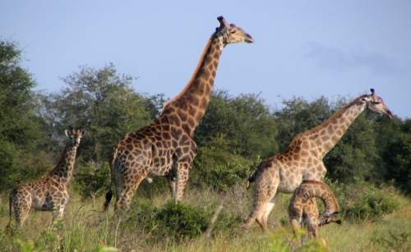
Adaptations of a Giraffe

Slide 9
Brown dots that help it blend in with its surroundings
Long neck to help it see its prey and to get its food
Long eyelashes to prevent any bugs get in its eyes
Little nose to help not get any flies in its nose
Very long legs to help it run very fast away from it’s predators
Have an extraordinary tongue, which helps them to eat and chew plants. It helps them to grab them off the bush by wrapping their tongue around the branch and aggressivley pulling them off. Their tongues can vary in size, but the typical size of their tongue is about 18 inches. Both the tongue and lips of a giraffe help it to eat its food. This is because the skin around each is very tough. This means that they will not get pricked by the thorns on the plants that they eat.
A giraffe can consume up to 12 gallons of water at one time when drinking from a water hole. They also obtain water from the dew on the leaves they eat and the water contained in their food.

Slide 10
VIDEO!!!

Slide 11
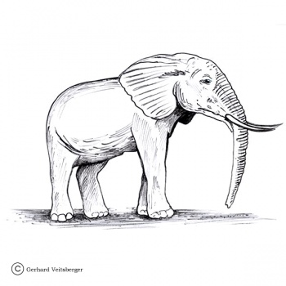
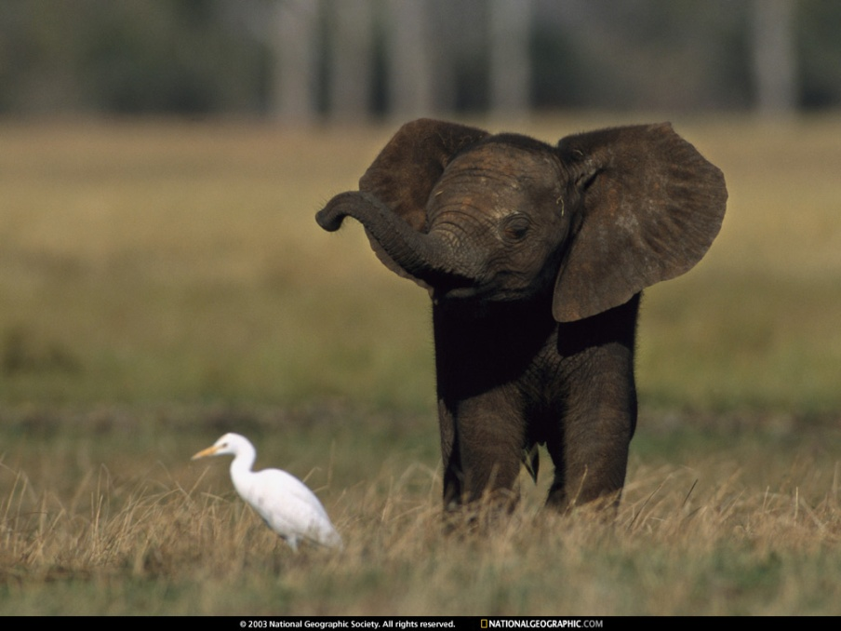
ADAPTATIONS OF AN ELEPHANT Lifespan
African Elephants can live to be 60 years old
Elephants are endangered.

Slide 12
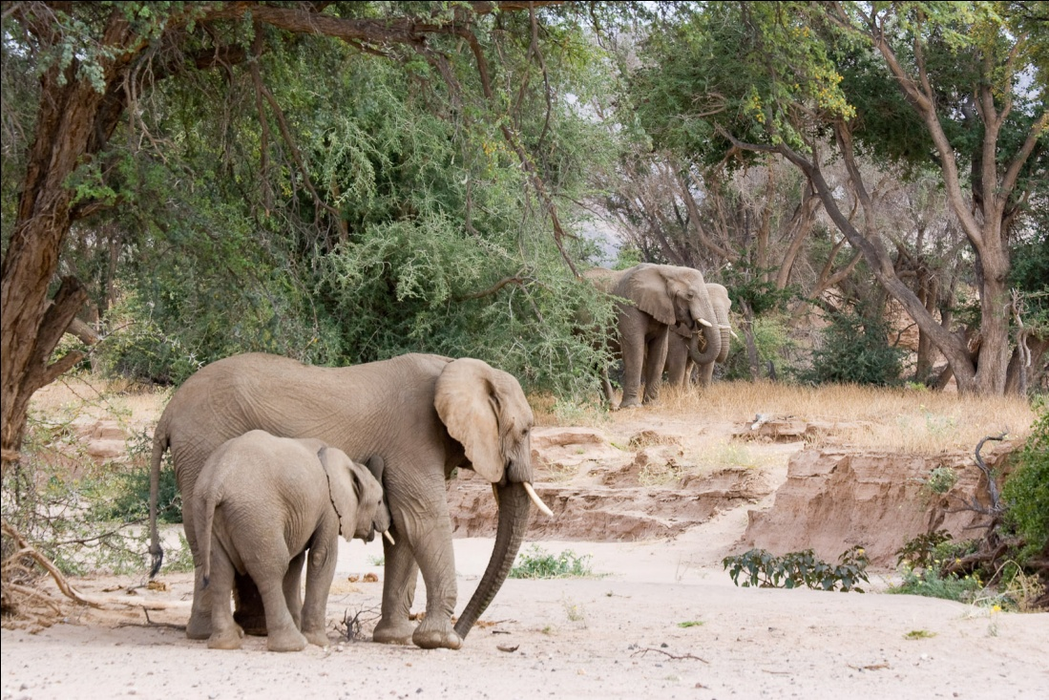
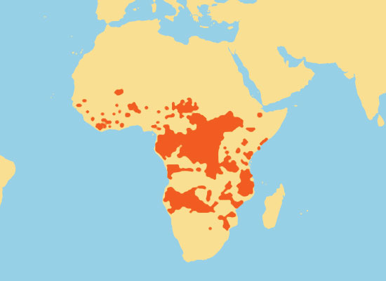
Climate
An African Elephants Climate is in the Desert,
it is hot and dry and it rarely rains

Slide 13
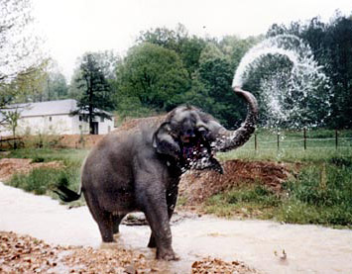
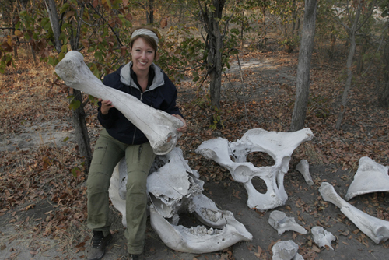
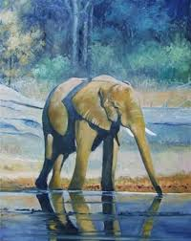
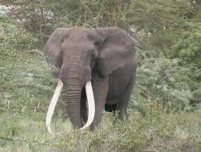

Slide 14
Adaptations
Long trunks help them to eat or take a bath. The trunk helps the elephant to reach food in difficult to get places and place it in its mouth. They use their trunks to spray water on themselves to keep cool.
Sharp tusks help it scare away predators. Tusks are elongated and grow throughout the lifetime. They are used for carrying and gathering food as well as weapons.
Big ears can be used to fan itself to bring it’s temperature down. Also it’s ears help it hear any danger coming.
Elephants have massive bones, this allows them to have a maximum amount of support for their big weight
Vision is poor. Long lashes and eye lids protect the eyes from dust.
Hearing is acute

Slide 15
VIDEO

Slide 16
ADAPTATIONS OF A CAMEL
Why do camels have long eyelashes?
The long eyelashes keep sand out of the camel's eyes.
Thick eyebrows shield the eyes from the desert sun.
Why does a camel have nostrils which can close?
A camels nostrils can close so it doesn't get sand up its nose.

Slide 17
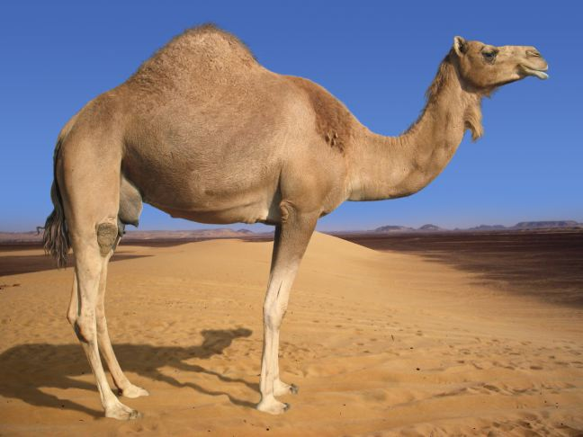

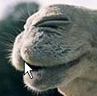
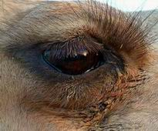

Slide 18
1. A camel can go a week or more without water, and they can last for several months without food. They can drink up to 32 gallons (46 litres) of water at one drinking session!
2. Camels store fat in the hump, not water. The fat can be metabolised for energy.
3. Unlike most mammals, a healthy camel's body temperature fluctuates (changes) throughout the day from 34°C to 41.7°C (93°F-107°F.) This allows the camel to conserve water by not sweating as the environmental temperature rises.
4. Camels feet are wide so they can walk on sand more easily. Their huge feet help them to walk on sand without sinking into it.
5. Camels have thick lips so they can eat the prickly desert plants with out feeling pain.
6. The colour of their bodies helps them to blend into their environment.
7. Camel's ears are covered with hair, even on the inside. The hair helps keep out sand or dust that might blow into the animal's ears.

Slide 19
ADAPTATIONS IN BATS

Slide 20
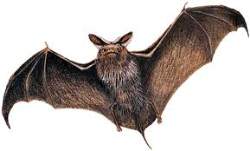
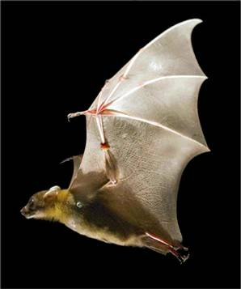
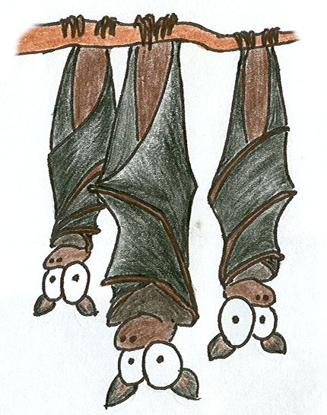

Slide 21
Bats are nocturnal. They may have evolved this lifestyle to avoid large day-time predators and to eat the large number of nocturnal flying insects, especially moths.
Bats sleep upside down.
This is helpful because unlike birds, bat wing structure is not built for take-off. Bats have to climb to a higher location before beginning flight. By sleeping upside down, they can take off immediately if there is danger.

Slide 22
Bats are NOT blind! Most bats have decent vision. Only 70% of
bats use echolocation and the other 30% have good night vision.
b. Echo: Bats emit sound and listen for the echo that bounces back from an object. From this they can determine many characteristics about the object such as its distance from the bat, direction of
movement, speed and size.
Interference with echolocation:
i. Bats rarely fly in the rain as it interferes with the reception of
sound waves, so they are more likely to fly into things.

Slide 23
VIDEO

Slide 24
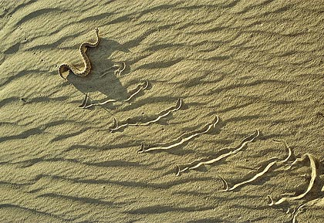
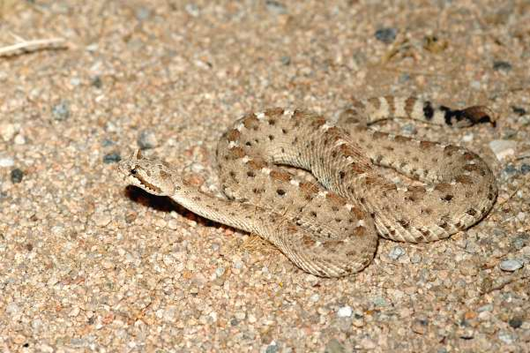
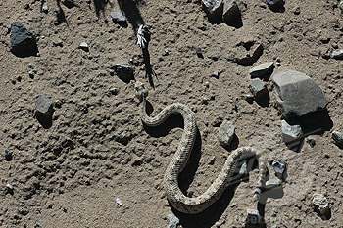
Desert Snake – Sidewinder snake

Slide 25
RANGE: Mojave and Sonoran deserts of southeastern California,
HABITAT: Arid deserts
DIET: Lizards, rats, mice, and sometimes birds. The venom of the sidewinder kills the prey.
Adaptations:
1. The sidewinder has upturned, horn-like scales over the eyes. This horn is capable of folding down over the eye for protection as it moves through burrows searching for food.
2. The sideways movement of the sidewinder (S-shaped locomotion) is particularly adapted for life in the desert. The side winding motion allows the snake to keep most of its body off the ground while moving. This reduces the body's contact with the hot desert sand and reduces heat absorption into the body.
3. Sidewinders are mostly nocturnal to help avoid the heat during the day.
4. The sandy color of the sidewinder protects themselves from predators and allows them to find/ trap prey easier in the desert.

Slide 26
VIDEO

Slide 27
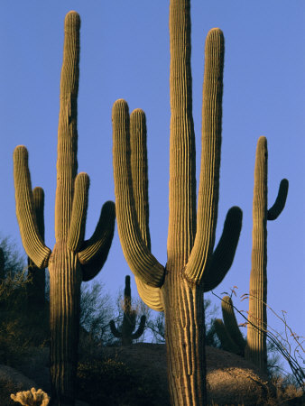
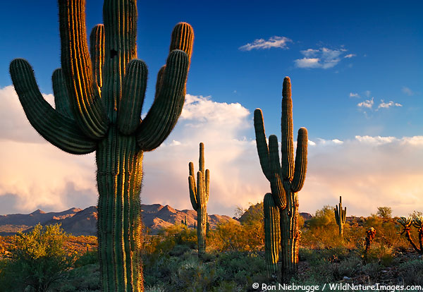
Cactus

Slide 28
Its expanding trunk allows it to take in and store a great deal of water when water is available.
2. It does not need a lot of water to survive.
3. The flower only opens on cooler nights and is closed during the heat of midday.
Cactus pads are modiﬁ ed stems with a waxy coating.
Their root system is very shallow, drinking up rainwater.
Small rain roots can grow as soon as soil is moistened by rain. They later dry up.
Prickly spines are modiﬁed leaves that help shade the stem.

Slide 29
VIDEO

