Slide 1
Excretion
To carry out its living processes, every cell in the body needs a supply of oxygen and food. Waste products such as carbon dioxide have to be removed before they reach harmful levels and damage the cell
These conditions are maintained by tissue fluid bathing the cells. Tissue fluid is derived from the blood
The tissue fluid contains oxygen and food which the cells can absorb, and also accepts the carbon dioxide and other waste products produced by the cells

Slide 2
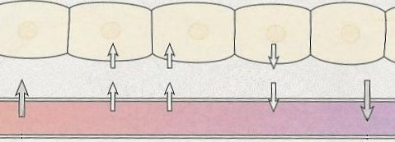
Blood and tissue fluid
9
The blood system maintains the composition of the tissue fluid
cells
tissue fluid
glucose
oxygen
carbon dioxide
carbon dioxide
fluid filtered out of capillary
tissue fluid enters capillary
blood flow

Slide 3
Urea
In the cells, the chemical breakdown of proteins produces the nitrogenous compound, urea. If this were allowed to accumulate in the cells it would damage or kill them.
The concentration of the blood and tissue fluids tends to vary. If water is lost through evaporation and sweating, the fluids become more concentrated. The intake of water dilutes the fluids
It is important that the concentration of blood and tissue fluid is kept within narrow limits if the cells are to function properly
These homeostatic functions are carried out by the kidneys

Slide 4
Controlling water levels
The control of water levels is carried out by the KIDNEYS.
It is closely linked to the excretion of urea.
Urea is a waste product that is made when the LIVER breaks down proteins that are not needed by the body.
Urea contains the element Nitrogen.

Slide 5
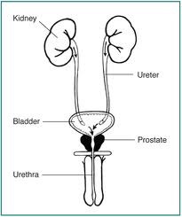
Urinary system

Slide 6
The kidneys
The kidneys “clean” the blood of waste products and control how much water is kept in the body. The waste products and water make up urine which is excreted via the ureter.
“Dirty” blood enters the kidney through the renal artery. Then, several things happen to clean the blood...

Slide 7
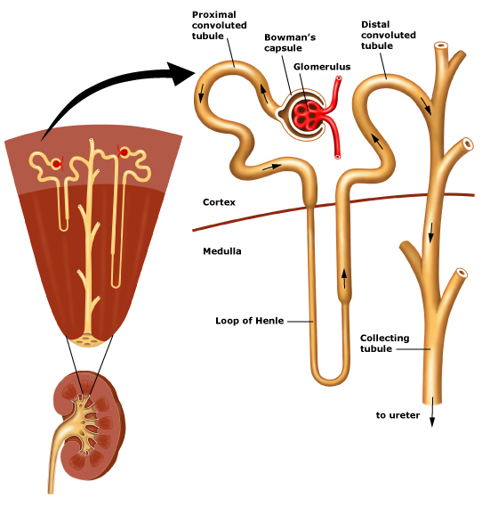
Nephron in ultrafiltration

Slide 8
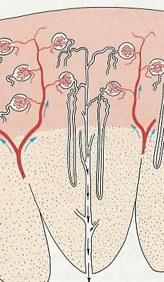
Kidney function
11
Microscopic slice of kidney tissue
Blood pressure forces tissue fluid out of a clump of narrow capillaries
The fluid contains urea, salts, glucose and other soluble substances
The fluid trickles down this tubule and the useful substances such as glucose are reabsorbed into the blood
In this tubule more or less water is reabsorbed to maintain the blood concentration
Excess water, some salts and urea collect here before passing to the bladder as urine

Slide 9
1. Filtration
Blood enters the tubule area in a capillary. Bowmans capsule
The capillary forms a small “knot” near the kidney tubule.
The blood is filtered so all the small particles go into the tubule.
The capillary then carries on to run next to the tubule.

Slide 10
The kidney tubule now contains lots of blood components including:
Glucose:
Ions:
Water:
Urea:

Slide 11
2. Reabsorb sugar
The body needs to have sugar in the blood for cells to use in respiration. So all the sugar is reabsorbed back into the capillary.

Slide 12
2. Reabsorb sugar
The body needs to have sugar in the blood for cells to use in respiration. So all the sugar is reabsorbed back into the capillary.

Slide 13
3. Reabsorb water
Water and ions are the next to be absorbed. It depends on how much is needed by the body.

Slide 14
3. Reabsorb water
Water and ions are the next to be absorbed. It depends on how much is needed by the body.

Slide 15
Reabsorbing water
If you have too little water in your blood, you will produce very concentrated urine.
(very little water in it)
If you have too much water in your blood, you will produce very dilute urine.
(lots of water in it)

Slide 16
5. Excrete the waste
Everything that is left in the kidney tubule is waste:
All the urea
Excess water
This waste is called urine. It is excreted via the ureter and is stored in the bladder.
Renal vein
The “clean” blood leaves the kidney in the renal vein.
Ureter

Slide 17
Summary of urine production
Urea is a waste product made in the LIVER
Water content of the body is controlled in the KIDNEYS
Urea, water and other waste makes up URINE.
Urine travels down the URETER and is stored in the BLADDER
Urine is excreted through the URETHRA.

Slide 18
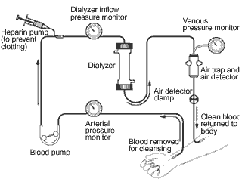
Hemodialysis

Slide 19
Parts of dialysis machine
Dialyser : large surface area membrane on plastic support. Blood pumped past one side of the membrane and dialysing fluid past the other side. Diffusion aided by counter current flow of plasma and dialysate.
Dialysate: has solute concentrations identical with those in normal plasma, so that any excess solutes in the plasma move down a concentration gradient and into the dialysate and any shortfall in the plasmasolutes is made upfor by diffusion in the opposite direction.the dialysate contains no wastes so substances such as urea move down the concentration gradient and into the dialysate.

Slide 20
Parts of dialysis machine
Constant temperature water bath: maintains at 37˚C no thermal damage to plasma proteins,no alteration in blood viscosity.
Bubble trap: removes any gas bubbles which might damage patient’s circulation.
Heparin: An anti coagulant added to prevent clotting and possible blockage of filteretion surface.
Roller pump: maintains pressure.
Hemoglobin sensor: detects damage to red blood cells.
Filter: removes any blood clots which may cause blockages or cardiovascular damage.

Slide 21
Kidney transplant
When both kidneys fail
Person who gives-donor person who recieves-recipent
The tissues have to match, blood group match inorder to avoid immune system’s tissue rejection
Rejection can be overcome by using immuno suppressive drugs. These supress the production of lymphocytes and their antibodies against the transplanted organ.
Donor can also lead a healthy life with one kidney.

Slide 22
Dialysis- Advantages and disadvantages
Provides temporary relief to person suffering total kidney failure
Solution to people suffering from partial kidney failure
Help prolonging life till a suitable donor is found
Expensive- expenditure is recurring
Physically emotionally exhausting process
A lot of diet restrictions

Slide 23
Kidney transplant- advantages & disadvantages
Freedom from dialysis
Increased level of energy
Fewer diet restrictions
Better quality of life
No recurring expenditure. it is one time investment
Needs to be on drugs rest of his life
All cannot afford the procedure
Difficult to find suitable donors
Side effects of medicine may be there for long time.

Slide 24
Question time…
Difference between egestion and excretion
Deamination: what? where? and why? And final products formed.
(20min)

