Slide 1
HIV/AIDS
By: Krish, Zaheen, Sayesha, Sarayu, Arnav and Simran
By: Arjun, Arnav, Dinesh,Medha, Neethi, Safia, Suman, Zach

Slide 2
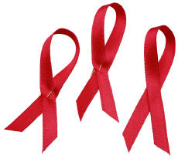
AIDS
AIDS stands for Acquired Immune Deficiency Syndrome
It is a disease that affects the immune system
It is caused by the HIV
It originated with the polio vaccine, coming from chimpanzees

Slide 3
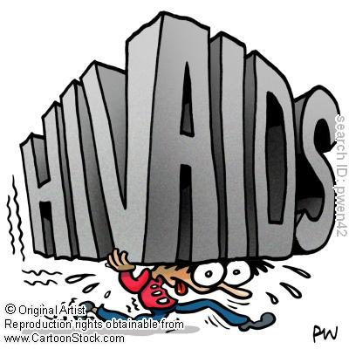
HIV
Stands for Human Immunodeficiency Virus
It is the virus which causes AIDS
A person who carries HIV doesn’t have to have AIDS

Slide 4
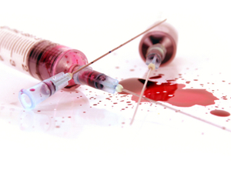
Transmission
HIV can be transmitted in three main ways:
Sexual transmission
Transmission through blood
Mother-to-child transmission

Slide 5
TRANSMISSIOn
HIV is transmitted by direct infection of the blood.
Drug users who share needles contaminated with infected blood have a high risk of the disease
Also transmitted sexually by a man and woman, and also homosexuals who practice intercourse
Can also be transmitted by blood donations, organ transplants, and skin grafts.
Also, semen donations for woman who do not want to have intercourse
It can also be hereditary, from a woman with AIDS to the baby during childbirth.

Slide 6
Mode of Attack
It attacks certain kinds of lymphocytes and weakens the immune responses of the host body
This causes the body to be more prone to diseases, such as blood disorders, skin cancer, and pneumonia

Slide 7
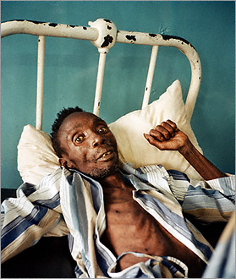
Symptoms
Years can pass before symptoms develop
Symptoms of HIV:
Fever
Headaches
Muscle & Joint Pain
Sore throat
Diarrhea
Rashes

Slide 8
Symptoms
Symptoms of AIDS:
Rapid weight loss
Night sweats
Unexplained Fatigue
Swelling glands in the armpits groins and neck
Diarrhea (for more than a week)
White spots on the tongue
Pneumonia
Red, Brown, Pink or Purplish spots under the skin, inside the mouth, in the nose and in the eyelids
Memory loss

Slide 9
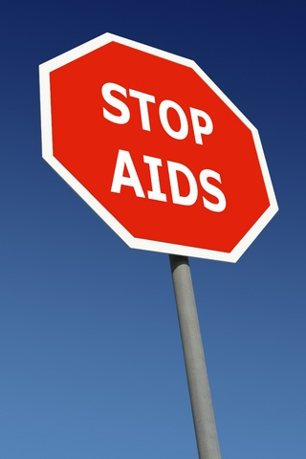
Prevention
Abstain from sex or delay first sex
Be faithful to one partner or have fewer partners
Condomise, which means using male condoms or female condoms consistently and correctly
Comprehensive sex education for young people is an essential part of HIV prevention.
Avoiding using the same razor while shaving
Going to legal tattoo parlors and using the same needle used by others
Transfusion of infected blood or blood products is the most efficient of all ways to transmit HIV. However, the chances of this happening can be greatly reduced by screening all blood supplies for the virus, and by heat-treating blood products where possible. In addition, because screening is not quite 100% accurate, it is sensible to place some restrictions on who is eligible to donate

Slide 10
Prevent transmission from mother to child
HIV can be transmitted from a mother to her baby during pregnancy, labour and delivery, and later through breastfeeding. The first step towards reducing the number of babies infected in this way is to prevent HIV infection in women, and to prevent unwanted pregnancies.
There are a number of things that can be done to help a pregnant woman with HIV to avoid passing her infection to her child. A course of antiretroviral drugs given to her during pregnancy and labour as well as to her newborn baby can greatly reduce the chances of the child becoming infected. Although the most effective treatment involves a combination of drugs taken over a long period, even a single dose of treatment can cut the transmission rate by half.
A caesarean section is an operation to deliver a baby through its mother’s abdominal wall, which reduces the baby’s exposure to its mother’s body fluids. This procedure lowers the risk of HIV transmission, but is likely to be recommended only if the mother has a high level of HIV in her blood, and if the benefit to her baby outweighs the risk of the intervention.
Weighing risks against benefits is also critical when selecting the best feeding option. The World Health Organisation advises mothers with HIV not to breastfeed whenever the use of replacements is acceptable, feasible, affordable, sustainable and safe. However, if safe water is not available then the risk of life-threatening conditions from replacement feeding may be greater than the risk from breastfeeding. An HIV positive mother should be counselled on the risks and benefits of different infant feeding options and should be helped to select the most suitable option for her situation

Slide 11
Tests
AIDS can be detected through a simple blood test
Called as the ELISA test

Slide 12
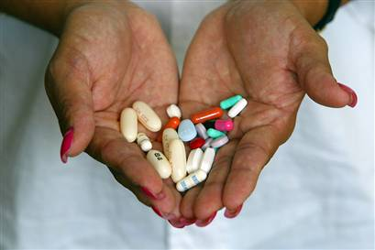
Treatment
HIV cannot be completely cured
There are medicines which stop the virus from reproducing
It can be kept in check
The drugs mostly used are Antiretrovirals
These keep HIV levels low

Slide 13
Interesting Facts
Famous people like Freddie Mercury, Magic Johnson, Isaac Asimov died of AIDS
Over a hundred thousand people a year die of aids
In 2009 2.6 million people died of AIDS
This will increase as there are 33 million people infected by AIDS now

