Slide 1
Comparison of aerobic and anaerobic respiration
 | Aerobic respiration | Anaerobic Respiration
 |  | in animals | in plants and yeast
Oxygen required? | yes | no | no
Glycolysis occurs | yes | yes | yes
ATP yield | 38ATP | 2ATP | 2ATP
Glucose completely broke down? | yes | no | no
End products | Carbon dioxide and water | Lactic acid | Ethanol and carbon dioxide

Slide 2
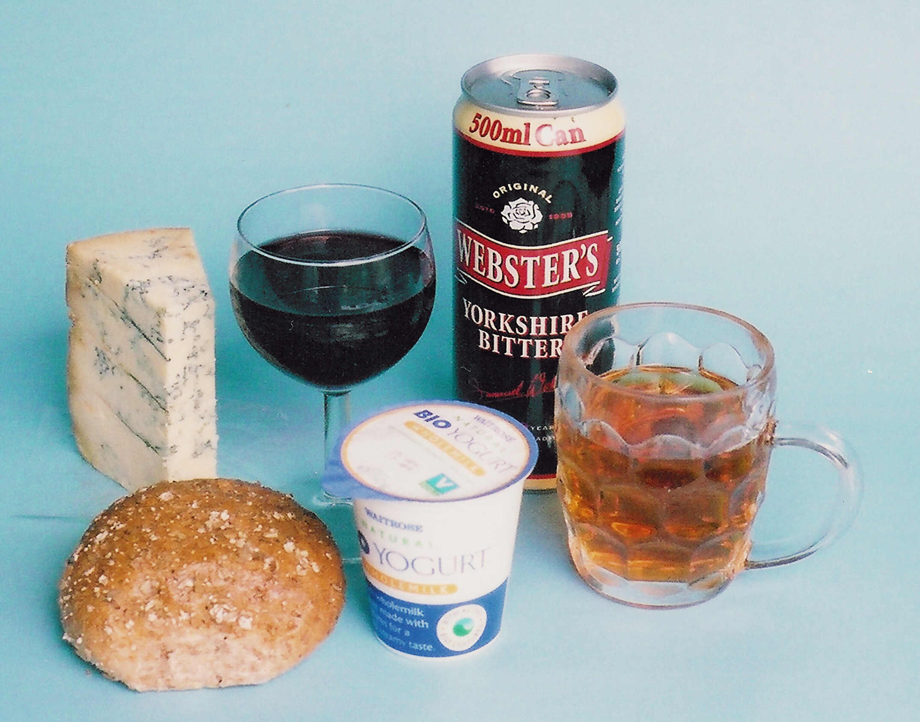
Anaerobic Respiration
23
Notes:
Anaerobic respiration is involved at some stage in the preparation of these foodstuffs

Slide 3
Types of respiration
24
The process of respiration is the release of energy when foodstuffs such as glucose react with oxygen to produce carbon dioxide and water.This form of respiration, which needs oxygen, is called aerobic respiration.
There is another form of respiration which does not need oxygen and is called anaerobic respiration.
In anaerobic respiration, glucose is still broken down to carbon dioxide with the release of energy, but without the involvement of oxygen
The glucose is not completely broken down to CO₂ and H₂O but to CO₂ and alcohol (ethanol).

Slide 4
25
Anaerobic respiration can be represented by the equation
energy
C₆H₁₂O₆ 2C₂H₅OH + 2CO₂
glucose alcohol
The energy released by anaerobic respiration is considerably
less than the energy from aerobic respiration.
Anaerobic respiration takes place at some stage in the cells
of most living organisms.
For example, our own muscles resort to anaerobic respiration when oxygen is not delivered to them fast enough.

Slide 5
Micro-organisms
26
Anaerobic respiration is widely used by many micro-organisms
such as bacteria and yeasts.
Bacteria and yeasts are microscopic single-celled organisms.
Bacteria are to be found everywhere, in or on organisms,
in water, air and soil
Yeasts are usually found in close association with vegetable matter such as fruit

Slide 6
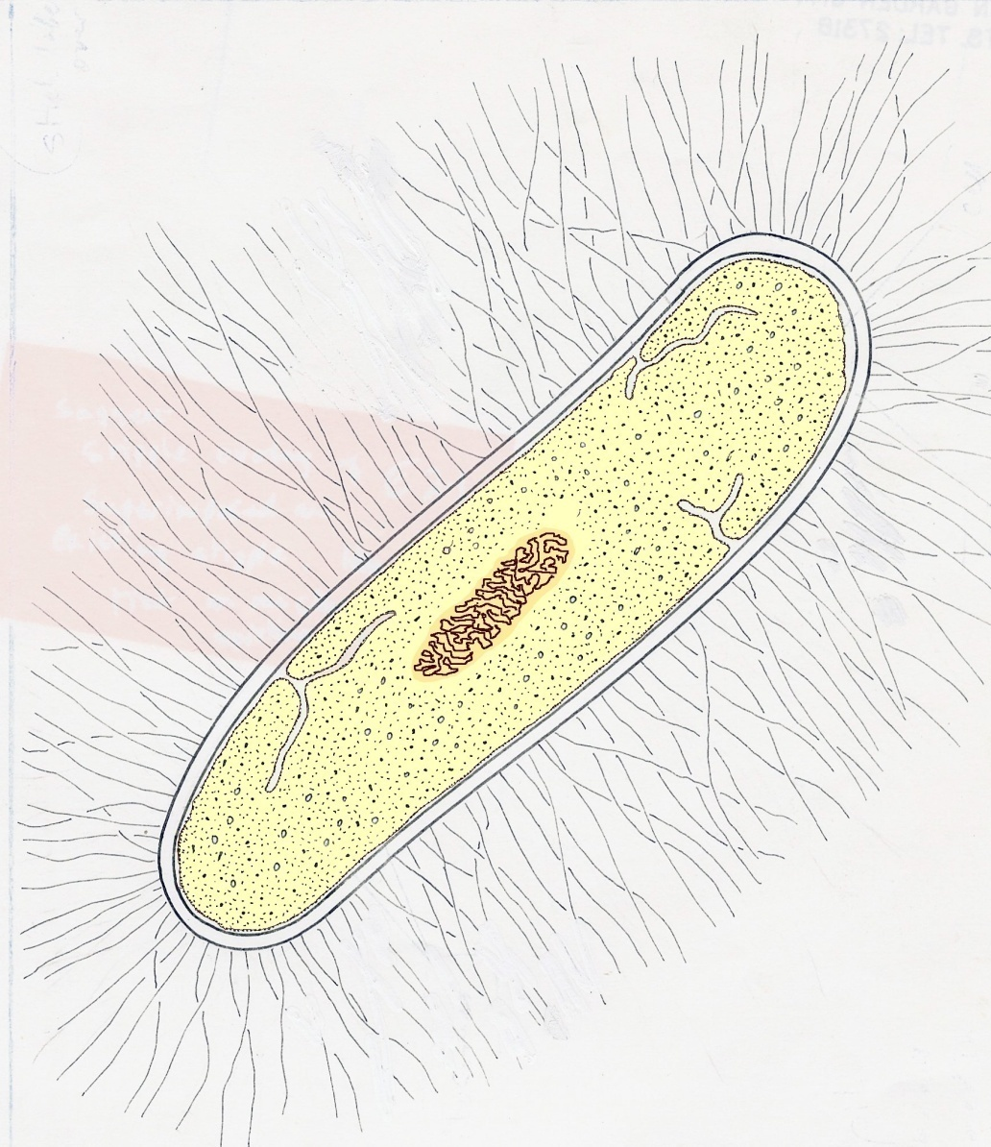
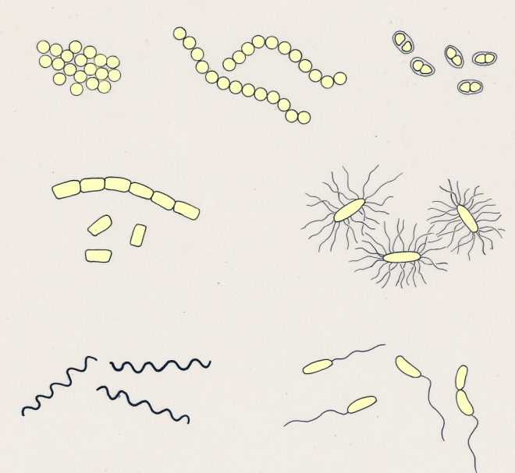
Bacteria
27
cell wall
there are many
species of bacteria
and they have different
shapes and sizes
nucleus
cytoplasm
0.002mm
a single bacterium
Notes:
The vast majority of bacteria are harmless. Some are beneficial, such as those which bring about decay of dead remains. A very small proportion are harmful and cause disease in animals and plants.

Slide 7
Aerobic and anaerobic bacteria
28
Bacteria which need oxygen in order to respire are called
aerobic bacteria.
Aerobic bacteria are likely to be found in the air, water
and soil where oxygen is available
Bacteria which can respire without needing oxygen are
called anaerobic bacteria
Anaerobic bacteria are to be found in situations where
oxygen is lacking, such as in stagnant water, waterlogged
soils or the intestines of animals
Notes:
Some bacteria can use both aerobic or anaerobic respiration according to the availability of oxygen, There are some anaerobic bacteria which cannot survive in the presence of oxygen.

Slide 8
Fermentation
30
One form of anaerobic respiration in bacteria and yeasts
is called fermentation.
During fermentation, sugar is broken down to alcohol and
carbon dioxide
The reaction described in slide 25 is an example
of fermentation
Fermentation is involved in brewing and wine-making

Slide 9
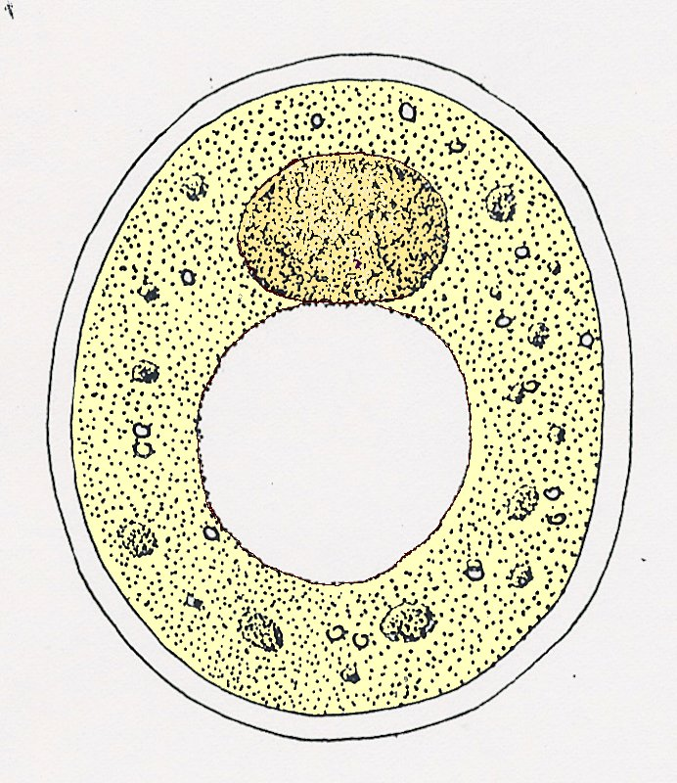
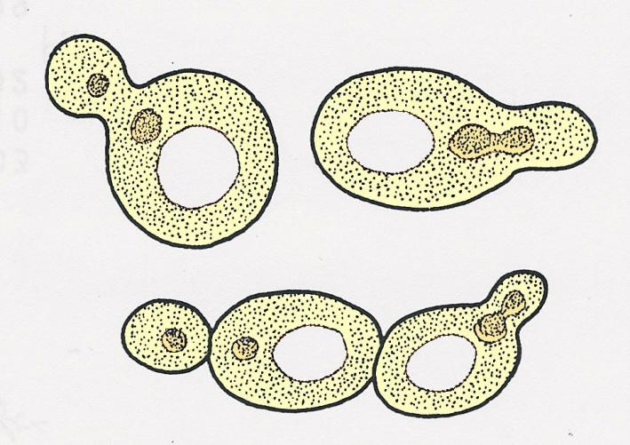
Yeasts
29
cell wall
nucleus
cytoplasm
0.005mm
vacuole
Yeast cells dividing
single yeast cell
Notes:
Yeasts can be seen as a thin, greyish ‘bloom’ on the surface of grapes, but they are present on the surface of most fruits. When these fruits are crushed and mixed with water, the anaerobic respiration of the yeasts causes fermentation with the production of carbon dioxide and alcohol.

Slide 10
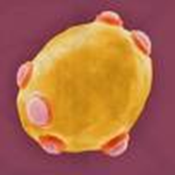
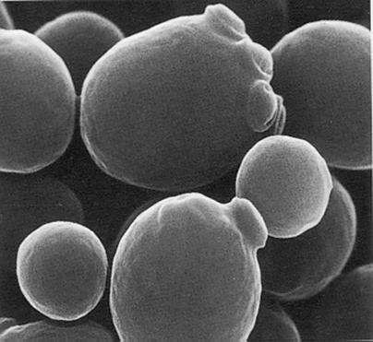
Cheese and yogurt
Lactic acid fermentation produces yogurt and cheese. Some fungi are also used to make the cheese turn blue!
Bread and dough products
Yeast is used to make bread and dough products.
Alcohol Production
Yeast is also used in alcohol production when fermentation occurs without air

Slide 11
Yogurt making
To set up yogurt production milk is heated, this helps kill other microorganisms that would compete with the starter culture
Lactobacillus bulgaricus interacts with Streptococcus thermophilus to form a symbiotic starter culture to ferment milk. By creating the starter culture it increases the production of lactic acid in the fermentation process.
Fermentation of the milk usually happens when the milk is around 45 degrees Celsius. Streptococcus thermophilus starts to grow first dropping the milks pH from 6.6 to 5.0, and produces carbon dioxide and lactic acid.
These products stimulate Lactobacillus bulgaricus to grow and further drop the pH to 4.2.
The sugar found in milk is lactose, when the starter culture is added to milk it breaks the lactose into glucose.
After the sugar glucose is formed it then is fermented into lactic acid by the microorganisms.
Acetaldehyde is also produced, this chemical compound creates the tart and sour taste of plain yogurt.
The lactic acid decreases the pH of the milk and causes the casein, protein found in milk, molecules to denature and stick together.
The milk then curdles to produce yogurt. To enhance the flavor a wide variety of fruits are mixed in or are found at the bottom of the finished product.

Slide 12
Wine making
31
Grapes are crushed and the sugar they contain is fermented
by yeasts to produce alcohol and carbon dioxide.
The carbon dioxide usually escapes but if the wine is
bottled before fermentation is complete, the carbon dioxide
dissolves and escapes as bubble when the bottle is opened
This is the case with ‘sparkling’ wines such as Champagne
Different varieties of grape produce different types of wine

Slide 13
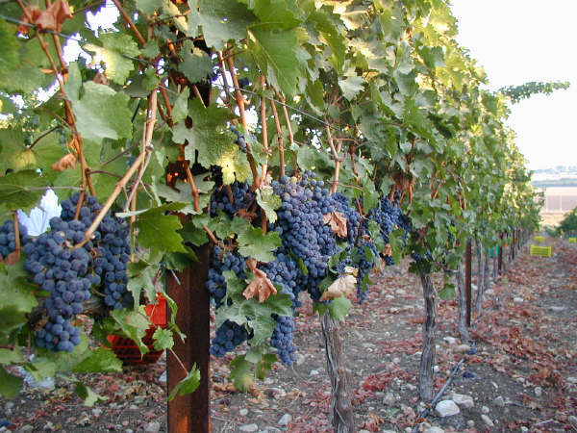
Black grapes growing in a vineyard
32
© Ilan’s Wine Making

Slide 14
Brewing
33
In brewing beer, a sugary product (malt) is dissolved out of germinating barley
Yeast is added to this solution and fermentation begins, producing alcohol and carbon dioxide
Some of the carbon dioxide escapes but the rest dissolves in the beer when it is bottled or put into casks
When the bottles or casks are opened, the dissolved CO₂ escapes as bubbles

Slide 15
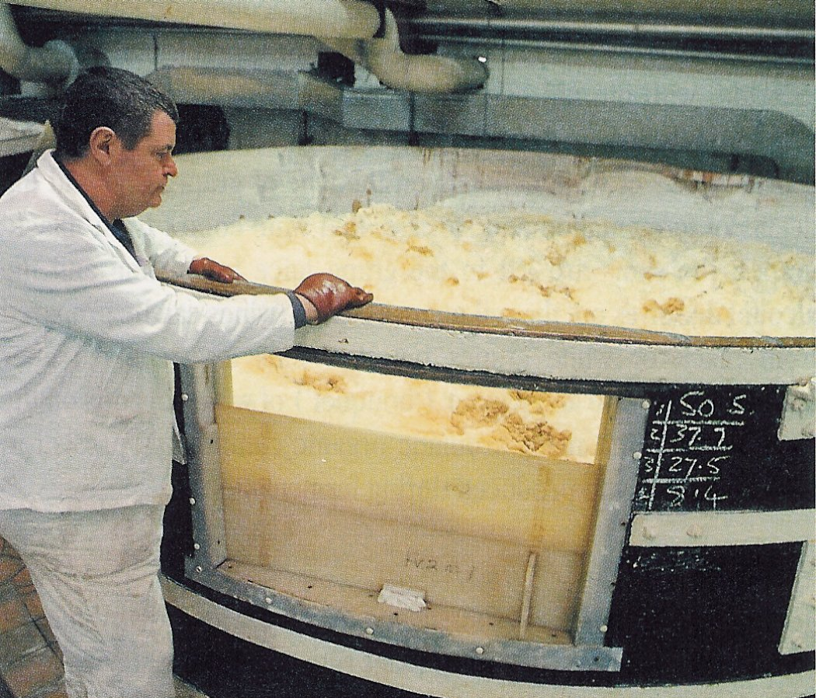
Beer fermenting
34
©Stuart Boreham/CEPHAS
Notes:
The carbon dioxide bubbles plus some of the beer constituents produce a dense froth on top of the beer. The fermentation vessel is an old-fashioned open type.

Slide 16
Baking
35
In baking, yeast is added to a mixture of flour and water,
made into the form of a dough
The yeast first changes the flour starch into sugar and then
ferments the sugar into alcohol and CO₂
The CO₂ forms bubbles in the dough which cause it to
expand (‘rise’)
When the dough is baked, the heat evaporates the
alcohol but makes the trapped bubbles expand giving the
bread a ‘light’ texture

Slide 17
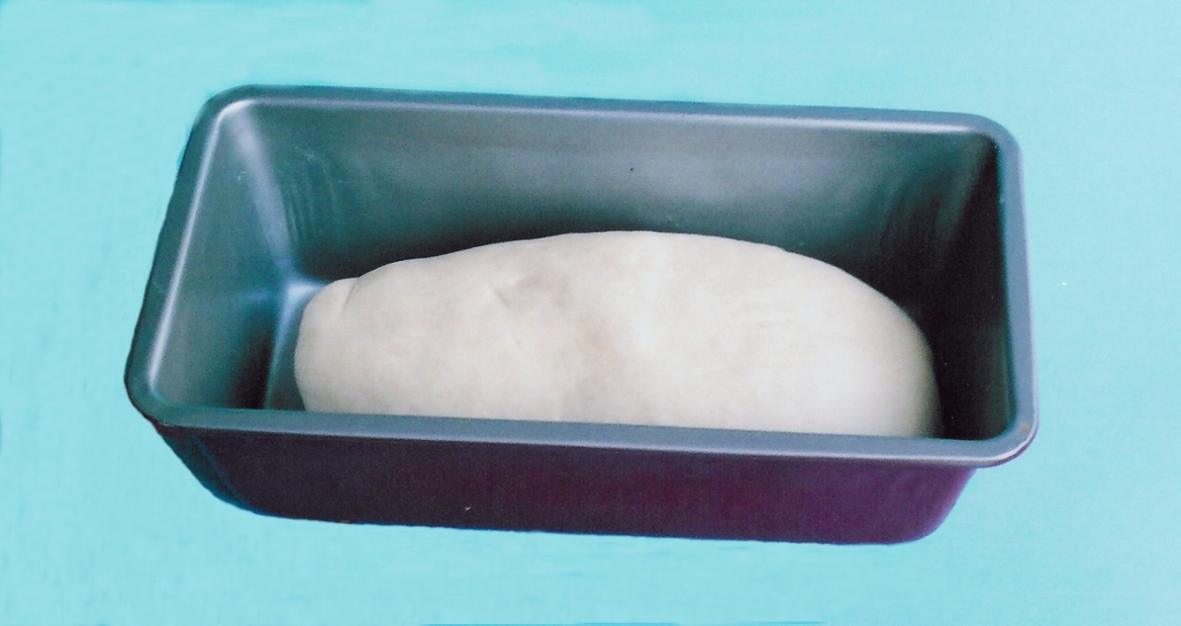
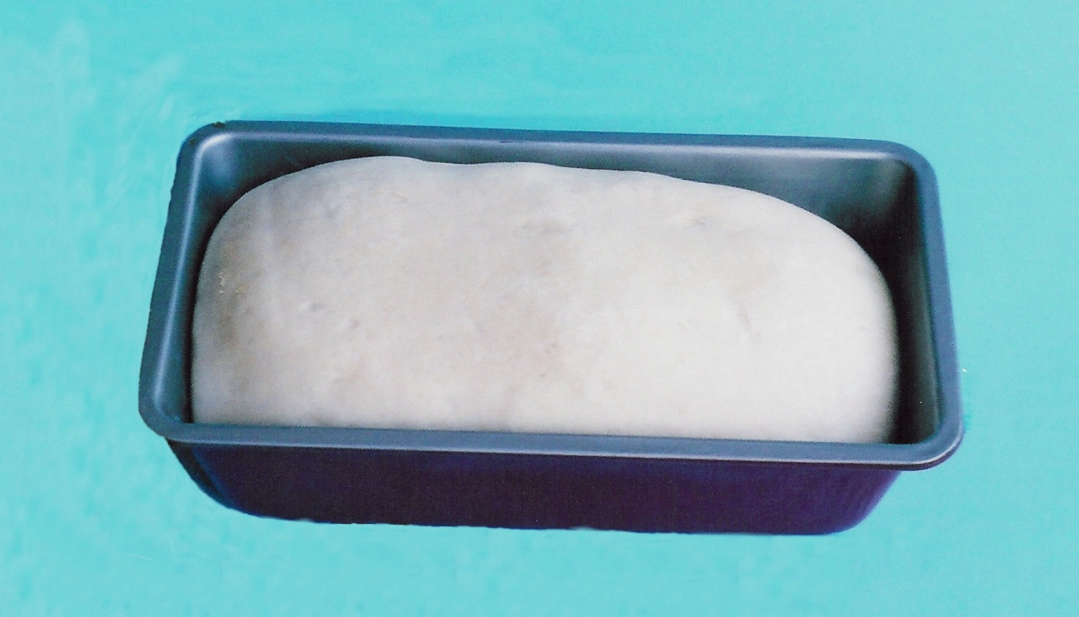
Dough rising
36
The yeast is mixed
with the dough
After 1 hour in a warm
place the dough has risen as a result of the carbon dioxide
produced by the yeast

Slide 18
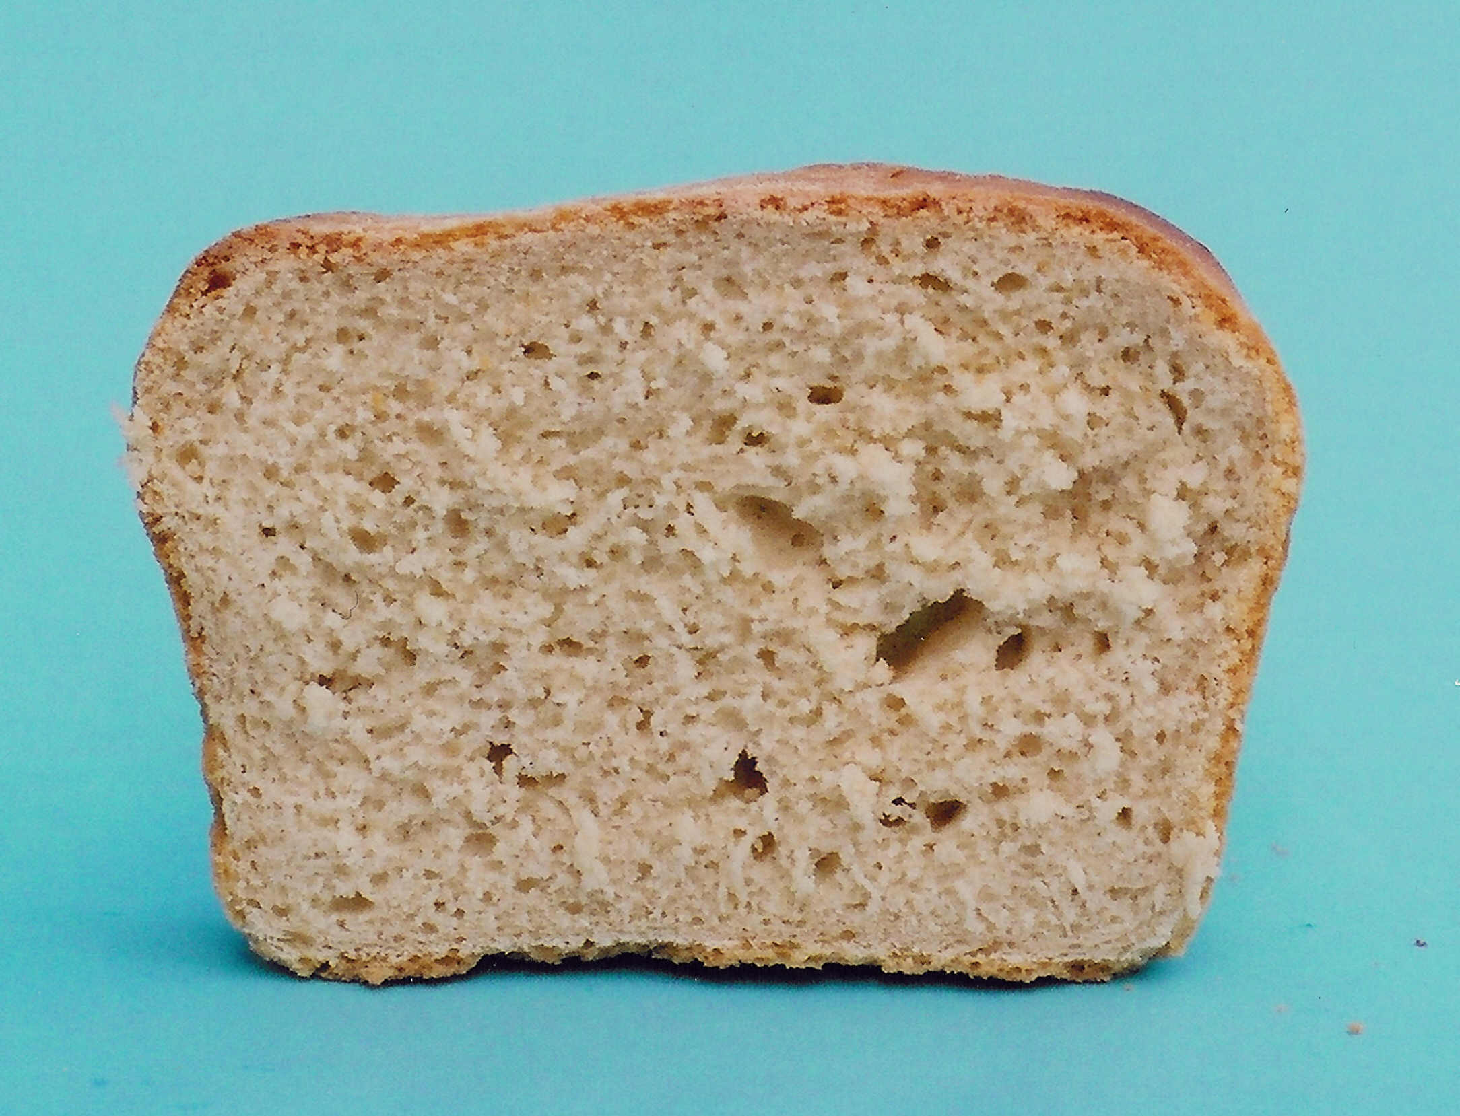
37
The ‘holes’ in the
bread are made by
the carbon dioxide
bubbles.
This gives the bread a ‘light’ texture

Slide 19
Question 1
38
Which statements are correct ?
Anaerobic respiration is different from aerobic
respiration because
a it produces CO₂
b it does not need glucose
c it does not need oxygen
d it produces less energy

Slide 20
Question 2
39
In what circumstances do our muscle use anaerobic
respiration ?
a When insufficient glucose reaches the
muscles
b When the carbon dioxide level increases
c When insufficient oxygen reaches the
muscles
d When we are asleep

Slide 21
Question 3
40
Anaerobic bacteria are most likely to be found
a in the middle of a compost heap
b in the air
c in fast-flowing streams
d on the surface of the skin

Slide 22
Question 4
41
In which of the following is the production of CO₂
more important than the production of alcohol ?
a Brewing beer
b Fermenting grape juice
c Making bread
d Bottling wine

