Slide 1
HW
7c – Read pg 1 to 5 FROM YOUR TEXT BOOK and write a short note on the history and use of microscope in the discovery of cells. Draw a time line for the invention of lenses and the microscope to help refine your notes. (DUE ON THE 24TH OF AUG)

Slide 2
Plant & Animal Cells
Similarities
  Both contain similar organelles
  Both surrounded by cell membrane

Slide 3
Characteristics | Plant Cell | Animal Cell
Cell Size | Large | Smaller than plant cells
Cell Shape | Rectangular | Circular
Vacuoles | A single centrally located vacuole. It takes up almost 90% of the cell volume. The vacuole stores water and maintains turgidity of the cell. | If any, there are a number of small vacuoles spread throughout the cytoplasm that store water, ions and waste materials.
Cell Wall | A rigid cell wall is present around a plant cell that helps it maintain its shape. | Cell wall is absent. This allows animal cells to adopt different shapes.
Chloroplasts | Present. Chlorophyll is the pigment that traps sun's energy which is utilized by plants to make food through the process of photosynthesis. This pigment is present in the chloroplasts. | Absent. As animals lack this pigment, they cannot make their own food.
Lysosomes | Absent | Present

Slide 4
SPECIALISED CELLS
Some plant and animal cells are specialised to carry about special functions. So as to enable them to do these functions they are structurally modified that means their structure and function is much different from a normal plant /animal cell.
Specialised cells in plant: root hair cell, palisade cell
Specialised cells in Animals: Red blood cells, nerve cell/neuron.

Slide 5
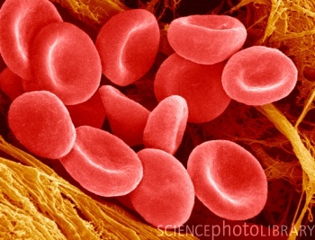
Red Blood Cell

Slide 6
Red blood cells transport oxygen
cell surface membrane
cytoplasm contains no nucleus
allows more room for haemoglobin
cytoplasm contains haemoglobin
haemoglobin is a protein which carries the oxygen molecules
bi-concave disc shape
increases surface area over which absorption of oxygen can occur

Slide 7

Root hair cells absorb minerals and water from the soil
Cross-section of a root hair cell
cell membrane
semi-permeable, so will allow water and mineral ions into the cell
cytoplasm
contains no chloroplasts as no photosynthesis is needed
root hair cell
increases surface area for absorption of water and mineral ions

Slide 8
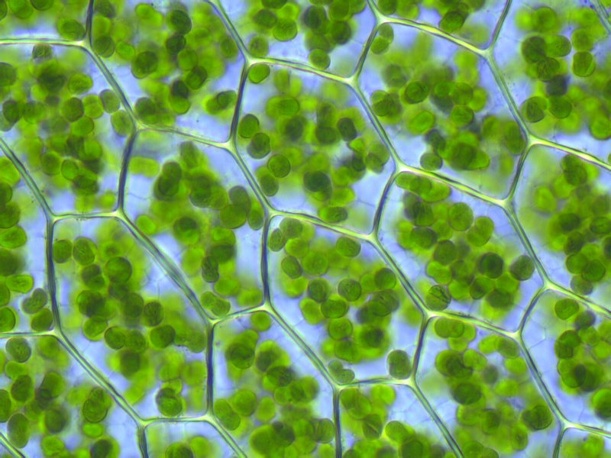
Image 4- Leaf Cells
Example of cell | Specific function | Specialised features suited to the function
Leaf palisade cell | Carries out photosynthesis | 1. Packed with chloroplasts containing the light absorbing pigment chlorophyll. 2. Regular shaped, closely packed cells forming a continuous layer for efficient absorption of sunlight.

Slide 9
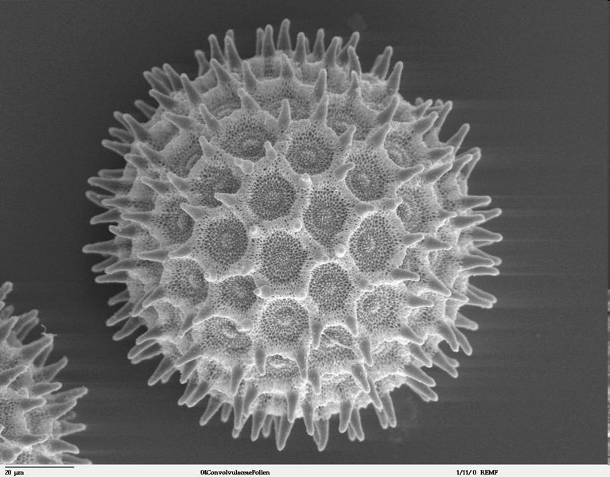
Image 6- Pollen Cell
Example of cell | Specific function | Specialised features suited to the function
Pollen cell | Helps in plant reproduction | 1. Tiny grain with half the genetic information , 2. Have a hard protective outer coat to survive bad conditions. 3. Shape and surface of outer coat is adapted to method of dispersal - eg smooth and sticky for insect dispersal, larger surface area for wind dispersal. 4. Germinate on reaching the stigma of another flower of the same species.

Slide 10
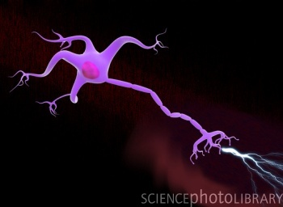
Nerve Cell

Slide 11
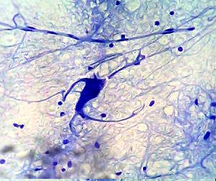
Image 3 - Nerve Cells
Example of cell | Specific function | Specialised features suited to the function
Nerve cell | Pass sensory impulses | 1. Dendrites to make connections with other neurones. 2. Long axon or nerve fibre to carry the impulse to the target organ. 3.passes messages from 1 neuron to another.

Slide 12
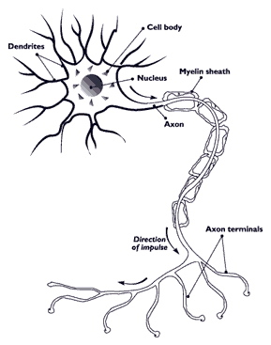
Nerve cell/ Neuron
Neurons make up the nervous system.
Sheath acts as shock absorbers and protects the cell from external damage.
Dendrites and axons help in impulse transmission.
Rest of the parts have similar functions as normal animal cells.

Slide 13
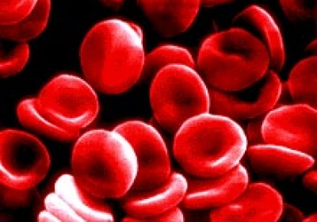
Red Blood Cells
Structure:
Has a dent at the center.
Doughnut with a Flattened center.
Red colored due to the pigment called hemoglobin.
Function:
Hemoglobin has an affinity for oxygen and hence is responsible for the transfer of oxygen throughout the body.

Slide 14
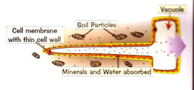
Plant Root hair cells
Increases the surface area for absorption. Thus enhances water and mineral uptake by plants.

Slide 15
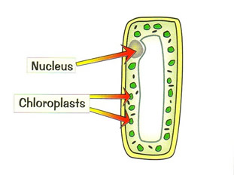
Palisade cell.
The palisade cell is packed with chloroplasts which are needed for photosynthesis so the plant can make its own food.

Slide 16
HIERARCHY OF STRUCTURAL ORGANISATION

Slide 17
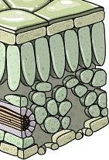
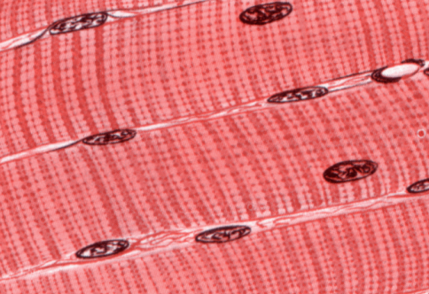
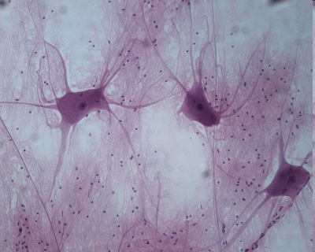
A tissue is a group of cell of similar structure that form a shared function
Tissues found in the leaf
Animal tissues:
muscle tissue
nervous tissue
upper epidermal
tissue
palisade mesophyll
tissue
spongy mesophyll
tissue
lower epidermal
tissue
Cross-section of a leaf

Slide 18
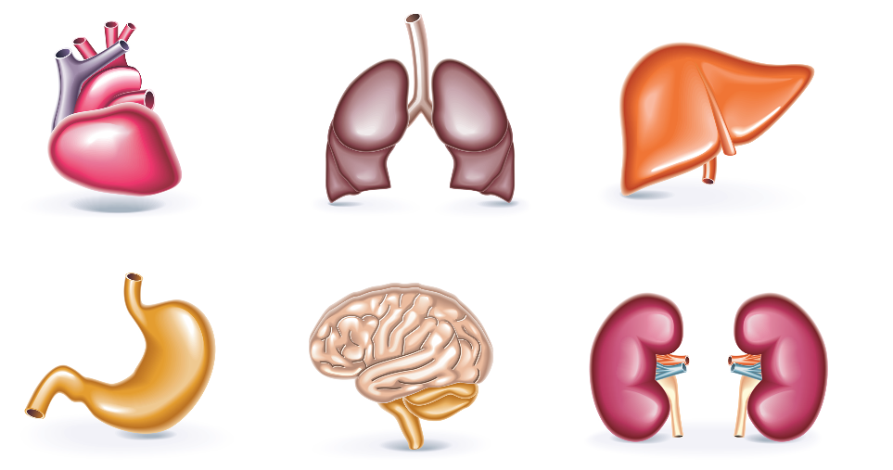
An organ is a structure made of a group of tissues working together to perform specific functions
heart
lungs
liver
stomach
brain
kidneys
Plant organs include the stem and the leaves

Slide 19
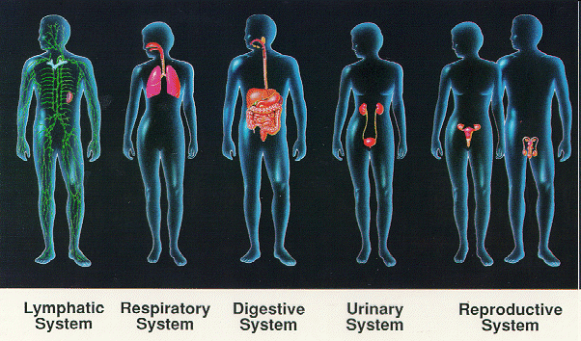
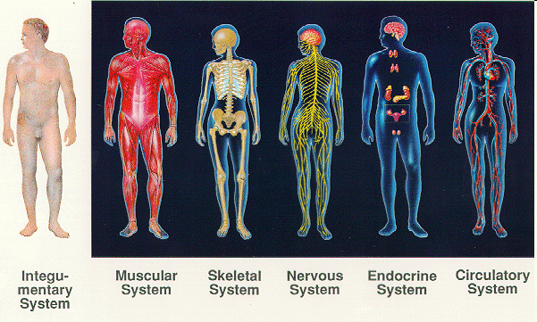
An organ system is a group of organs that coordinate to perform related functions
lymphatic
system
digestive
system
reproductive
system
skeletal
system
endocrine
system
respiratory
system
excretory
system
muscular
system
nervous
system
circulatory
system
In plants the shoot is an organ system consisting of leaves and the stem

Slide 20
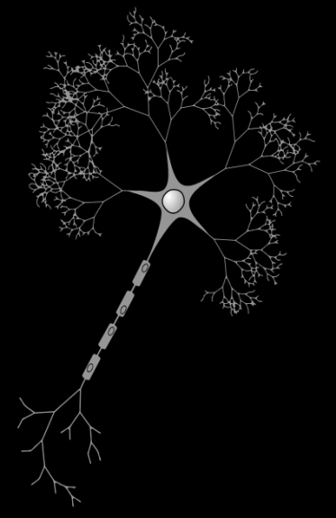
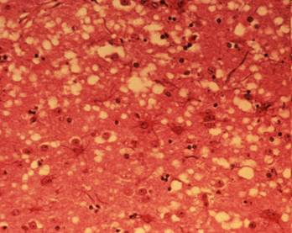
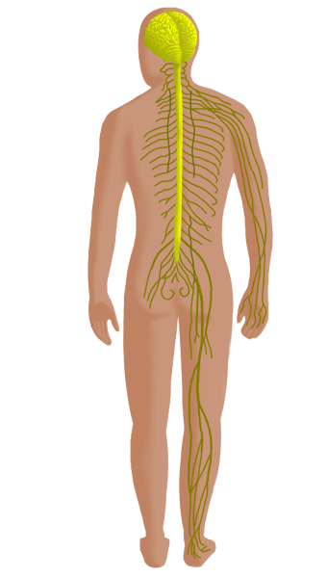
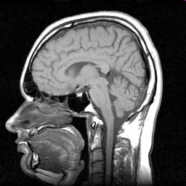
Levels of organisation
cell
tissue
organ
organ
systems
organism
nerve cell
nervous tissue
brain
nervous
system
Homo sapiens
smallest
largest

