Slide 1
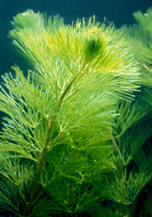
How can we show that plants use carbon dioxide in photosynthesis?

Slide 2
Hydrogencarbonate Indicator
Increasing CO₂ in indicator
Atmospheric CO₂ level
Decreasing CO₂ in indicator
Hydrogencarbonate indicator is used to measure carbon dioxide levels in aquatic systems.
It is red in equilibrium with atmospheric air.
It becomes more orange/yellow with increased carbon dioxide levels.
It changes from red through magenta to deep purple as carbon dioxide is removed.

Slide 3
Method
Take four transparent containers that can be easily sealed.
Rinse the containers with a small amount of indicator.
Add a standard volume of indicator to each container and in three of the containers, place equal length sprigs of pondweed e.g. Cabomba
Seal all the containers.
Place one with pondweed into a dark cupboard.
Take another containing pondweed and cover it with shading.
Place the three remaining containers (including the one with no plant in), the same distance from a bright white light source and leave until there is a noticeable change in colour.
Make sure the lamp will not cause your pond water to overheat. You might want to place a transparent screen between the light and the plant, or a flat sided container of cold water to absorb the heat but none of the light.
When there is a noticeable change in colour in the indicator, remove the shading and compare the colours in the four containers to those in the picture.

Slide 4
Table of results
Container | Pondweed present | % of full light | Colour of indicator | Has the carbon dioxide in the indicator increased or decreased? | _{What does this tell you ?}
1
2
3
4

