Slide 1
Structure of the human respiratory system

Slide 2
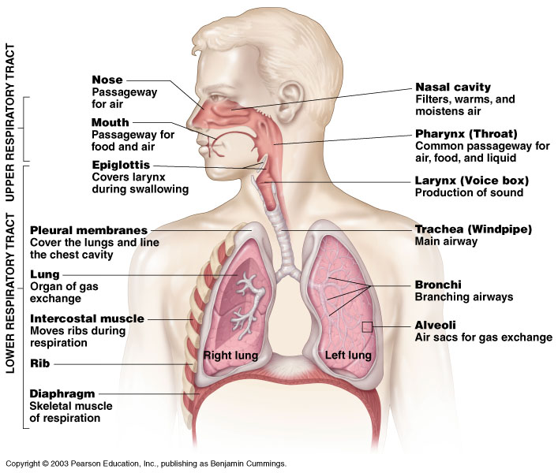
Human Respiratory System
Figure 10.1

Slide 3
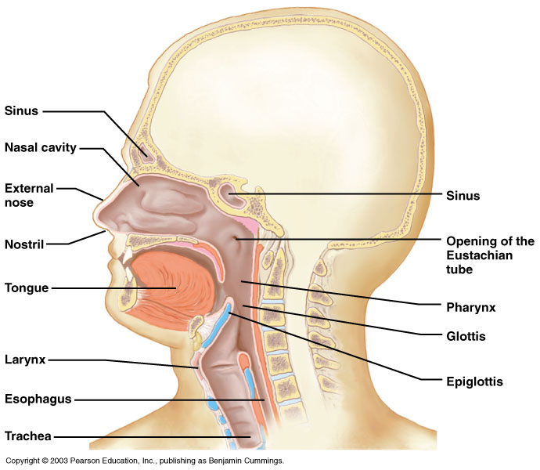
Components of the Upper Respiratory Tract
Figure 10.2

Slide 4
Upper Respiratory Tract Functions
Nose, nasal cavity, and nasal sinuses
Passageway for respiration
Receptors for smell
Filters incoming air to filter larger foreign material
Moistens and warms incoming air
Resonating chambers for voice

Slide 5
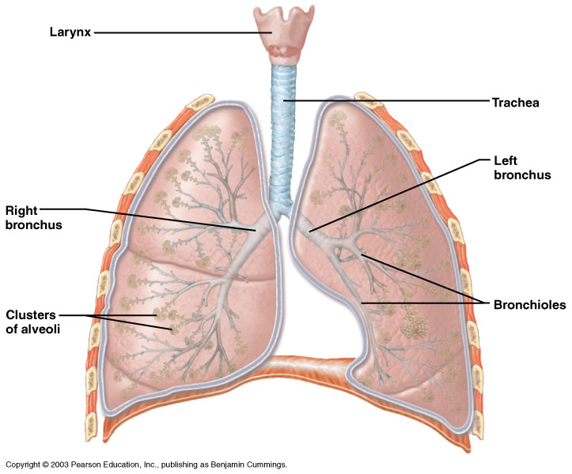
Components of the Lower Respiratory Tract
Figure 10.3

Slide 6
Lower Respiratory Tract
Functions:
Pharynx & Larynx: maintains an open airway, routes food and air appropriately, assists in sound production
Trachea: transports air to and from lungs
Bronchi: branch into lungs
Lungs: transport air to alveoli for gas exchange

Slide 7
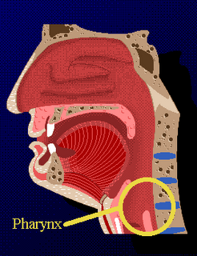
Pharynx
Funnel-shaped passageway
Connects nasal cavity and mouth
Shared by the digestive and respiratory systems
Divided into three sections by location

Slide 8
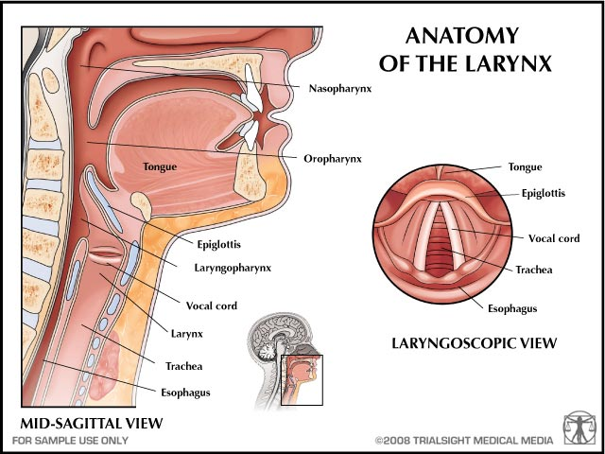
Larynx
Prevent food and drink from entering the trachea
Passageway for air
Produces Sound
It connects the pharynx to the trachea

Slide 9
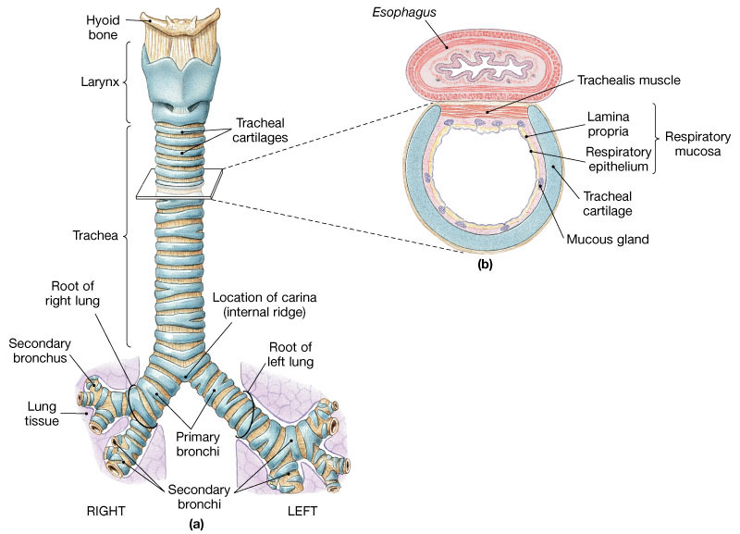
The Trachea
C-shaped cartilage rings keep airway open
Carina - marks where trachea divides into two primary bronchi
Epithelium

Slide 10
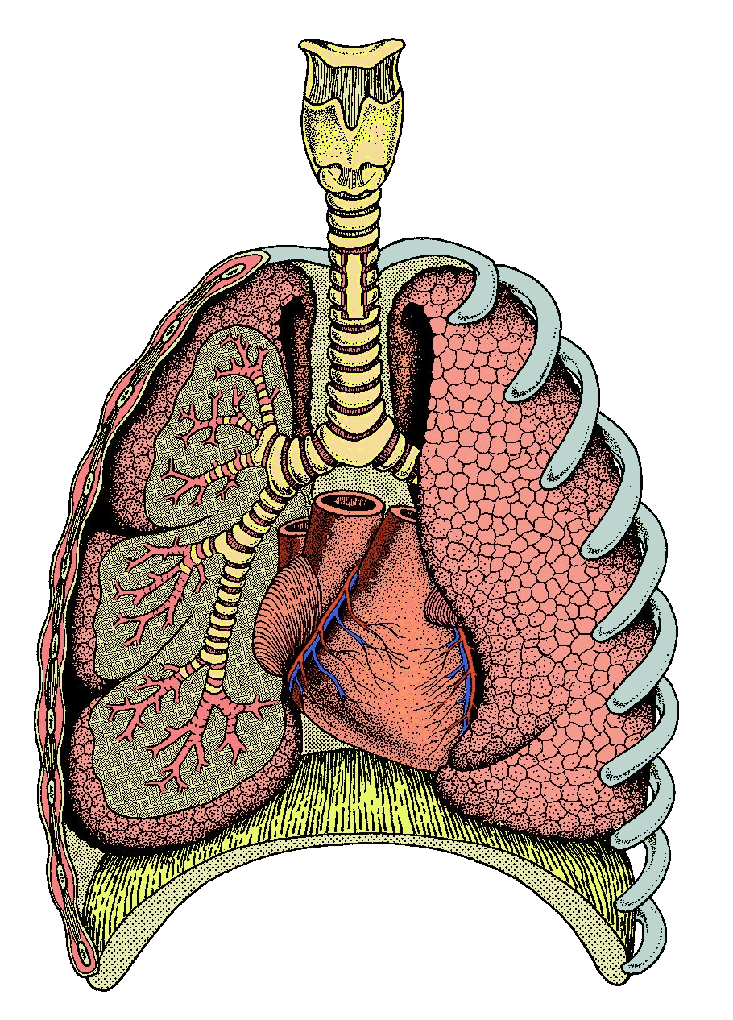
Trachea
Ribs
Alveoli
Bronchi
Bronchioles
Lung
Intercostal
Muscles
Diaphragm

Slide 11
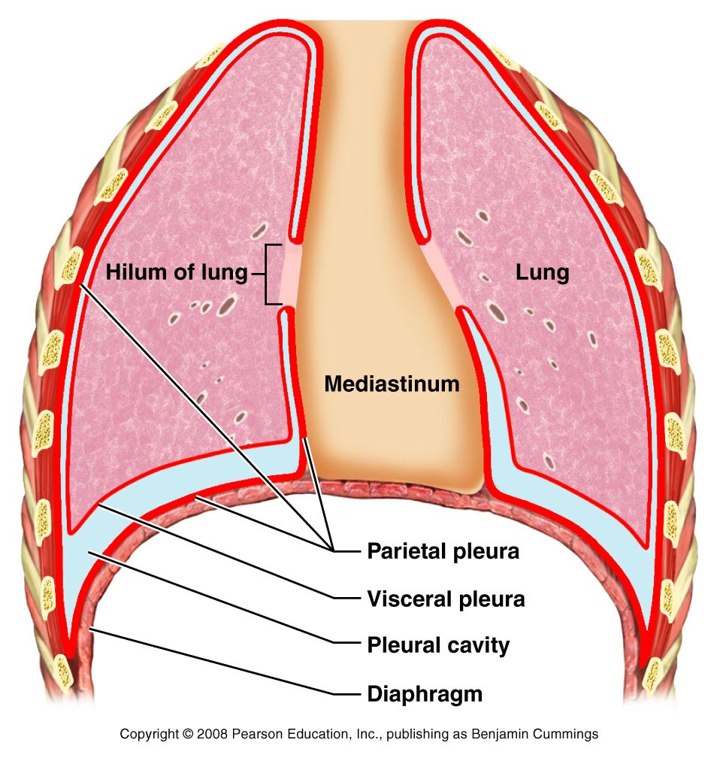
The Pleurae
A double-layered sac surrounding each lung
Outer pleural membrane
inner pleural membrane
Pleural cavity - space between the pleural membranes.

Slide 12
What are the lungs?
Lungs are the organs of respiration.
.
The right lung is a little bigger than the left lung. This the left lung has to fit around the heart making it slightly smaller.
The lungs are split into lobes
The left lung is split into 2 lobes while the right lung is split into 3 lobes.
Lungs have a very spongy texture and have a large surface area.

Slide 13
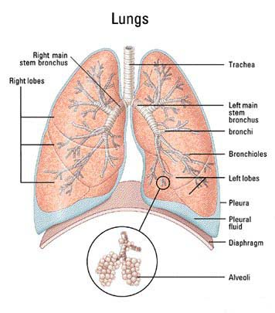
Lungs
The job of the lungs is to provide oxygen to the rest of the body. In addition to providing the body with oxygen the lungs also adjust the Ph of the blood by regulating the carbon dioxide levels in the blood.

Slide 14
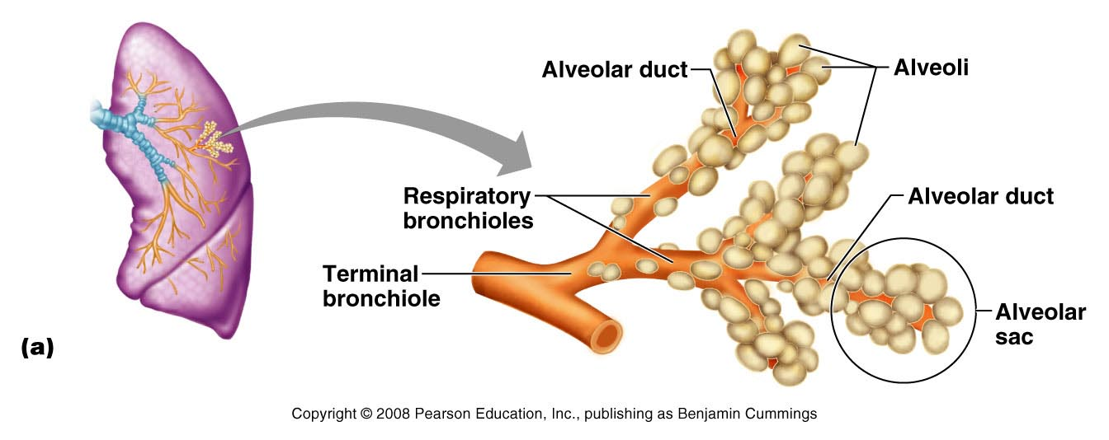
Structures of Air Exchange
Consists of air-exchanging structures
Respiratory bronchioles – branch from terminal bronchioles
Lead to alveolar duct

Slide 15
Features Of Alveoli
Alveoli has 3 cell types
Type I cells are sites of gas exchange and
Type II cells - secrete surfactant
Macrophages
Figure 21.10b

Slide 16
The process of gas exchange

Slide 17
Gas Exchange
Our cells require a constant supply of oxygen for respiration. Carbon dioxide, a waste product of respiration must be excreted.
The process of “swapping” oxygen for carbon dioxide is called gas exchange – it occurs in the alveoli of the lungs

Slide 18
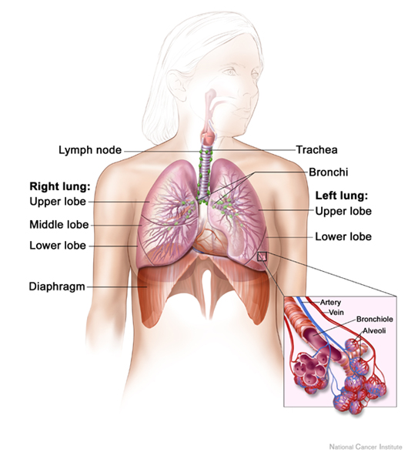
Gas Exchange

Slide 19
Gas Exchange: Alveoli
Gas Exchange

Slide 20
Gas exchange
Gas exchange takes place in the alveoli – oxygen is transferred into the blood and carbon dioxide moves out of the blood.
Each alveolus has a thin wall so that gas exchange between
the lungs and the blood can take place quickly.

Slide 21
RBC’s and Haemoglobin
The haemoglobin in the red blood cells picks up oxygen to form oxyhaemoglobin.
When the RBC’s reach the cells where oxygen is needed, oxygen is released from the oxyhaemoglobin and diffuses into the body cells.
At the same time, CO₂ (a waste product) diffuses into the plasma of the blood to be carried back to the lungs to be excreted.

Slide 22
Gas Exchange Surfaces & Alveoli
The alveoli of the lungs are specialised for efficient gas exchange:
FEATURE | REASON FOR THIS ADAPTATION
Thin, permeable walls
Moist lining
Large Surface Area
Good blood supply & oxygen supply
Use D.G.Mackean Pg. 123 You have 7 minutes.

Slide 23
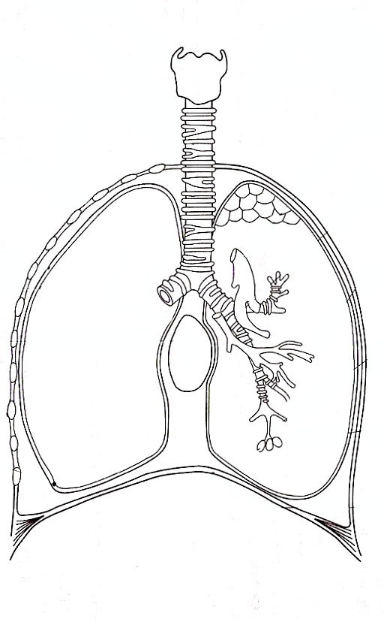
The Respiratory Structures
Use D.G.Mackean Pg.123 to label the diagram

Slide 24
The Respiratory Structures
Part | Function (Job)
Mouth | Warms and moisten inhaled air
Larynx | Voice box to speak
Trachea | Transports air to the lungs from mouth, contains hairs (cilia) to filter the air
Bronchus | Connects the trachea to bronchioles
Bronchiole | Carries air from bronchus to the alveoli
Alveoli | Allows gas exchange to take place
Diaphragm | Changes the volume of the chest to help with breathing
Rib | Protects the lungs
Intercostals | Muscles that Help move rib cage up & down in breathing
Explain how each function helps with Gas Exchange

