Slide 1
Mechanism of Breathing

Slide 2
9B In… out… in… out...
Stand up and feel your ribs! Can you feel these movements when you breathe in and out?

Slide 3
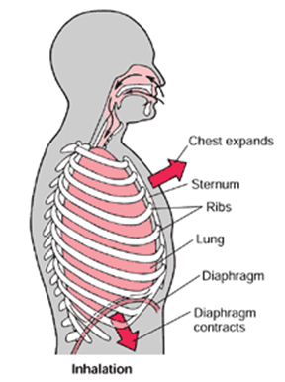
Breathing in = inhalation
Diaphragm is lowered
Rib cage is raised
Chest volume increases
Pressure in chest decreases
Air enters the lungs to equalise the pressure

Slide 4

Inhalation

Slide 5
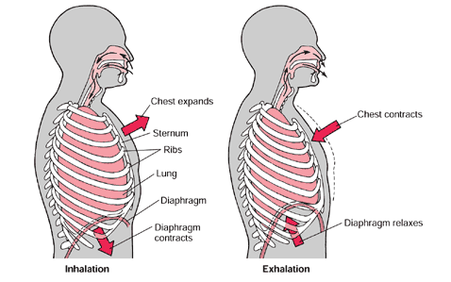
Breathing

Slide 6
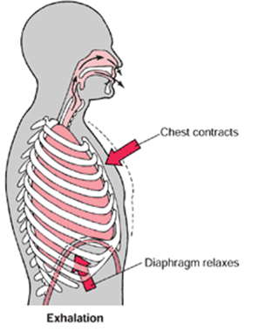
Breathing Out = Exhaling
Diaphragm is raised
Rib cage is lowered
Chest volume decreases
Pressure in chest increases
Air leaves the lungs to equalise the pressure

Slide 7
Exhalation

Slide 8
Test yourself!!
Explain how the diaphragm and the intercostal muscles work together to let air into the lungs
Write a paragraph using the words in the box
5 minutes
Diaphragm
Contracts
Moves down
Intercostal muscles
Ribs
Up & out
Increases
Decreases
Volume
Pressure
Air
Enter

Slide 9
Test Yourself: Model Answer
The diaphragm contracts and moves down. At the same time, the intercostal muscles contract moving the ribs up and out. This increases the volume and decreases the pressure in the lungs. This decrease in pressure forces air to enter the lungs
Give yourself a mark out of 5
☺
☺
☺
☺
☺

Slide 10
DO NOW – 4 minutes
Define Respiration
Write a balanced equation for aerobic respiration
Describe the path of air in the respiratory system from the mouth to the blood
Define diffusion
Explain how gas exchange occurs in the human respiratory system

Slide 11
Respiratory disorders.

Slide 12
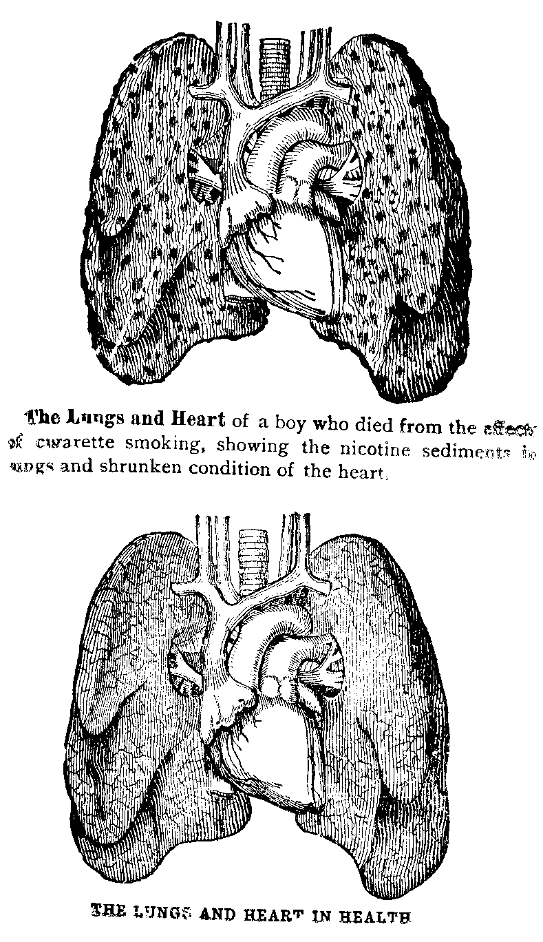
Smoking & Respiratory Disease

Slide 13
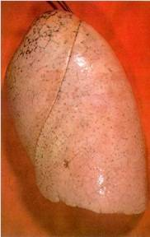
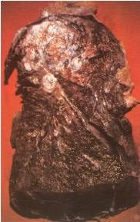
Smoking & Respiratory Disease

Slide 14
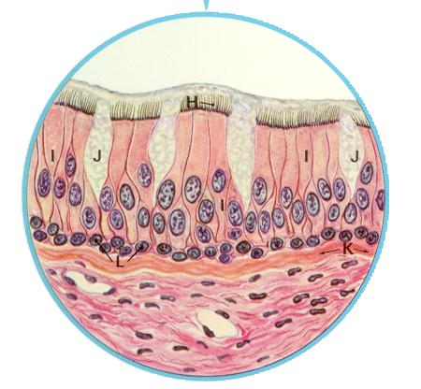
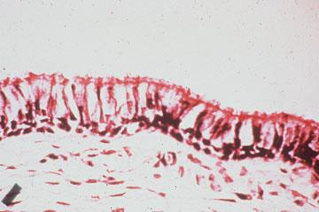
Smoking: Trachea & Cilia Damage
HEALTHY
SMOKER

Slide 15
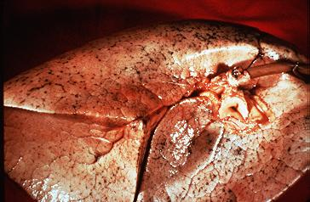
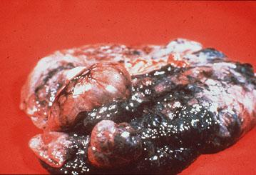
Smoking & Respiratory Disease
HEALTHY
SMOKER

Slide 16
Second-Hand Smoking
People who breathe in smoke from other people’s cigarettes can breathe in even more harmful substances than the smoker because they breathe unfiltered smoke!!

