Slide 1
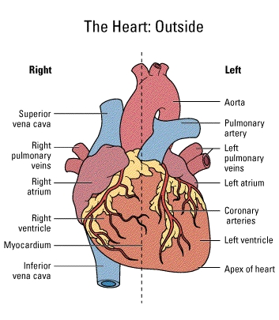
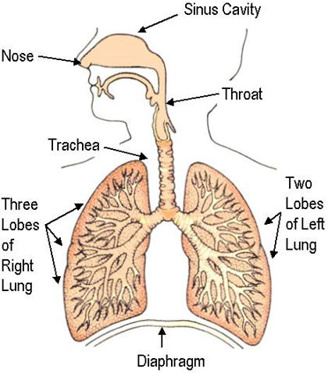
Unit 4: Human Respiration and Transport

Slide 2
Respiration
Respiration is NOT breathing!
Cellular respiration is the release of energy from food (glucose). It happens in every cell of our bodies
The site of respiration is the mitochondria

Slide 3
Cool so we got heaps of energy…now what?
Why do animals and plants bother to respire?
What happens to the energy?
How is it used?

Slide 4
Burning our Food
The breakdown of glucose in oxygen is like a burning fire
What is combustion? What is the equation for combustion of methane (CH₄)
How is it similar to respiration? How is it different?
Under normal circumstances all plants and animals carry out aerobic respiration

Slide 5
Breathing for Respiration
GAS | Air In | Air Out
Nitrogen | 79% | 79%
Oxygen | 21% | 16%
Carbon Dioxide | 0.04% | 4%
Water Vapour | Varies | lots

Slide 6
Breathing is only a part of the respiration process.
It refers to the intake of air (Taking in Oxygen-Inspiration) and the letting out of air (Carbon dioxide-expiration) from our body.

Slide 7
7
One of the energy-producing reactions is called respiration
(Respiration is not the same thing as breathing)
The chemical reactions of respiration take place
in all living cells
The reaction takes place between oxygen and a
substance which contains carbon. The reaction
produces carbon dioxide and water, and releases
energy
Notes:
The word ‘respiration’ is used in everyday language to mean breathing; as in,for example, ‘respiration rate’ (breathing rate) or ‘artificial respiration’. In biology, it is best to avoid confusion by using the term ‘respiration’ for the chemical reaction in cells. ‘Artificial respiration’, is better described as ‘resuscitation’.

Slide 8
4
an atom of carbon
c
plus
a molecule of oxygen
O₂
o
C
o
combine to form a molecule of carbon dioxide
CO₂

Slide 9
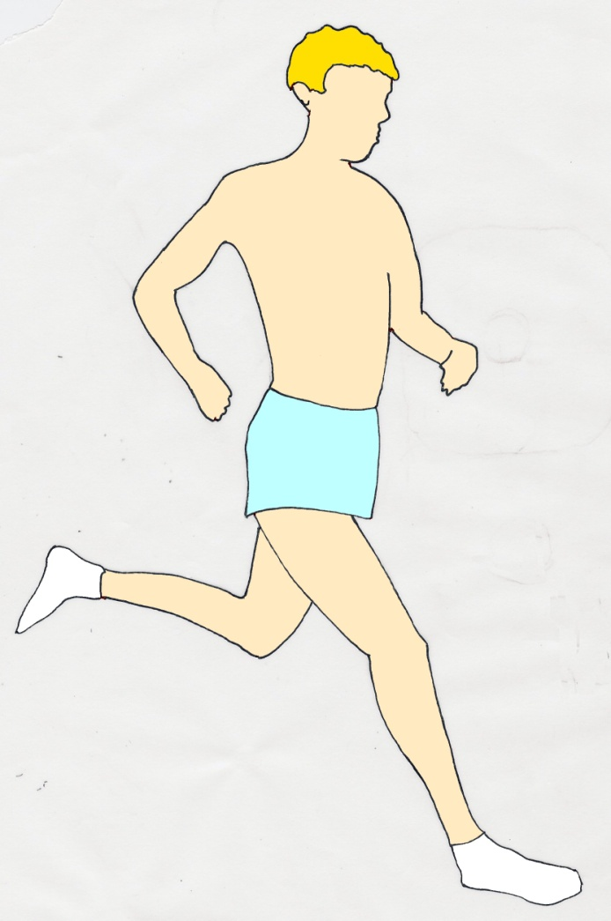
15
One example of respiration in ourselves
2. The lungs absorb oxygen
from the air
1. Air taken in
1.Food taken in
2.The stomach and
intestine digest food.
One of the products
is glucose
3.The blood stream
carries glucose and oxygen to the muscles
4 RESPIRATION
5 Carbon dioxide
is carried to the lungs
by the blood
Glucose and oxygen react to produce energy for muscle contraction
Notes:
The water produced as a waste product of respiration is picked up by the blood stream and may be lost in sweat, water vapour from the lungs or in urine

Slide 10
8
The carbon-containing substances come from FOOD
The oxygen comes from the AIR (or water)
The energy is used to drive other chemical reactions taking place in cells
One example of this is the release of energy in muscle cells to make them contract and produce movement
Notes:
Organisms living in water absorb oxygen from it. But it is not the O of H₂O that they use. The oxygen which they can use is dissolved in the water and comes, originally, from the air.

Slide 11
An examples of an Energy producing reaction in living organisms:
C₆H₁₂O₆ + 6O₂
6CO₂ + 6H₂O +
energy
sugar (glucose)
oxygen
carbon dioxide
water

Slide 12
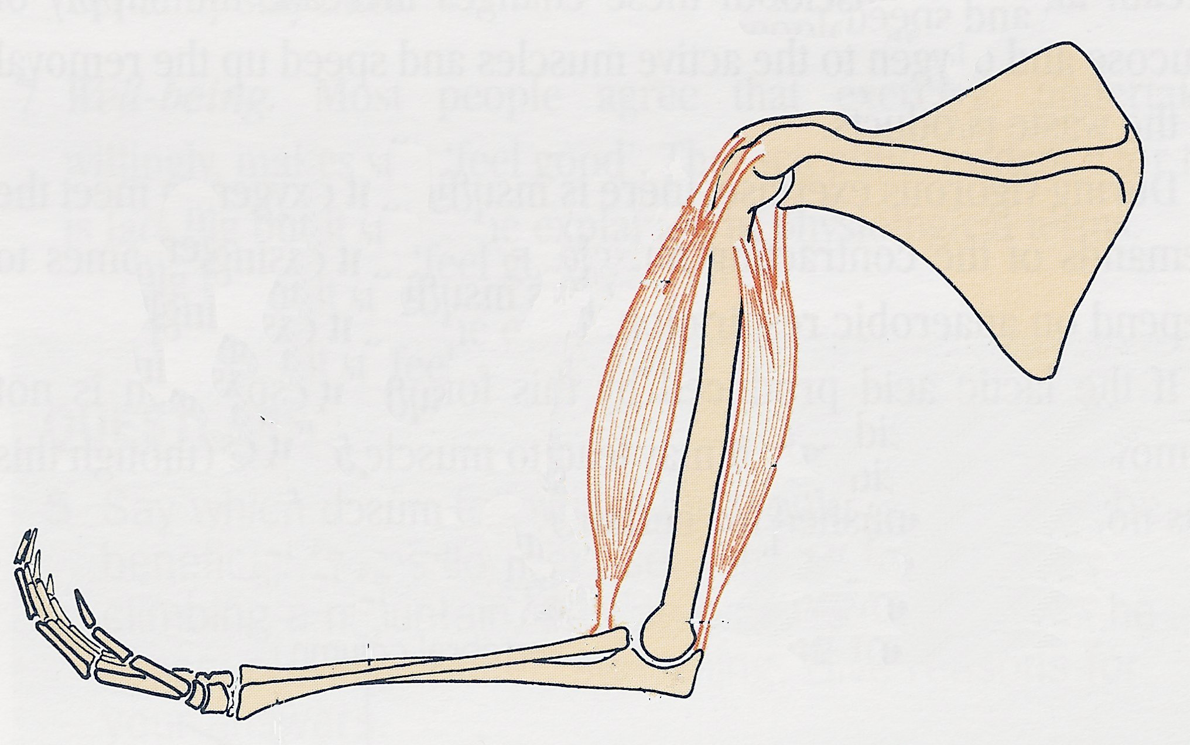
Energy use in muscle contraction
11
shoulder blade
The blood stream brings food and oxygen to the muscle cells. Respiration occurs in the cells and releases energy which……
upper arm
bone
lower arm bones
Notes:
The drawing represents the human arm bones with two of the muscles which produce movement (biceps and triceps)

Slide 13
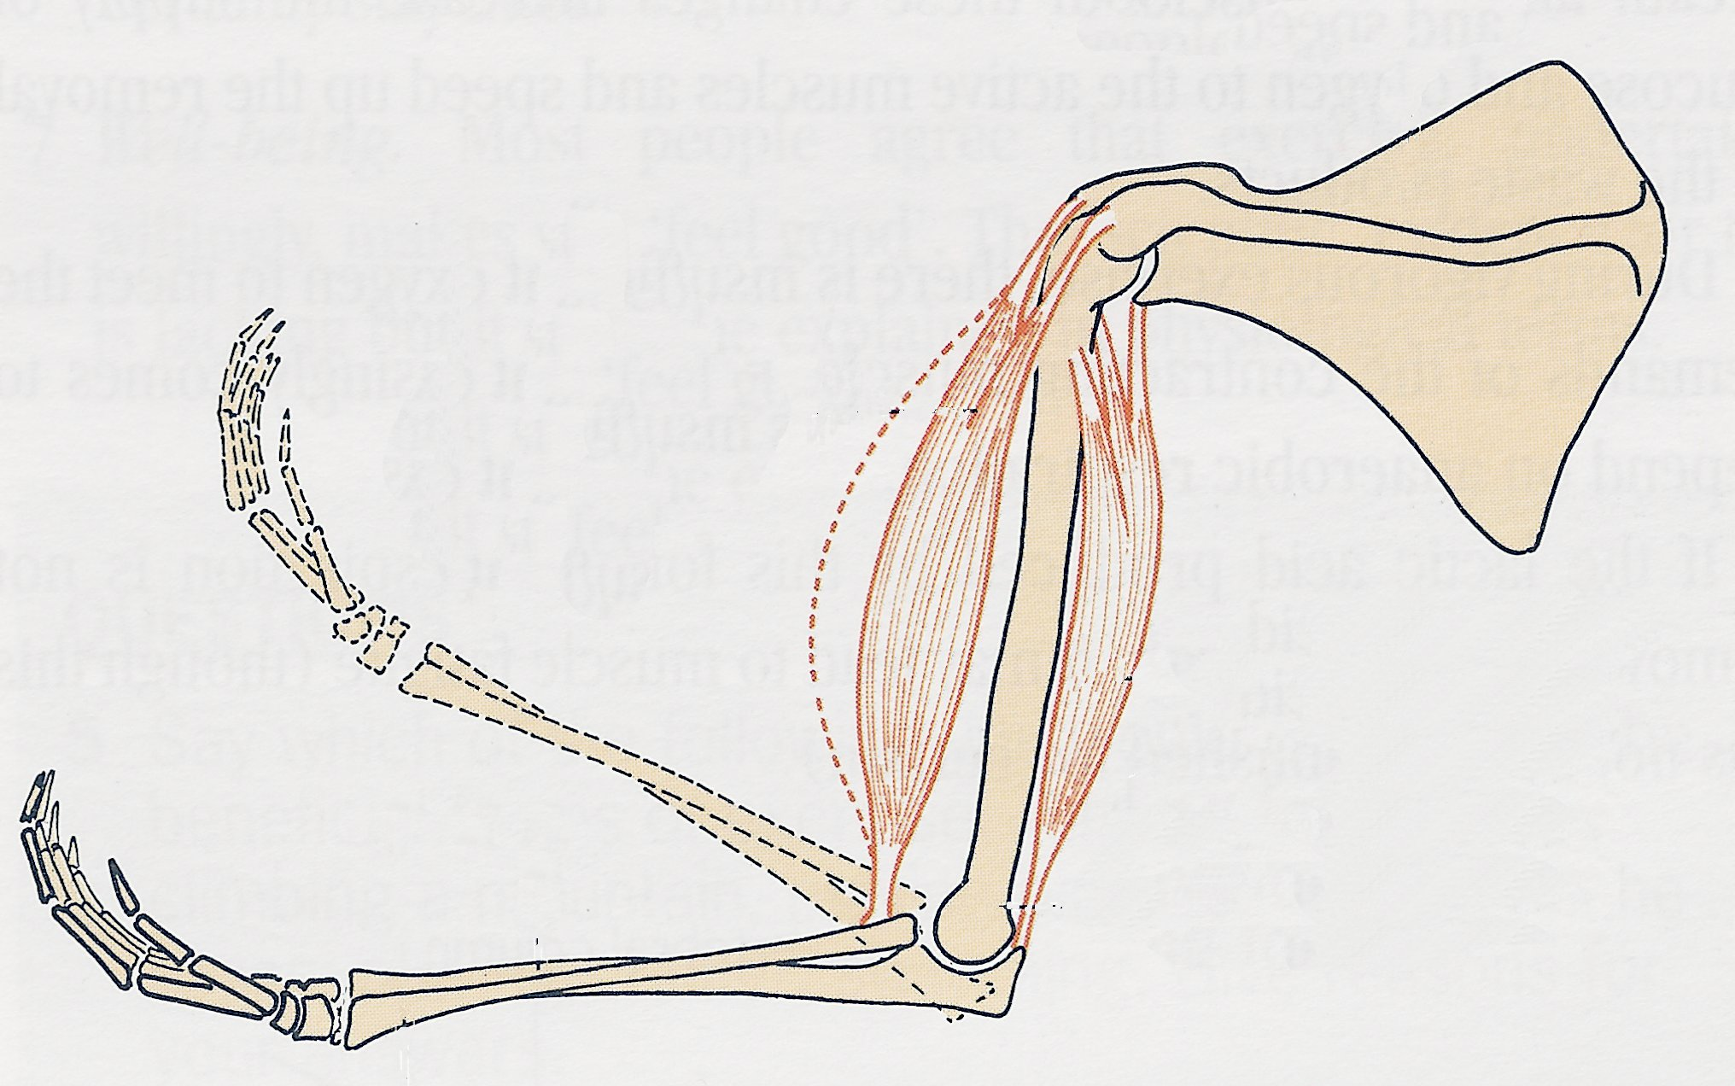
12
…….makes the muscle contract
and pull the lower
arm up

Slide 14
Do Now Questions – 4 min
In which parts of a living organism does respiration take place?
Which word best describes what respiration is about?
Breathing 2. Energy 3. Mitochondria
Victims of drowning who have stopped breathing are sometimes revived by “artificial respiration”. Why do biologists reject this expression and prefer to use the word “resuscitation”?
If a cell has many mitochondria what does it tell you about that cell?

