Slide 1
Role of Placenta, Umbilical Cord, Amniotic Sac and Amniotic Fluid
By Anokhi and Shreya

Slide 2
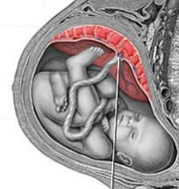
Development of Placenta
Soon after the embryo implants in the lining, some cells grow into a disc-like structure called the placenta.
The placenta becomes closely attached to the lining of the uterus and is connected to the embryo by a tube called the umbilical cord.
At the end of pregnancy, the placenta weighs about 1.5 pounds.

Slide 3
Role of Placenta
This organ has many functions:
Nutrition
Excretion
Protection - of fetus from mother’s immune system and against mother’s blood pressure
Secretion of hormones - such as hCG (human chorionic gonadotropin) and hPL (human placental lactogen) hormones
Immunity – provides fetus with antibodies from mother (provides immunity for several months after birth)

Slide 4
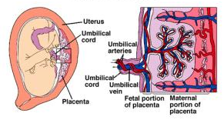
Exchange of Substances
Oxygen, glucose, amino acids and salts pass from mother’s blood to embryo’s blood through the umbilical cord.
Carbon dioxide and urea pass from embryo’s blood to mother’s blood.
There is no direct contact between maternal blood and fetal blood.

Slide 5
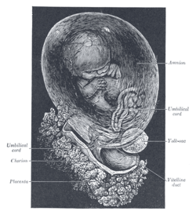
The Amnion
A thin tough membrane in the forms of a sac that encloses and protects the growing embryo in the uterus.
When first formed: in contact with the embryo
Within 4-5 weeks, a fluid known as the amniotic fluid or liquor amnii begins to accumulate in it.
-causes the amnion to expand.
-increases in quantity upto 6-7 months of pregnancy, after which it reduces amounting to about 1 litre at the end of the pregnancy.

Slide 6
Amniotic fluid
Amniotic fluid: pale yellow fluid.
-Serves to cushion unborn baby from jolts and bumps, protecting from mechanical shock.
-Protects embryo from unequal pressures acting on it.
-Keeps the embryo from drying out.
-Provides stable temperature therefore maintaining a stable body temperature for the unborn child.
-Allows baby to move freely and exercise growing muscles to develop a symmetrical muscular system.

Slide 7
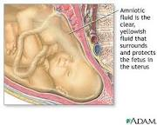
Amniotic fluid
Allows for lung development as the baby begins to breathe amniotic fluid to strengthen his lungs and swallow fluid to develop the gastrointestinal tract.
The kidneys develop as the baby urinates in the fluid.
Contains less than 2 percent solids consisting of urea and other extractives, inorganic salts, a small amount of protein and sugar.

Slide 8
Bibliography
IGCSE Biology – By D.G. Mackean
Worksheets received in class
http://en.wikipedia.org/wiki/Placenta
http://courseweb.edteched.uottawa.ca/medicine-histology/english/reproduction/Placenta/ Default.htm
http://www.pregnancy-calendars.net/placenta.aspx#.UExwfY0gegY
http://en.wikipedia.org/wiki/Amnion
http://www.ehow.com/about_4576411_what-function-amniotic-sac.html

