Slide 1
Genetically Modified Food: An Evil In Disguise
By: Neil, Pranav

Slide 2
Introduction
Genetically Modified (GM) food is food made from genetically modified organisms.
The Genetically Modified Organisms have had specific changes introduced into their DNA
While, GM Food may appear as a solution due to its increased nutritional value and health benefits, it is actually an evil in disguise as shown in the following slides

Slide 3
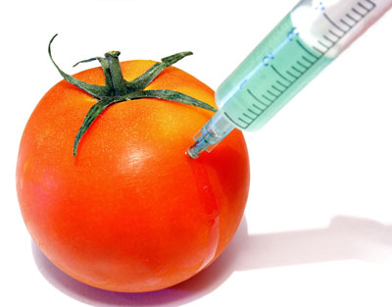
GM Food

Slide 4
Toxins in Food Harms Consumers
A pesticide called Bacillus thuringiensis (Bt) is used by farmers to kill insects by spraying it on crops
This pesticide is inserted into corn and cotton by genetic engineers so the plants kill the insects by themselves
However, this toxin is much more concentrated in GM Food and can not be washed off
This can lead to itching or flu-like symptoms

Slide 5
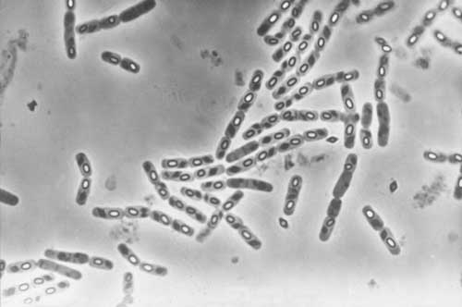
Bacillus Thuringiensis

Slide 6
Genetically Modified Organisms Trigger Immune Reactions
Genes inserted in GM Foods can often trigger allergic reactions
Genes inserted in GM Foods can also trigger asthmatic reactions
The most common allergy triggered by GM Food is Soy
Since GM Food was introduced to England, the amount of cases of allergic reactions shot up by 50%

Slide 7
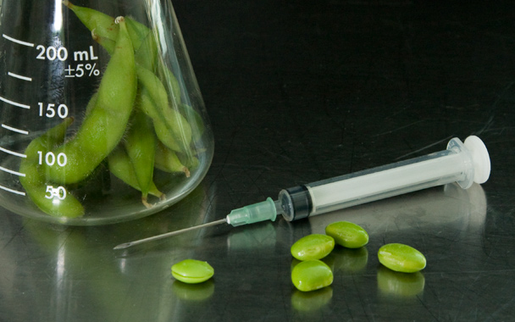
GM Soy

Slide 8
Animals are dying in large numbers
In most countries of the world, animals are allowed to graze on fields of crops
However, when animals are allowed to graze on GM Crops, most of the animals die
This is because the toxins present in the GM Crops caused severe irritation in the animals’ liver and intestines
In a small village in Andhra Pradesh, buffalos grazed on cotton plants for eight years without an incident. After the buffaloes grazed on GM Crops for the first time, all thirteen buffaloes died in the first three days

Slide 9
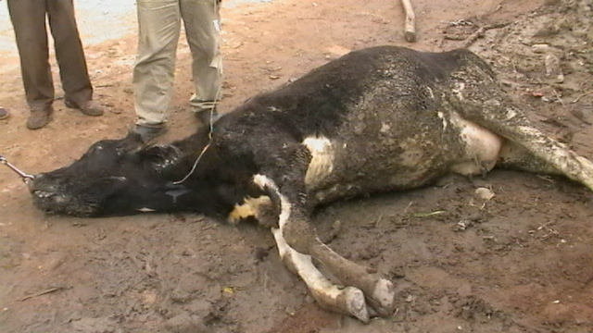
Cows dying in large numbers

Slide 10
Genetically Modified Organisms Stay Inside Our Body
It has been discovered that after we eat GM Food, the Genetically Modified Organisms stay inside our body
These organisms in our body cause gastro-intestinal problems
The worst part of all is that these organisms can never be removed from our body, so even if a person has only eaten GM Food once, they will still have Genetically Modified Organisms inside their body

Slide 11
Bibliography
http://www.responsibletechnology.org/gmo-dangers/health-risks/articles-about-risks-by-jeffrey-smith/Genetically-Engineered-Foods-May-Cause-Rising-Food-Allergies-Genetically-Engineered-Soybeans-May-2007
http://en.wikipedia.org/wiki/Genetically_modified_food#Controversy
http://en.wikipedia.org/wiki/Genetically_modified_food_controversies#Health_risks_of_consuming_GM_food
http://www.opposingviews.com/i/genetically-modified-foods-pose-huge-health-risk

Slide 12
THE END

