Slide 1
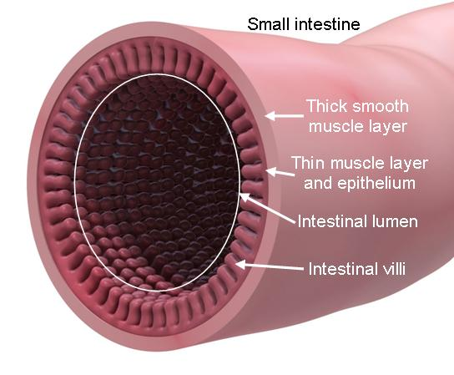
Inside our Intestine
A closer look
By
Arya Gaby and Jamie

Slide 2
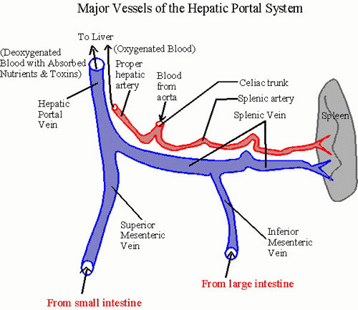
Hepatic Vein
Hepatic vein, often known as portal vein, is a short vein present in the abdominal cavity.
The Hepatic Portal Vein carries blood from the small intestine to the liver.
It carries blood is low in O₂ but rich in Glucose and other food types. The Glucose is converted to Glycogen in the Liver and stored there.

Slide 3
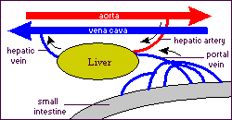
Function of the hepatic portal vein
The vein is responsible for draining blood from the gastrointestinal tract and transporting it to the liver.
The blood coming from the different parts of the digestive system is fully loaded with nutrients and toxins that have been absorbed along the tract from the ingested food.
The liver detoxifies the blood by filtering it and it’s fro this reason that the blood is brought here through the Haptic Portal Vein.
The blood is then transported to the heart and is circulated all around the body.

Slide 4
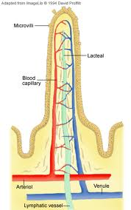
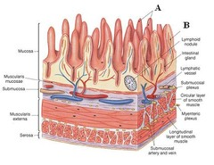
Capillaries and Lacteals
Capillaries are the link between arteries and veins – where exchange with tissues occurs.
The capillary wall is one cell thick — ideal to allow materials to pass in and out.
All tissue cells are very close to a capillary so exchange is very efficient.
Exchange at the capillaries is by diffusion and active transport.
Blood flow in capillaries is slow giving enough time for effective exchange.
The inner lining of the small intestine is covered by many small villi.
A small lymph vessel arises in each of these villi, these specialized lymph vessels in the villi are known as lacteals.
The lacteals are tiny tubes that have a slightly larger diameter than blood capillaries.
Digested fats which are absorbed by the villi pass into these small lacteals.
This occurs because the lymphatic system of the body can absorb and transport molecules that may be too large to pass directly into the bloodstream.
The absorbed fats give the lymph a milky white appearance.

Slide 5
What’s the difference?
Lacteals transport fat globules while capillaries transport Glucose and Amino Acids.
Lacteals empty out it’s contents into the bloodstream while the capillaries empty it’s contents into the liver.
Capillaries form the Hepatic Portal Vein while lacteals are part of the lymphatic system.
Lacteals are white in colour while capillaries are not.

Slide 6
Describe the structure of lacteals
The villus lacteals are the parts in the villi that absorb the fatty acids from food.
They are lymphatic vessels which turn white the minute they come in contact with fat globules.
The smallest of the lacteals are lacteal capillaries, which are minute vessels running down the centre of the villus of the small intestine.

Slide 7
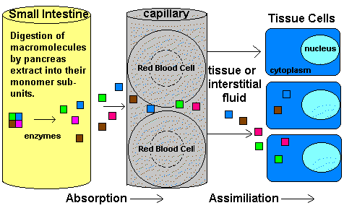
Explain Assimilation
Assimilation is the using up of broken down food substances and materials necessary for the body to grow and function normally.
The nutrients are received by allowing our food to react with different acids and enzymes in our body.
When this happens, it is known as a chemical breakdown of food because it uses chemicals to release the required nutrients.

Slide 8
bibliography
http://www.buzzle.com/articles/hepatic-portal-vein.html
http://resources.teachnet.ie/farmnet/Circulatory.htm
http://www.wisegeek.com/what-are-villi.htm
http://simple.wikipedia.org/wiki/Assimilation_(biology)

