Slide 1
The use of microorganisms
In making of Yogurt as a single
Celled protein and
Making of bread
By- Crisitian, Ram D, Vikram

Slide 2
Bread Making
Yeast is used in the making of bread. Yeasts is an eukaryotic microorganism. Yeast is used in all bread recipes. Yeast is a living fungus that feeds on sugar or other sweeteners. As it does, the yeast ferments the bread dough and releases carbon dioxide. It is the release of this gas that causes bread dough to rise. The ‘holes’ in the bread are made by carbon dioxide bubbles. This gives the bread a ‘light’ texture

Slide 3
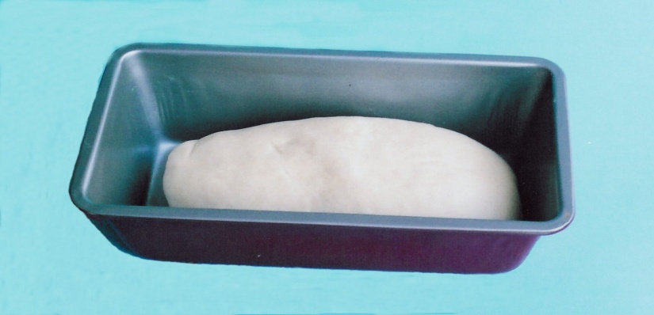
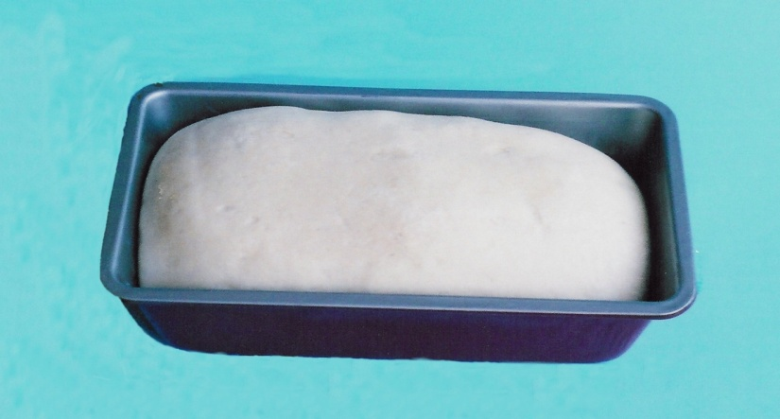
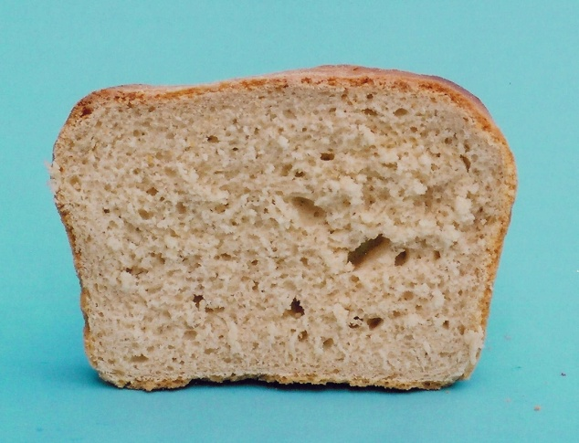
Dough Rising
The ‘holes’ in the bread are made by the carbon dioxide bubbles.
This gives the bread a ‘light’ texture

Slide 5
Making Of Yogurt
Milk is heated to kill other microorganisms
2 bacteria are added to increase production of lactic acid
At temperature of 45 degrees the milk ferments and one of the bacteria grows and drops the milk’s pH to 5 and produces carbon dioxide and lactic acid
The products make the other bacteria grow and drop the milk’s pH further to 4.2

Slide 6
Contd…
Lactose found in the milk is broken down into glucose when the bacteria is added
After glucose is formed it is fermented into lactic acid by the microorganisms
Acetaldehyde is produced; this creates the tart and sour taste of plain yogurt
Lactic acid makes the pH drop causing the casein to denature and stick together
The milk curdles producing yogurt. For flavour different fruits are mixed in or found at the bottom of the product

Slide 7
Single Celled Protein
Single celled proteins are the dried microbial cells or protein extracted from pure microbial cultures (biomasses) of either yeast, fungi, bacteria or algae. They can be used as substitute protein sources for human and animal consumption. SCP was developed to help bridge the gap between the worlds’ protein needs. They are much easier to produce than actually protein sources because the substrate to be used to create the biomass of microbes can be almost anything organic like wood shaving, sources of carbon and even human and animal wastes, but this can be an expensive process. Yeast is a very popular example as a SCP as it can be used directly or the protein can even be extracted and processed to make other protein related products like fishmeal, dog food and even chicken-like eatables.

Slide 8
Bibliography
www.wikipedia.org
www.googleimages.com
http://bio4indusbangalore.weebly.com/
http://biomaster2011.blogspot.in/

Slide 9
THANK YOU

