Slide 1
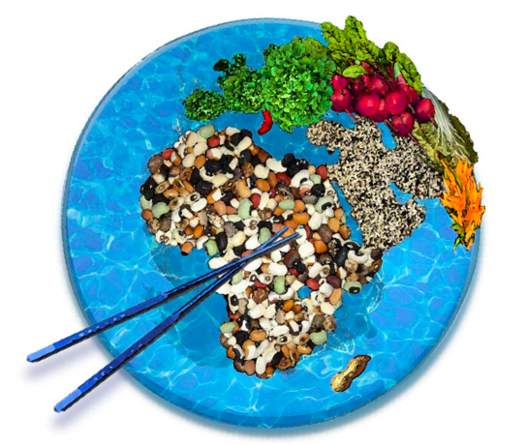
By Manisha and Neha
Problems of World Food Supplies
Notes:
What is a Famine?
- Famine is caused when people lose their ability to obtain foods by growing or buying foods

Slide 2
Causes of Famine: Unequal Distribution of Food
Environmental, economic, and political factors all determine the distribution of food in a country
Unequal distribution of food is when food is not divided equally throughout a nation.
This can happen due
Division in social classes
Need of Money in poorer countries
Climate conditions
Price of foods
Corruption of the government
Unequal distribution of food is a problem seen in India as well as other LEDCs and NICs
Notes:
Famine is a problem of distribution as well as production. Environmental, economic, and political factors together determine the supply and distribution of food in a country. Starvation occurs when people lose their ability to obtain food by growing it or by buying it. Often, poor decisions and organizations aggravate environmental factors to cause human suffering. In Bangladesh, floods during the summer of 1974 interfered with rice transplantation, the planting of small rice seedlings in their rice patties. Although the crop was only partly damaged, speculators hoarded rice, and fears of a shortage drove prices beyond the reach of the poorest in Bangladesh. At the same time, disruption of the planting meant lost work for the same people. Even though there was plenty of rice from the previous year's harvest, deaths from starvation rose as the price of rice went up. In December of 1974, when the damaged rice crop was harvested, the country found that its crop had been only partly ruined. Starvation resulted not from a shortage of rice, but from price speculation. The famine could have been avoided completely if the government had responded more quickly, acting to stabilize the rice market and to provide relief for famine victims.

Slide 3
Cause of Famine : Drought http://video.nationalgeographic.com/video/environment/environment-natural-disasters/landslides-and-more/droughts/
Droughts are unusually long periods of without enough rainfall
In times of drought, crops cannot grow because they do not have enough water.
Effects
damaged crops cause food shortages,
They make any food available too expensive for many people.
Reduced food production means less work for those who rely on temporary farm work for their income.
Notes:
Many famines occur in the aftermath of natural disasters like floods and droughts. In times of drought, crops cannot grow because they do not have enough water. In times of flood, excess water washes out fields, destroying crops and disrupting farm activity. These disasters have several effects. First, damaged crops cause food shortages, making nutrients difficult to find and making any food available too expensive for many people. Second, reduced food production means less work for those who rely on temporary farm work for their income. Famines usually affect only the poorest five to ten percent of a country's population. They are most vulnerable because during a crisis wages for the poorest workers go down as food prices go up.

Slide 4
Bibliography
https://www.youtube.com/
http://www.jumpingmonkeys.com/famines_droughts
naturalgeographic.com
http://www.naturaldisastersinfo.com/famines_causes

Slide 5
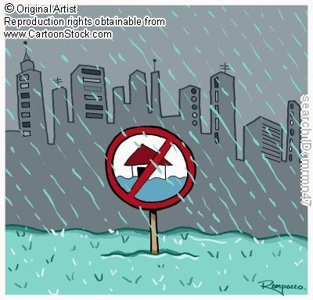
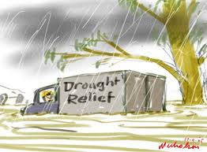
Floods
A flood is an overflow of water that submerges land.
Effects of floods on famine include:
Contamination of water supply; Clean water sources will become scarce.
Shortage of food crops caused by the loss of entire harvests.

Slide 6
Case Study – Famines Caused by Heavy Floods and in China
Floods occur almost every year in China, but heavy floods and droughts take place almost every year.
On the other hand, floods makes a heavy loss of grain production since crops are destroyed or submerged by floods.
It is inevitable to have a famine when heavy floods take place.

Slide 7
Bibliography
http://www.sciencepub.net/nature/0202/05xie.pdf
http://en.wikipedia.org/wiki/Floods#Primary_effects
http://library.thinkquest.org/10136/famine/famitq.htm

Slide 8
Striking the balance- a tomorrow where no one sleeps hungry .
Heera, Ayush, and Neha

Slide 9
What is starvation?
Starvation is when the body doesn’t have enough intake or consumption of caloric energy ,nutrients and vitamins
The worst form of starvation is malnutrition which can lead to permanent organ damage and eventually death .

Slide 10
Organizations
According to the World Health Organization, hunger is the single gravest threat to the world's public health.
The WHO also states that malnutrition is by far the biggest contributor to child mortality, present in half of all cases. Six million children die of hunger every year.
Figures on actual starvation are difficult to come by, but according to the FAO, the less severe condition of undernourishment currently affects about 925 million people, or about 14% of the world population.
It is quite common to depict a thin child with a bloated stomach as starving, but in reality, such child is malnourished.

Slide 11
Why we need our food
We need our food the same way how cars and other engines need fuel.
Our body uses up energy everyday, not only to exercise but for our organs and it still uses up the energy when were asleep.
Food contains other nutrients to keep our bones, hair , skin strong and helps us build up our immune system.

Slide 12
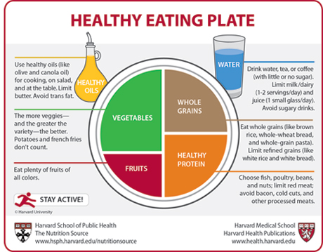
Why are people hungry
Hunger and food insecurity have many contributing factors:
including poverty, natural disasters, drought, war, lack of infrastructure, and exploitation of the environment.

Slide 13
For many poor households forced to spend more than half of their incomes to eat, the recent jumps in staple food prices are crippling their ability to access enough nutritious food while coping with other needs.
This can lead to chronic malnutrition which affects every aspect of a child’s life.

Slide 14
Hunger Movements
Join the movement to end hunger Stop Hunger Now is an international hunger relief organization that coordinates the distribution of food and other life-saving aid around the world.
The organization is driven by a vision of a world without hunger and a mission to end hunger in our lifetime by providing food and life-saving aid to the world's most vulnerable and by creating a global commitment to mobilize the necessary resources.

Slide 15
Striking the balance
Stop Hunger Now’s meal packaging program provides volunteers the opportunity to package dehydrated, high protein, and highly nutritious meals that are used in crisis situations and in school feeding programs for schools and orphanages in developing countries around the world.

Slide 16
bibliography.
http://www.wfp.org/
www.wikepedia.org

