Slide 1
PLANT NUTRITION AND TRANSPORT

Slide 2
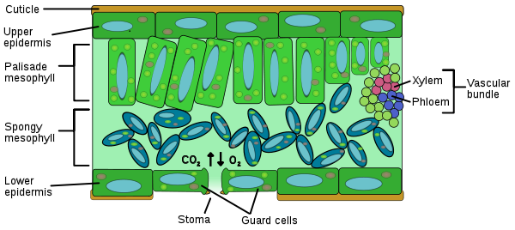
The cellular and tissue structure of a dicotyledenous leaf.

Slide 3
Cuticle is a waxy layer which reduces water loss through the upper epidermis.
Epidermis. The upper and lower surfaces of leaf are covered by upper and lower epidermis respectively.
Upper epidermis: Upper epidermis is a flattened layer of cell that forms the surface of the leaf and makes the cuticle. It consists of a single layer of closely fitted cells without chloroplasts. The stomata are usually absent.

Slide 4
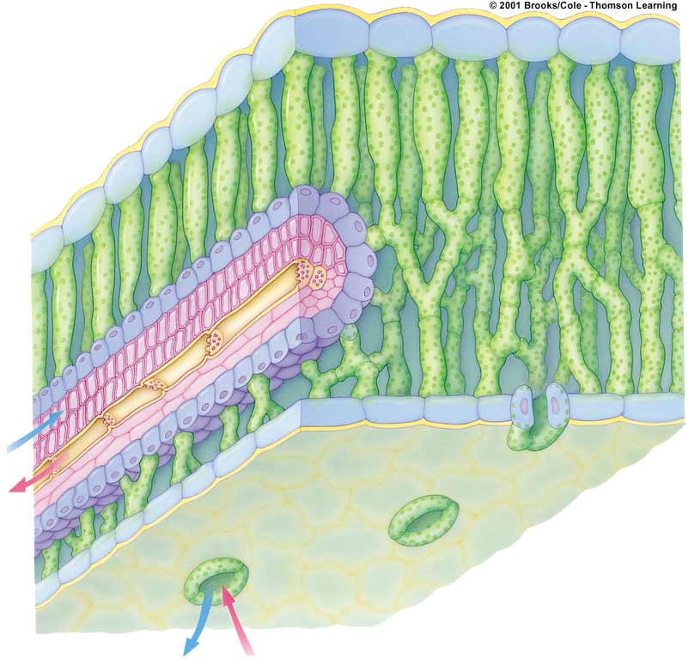
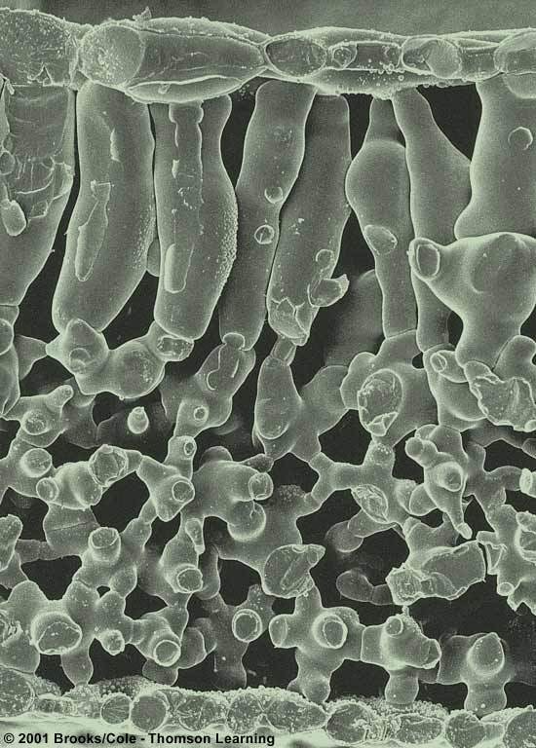
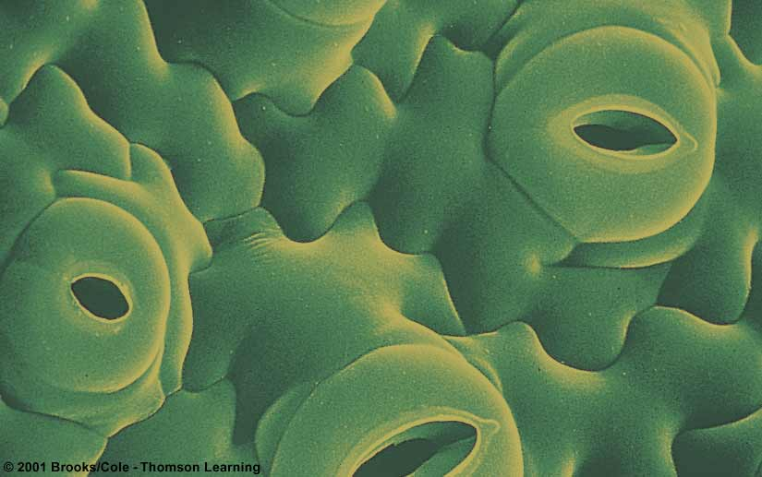
cuticle
LEAF ANATOMY
vein
xylem
upper
epidermis
phloem
palisade
mesophyll
spongy
mesophyll
lower
epidermis
one stoma

Slide 5
Lower epidermis: It is provided with pore called stomata which are guarded by kidney shaped guard cells. The guard cells contain chloroplasts. The stomatal pores open to facilitate gaseous exchange. As a result transipiration also occur.
Palisade Layer: This is the main photosynthetic region of the leaf. The cells contain numerous chloroplasts and are mainly photosynthetic in function.

Slide 6
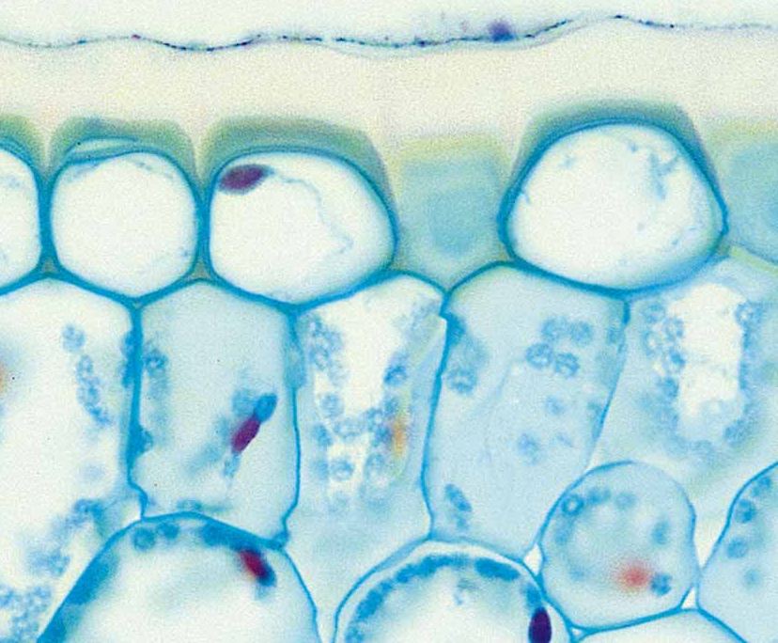
DERMAL TISSUE SYSTEM
cuticle
  waxy
  no cells
  protection
  prevents H₂O loss
epidermis
  single cell layer
  protection
stomata (opening)
  gas exchange
  surrounded by guard cells
  open & close to prevent H₂O loss

Slide 7
Spongy mesophyll: contains spaces that allows the movement of gases and water through the leaf tissue. They have less chloroplasts.
Vascular bundle: contains the transport system and vascular tissue (x-xylem, p-phloem). ) Phloem transports the products of photosynthesis (sugars, amino acids). Xylem transports water and minerals into the leaf tissue from the stem and roots.

Slide 8
Photosynthesis
Anabolic (small molecules combined)
Endergonic (stores energy)
Carbon dioxide (CO₂) requiring process that uses light energy (photons) and water (H₂O) to produce organic macromolecules (glucose).
6CO₂ + 6H₂O → C₆H₁₂O₆ + 6O₂
SUN
photons
glucose

Slide 9
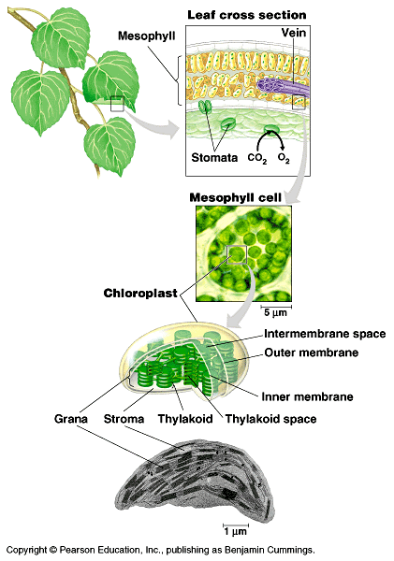
Focusing on the location of photosynthesis in a plant

Slide 10
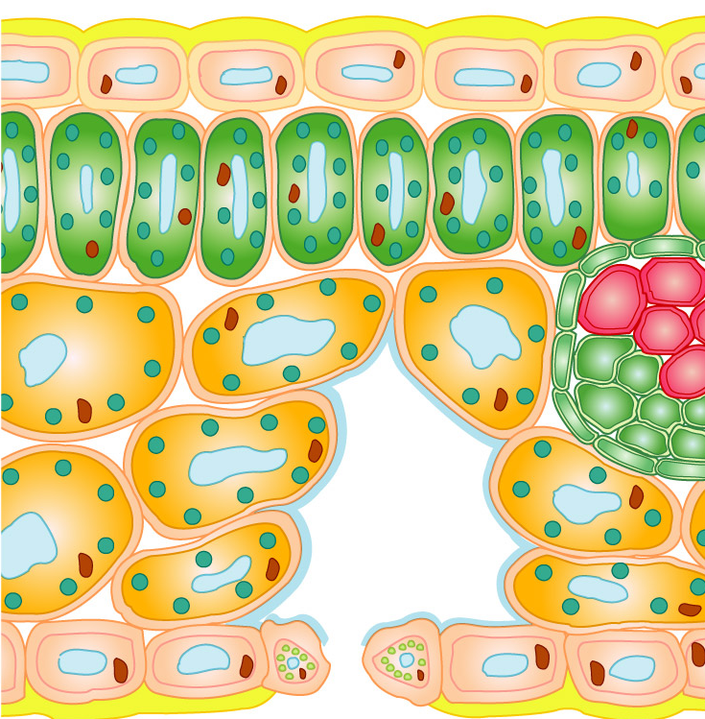
Transpiration
The process of transpiration
A leaf section
The loss of water vapour from the surfaces of plants due to evaporation.
1) Water on the surface of the mesophyll cells evaporates into the air space.

Slide 11
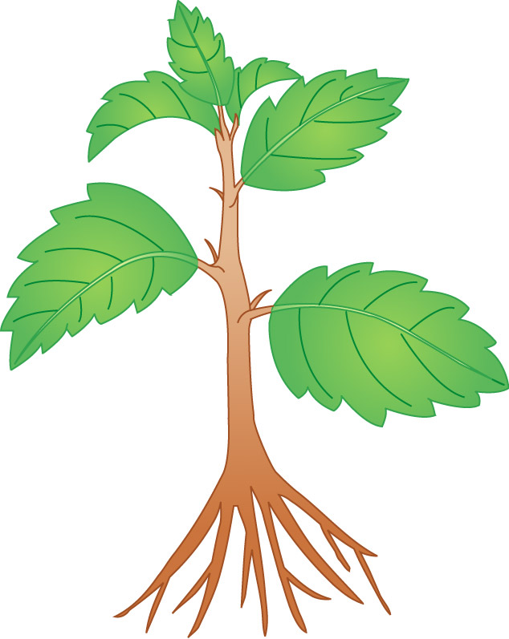
How is water lost in transpiration?
All organisms lose water all the time.
➔ In plants: through transpiration
H₂O
H₂O
H₂O

Slide 12
The water lost must be quickly replaced.
➔ by absorption from soil in the roots
H₂O
H₂O

Slide 13
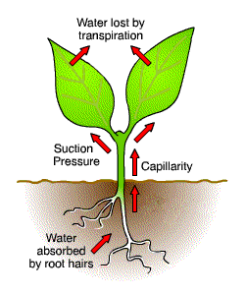
Transpiration stream
Water enters the large surface area of the root hair cell.
Water moves from the root cell
Water moves through the stem in the xylem( this is lignified so that it is waterproof.)
Water arrives at the leaf and enters the palisade cell for photosynthesis
As the leaf is warmed by light some of the water evaporates through the stomata if they are open

Slide 14
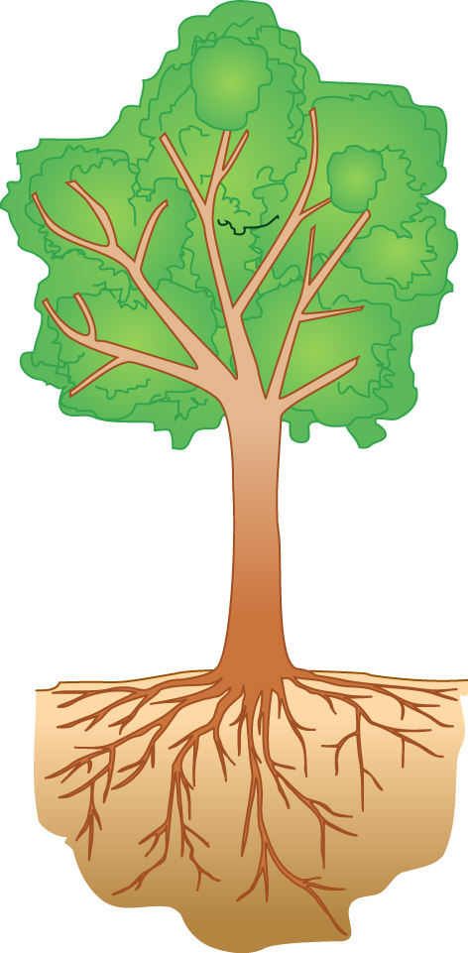
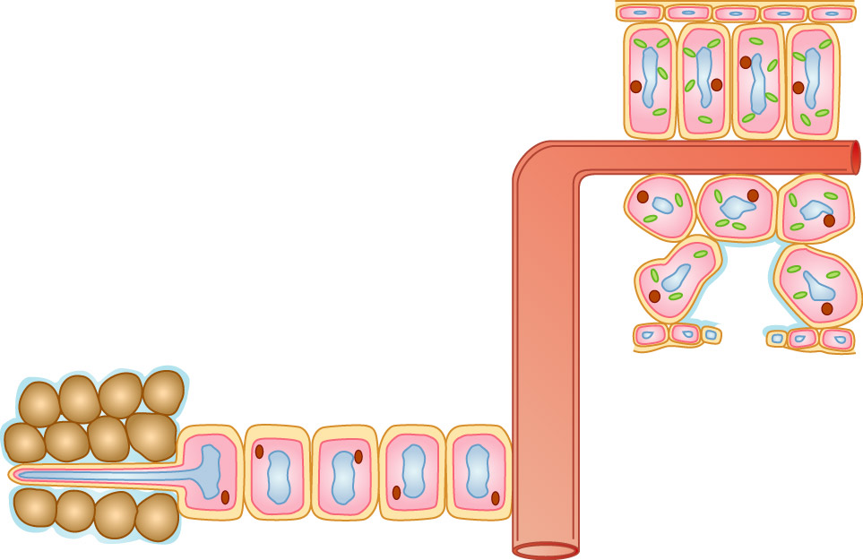
Absorption of water in roots
1 Water moves into the root hairs by osmosis.

Slide 15
Absorption of water in roots
2a Water moves into the neighbouring cortex cells by osmosis.
➔ it moves inwards from cell to cell

Slide 16
Absorption of water in roots
2b Some water moves along the cell wall.

Slide 17
Absorption of water in roots
xylem vessel in the stem
3 Water is drawn up the xylem vessel by transpiration pull.

Slide 18
Absorption of water in roots
4 Water evaporates from the leaf cells and diffuses out through the stomata as water vapour.
water vapour

Slide 19
Transpiration is fast on a dry windy and hot day as the water particles have a lot of kinetic energy . They are more likely to evaporate and escapes through the open stomata of the leaf.
Transpiration is slower on a humid, cold day that is not windy as the water particles have less kinetic energy. They are less likely to evaporates and escape through the open stomata.

Slide 20
Did you ever wonder: How does water move from roots to leaves when a tree doesn’t have a heart to pump the water?
Cohesion-Adhesion Theory
-As water evaporates from leaves, it tugs on the water molecules below
-Cohesion and adhesion pull water up and replace missing water molecules
-Water enters the roots by osmosis
www.emc.maricopa.edu/.../BioBookPLANTHORM.html

Slide 21
The creation of transpiration pull
A leaf section
1) Water is lost from the permeable cell wall, which is replaced by water in the cell.
➔ Each cell then draws water from its neighbouring cells.

Slide 22
The creation of transpiration pull
A leaf section
2) Cells draw water from the xylem vessels, pulling water up the plant.
➔ transpiration pull is created
Transpiration pull is the suctional force generated by transpiration.

Slide 23
Cohesion
Cohesion is the property of water that causes it to be
attracted to itself.
http://www.realeyz.com/photo/macro/photos/leaf_drops.jpg

Slide 24
Adhesion
Attraction between molecules of different substances
  Ex: glass and water
Capillarity Water molecules will “tow” each other along when in a thin glass tube.
http://staff.um.edu.mt/rlib1/sm/wpe32.jpg

Slide 25
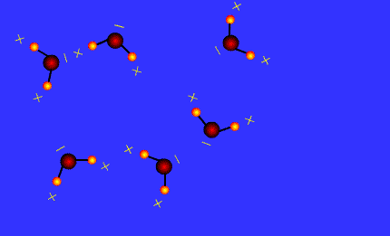
hydrogen bonding
Water will make hydrogen bonds with other surfaces such as glass, soil, plant tissues, and cotton.

Slide 26
Importance of transpiration
1) produces a cooling effect in the plant and helps leaves withstand high temperatures
2) helps in the absorption of water and minerals from the soil
3) causes the transport of water and minerals in plants

Slide 27

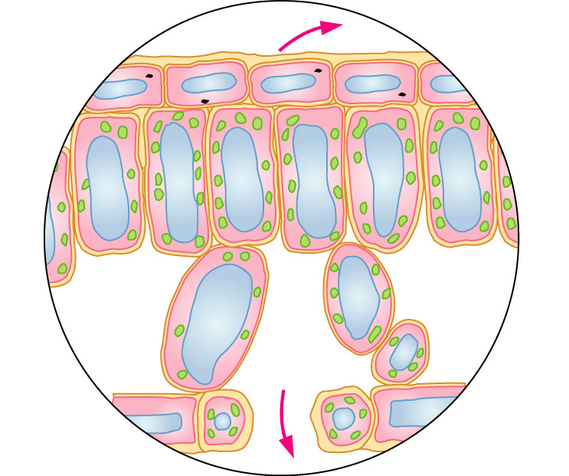
➔ > 90% of the total water loss from stomata

Slide 28
A leaf section
Water vapour diffuses through the stomata to the outside.

Slide 29
The guard cells control the opening and closing of the stomata
Guard cells flaccid
Guard cells turgid
Thin outer wall
Thick inner wall
Stoma closed
Stoma open

Slide 30
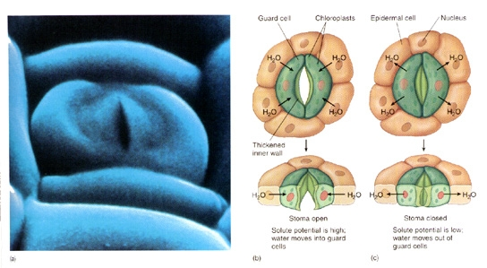

Slide 31
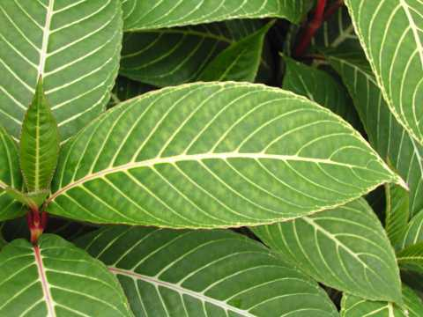
Distribution of stomata on leaves in terrestrial and aquatic plants
Terrestrial dicotyledonous plants
more stomata in the lower epidermis than the upper epidermis
fewer stomata in the upper epidermis: reduce water loss

Slide 32
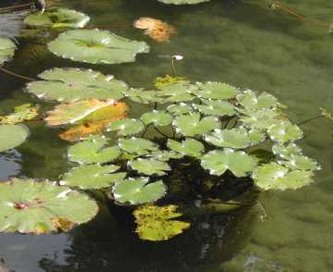
Distribution of stomata on leaves in terrestrial and aquatic plants
Submerged leaves of aquatic plants
no cuticle
gases, water and minerals diffuse directly all over their surface
few or no stomata in the upper and lower epidermis

Slide 33
Distribution of stomata on leaves in terrestrial and aquatic plants
Floating leaves of aquatic plants
have stomata in the upper epidermis only
no stomata in the lower epidermis

Slide 34
Distribution of stomata on leaves in terrestrial and aquatic plants
Plant species | Number of stomata per cm²
 | Upper epidermis | Lower epidermis
Terrestrial dicotyledons Apple Tomato
Submerged leaves of aquatic plants Hydrilla
Floating leaves of aquatic plants Water lily
0
14 100
1 200
13 000
0
0
9 500
0

Slide 35
➔ very small amount of water lost through cuticle

Slide 36
4 Environmental Factors Affecting Transpiration
Humidity:- The lower the humidity outside the leaf the faster the rate of transpiration.
Air Movement:- increase air movement increases the rate of transpiration.
3. Temperature:- increase in temperature increases the rate of transpiration.
4. Light intensity :- greater light intensity increases the rate of transpiration because it causes the stomata to open, so increasing evaporation through the stomata.

Slide 37
Intrinsic Factors Affecting the Rate of Transpiration.
Leaf surface area
Thickness of epidermis and cuticle
Stomatal frequency
Stomatal size
Stomatal position

Slide 38
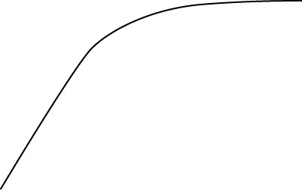
Effects of the environmental factors on the rate of transpiration
1 Light intensity
light intensity, the stomata open wider
➔ more water vapour in the air space can diffuse out
rate of transpiration
➔ rate of transpiration
light intensity

Slide 39
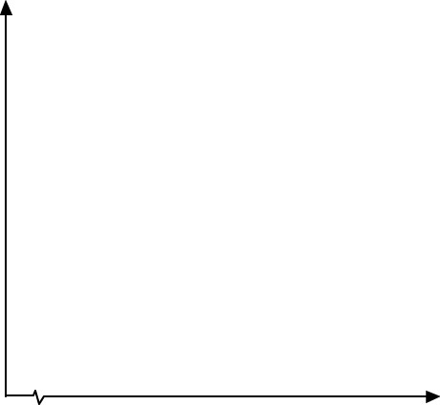
Effects of the environmental factors on the rate of transpiration
2 Temperature
temperature
➔ (1) rate of evaporation and rate of diffusion of water vapour out of stomata
rate of transpiration
➔ (2) relative humidity
temperature
➔ rate of transpiration

Slide 40
Effects of the environmental factors on the rate of transpiration
3 Humidity
Humidity ➔ the concentration gradient of water vapour between the air space and the atmosphere.
rate of transpiration
➔ less water vapour diffuse out through stomata
humidity
➔ rate of transpiration

Slide 41
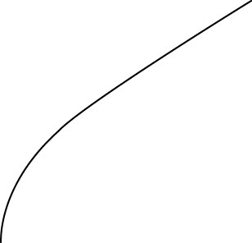
Effects of the environmental factors on the rate of transpiration
4 Air movement
air movement ➔ the concentration gradient of water vapour between the leaf and the drier air outside
rate of transpiration
➔ rate of diffusion
wind velocity
➔ rate of transpiration

Slide 42

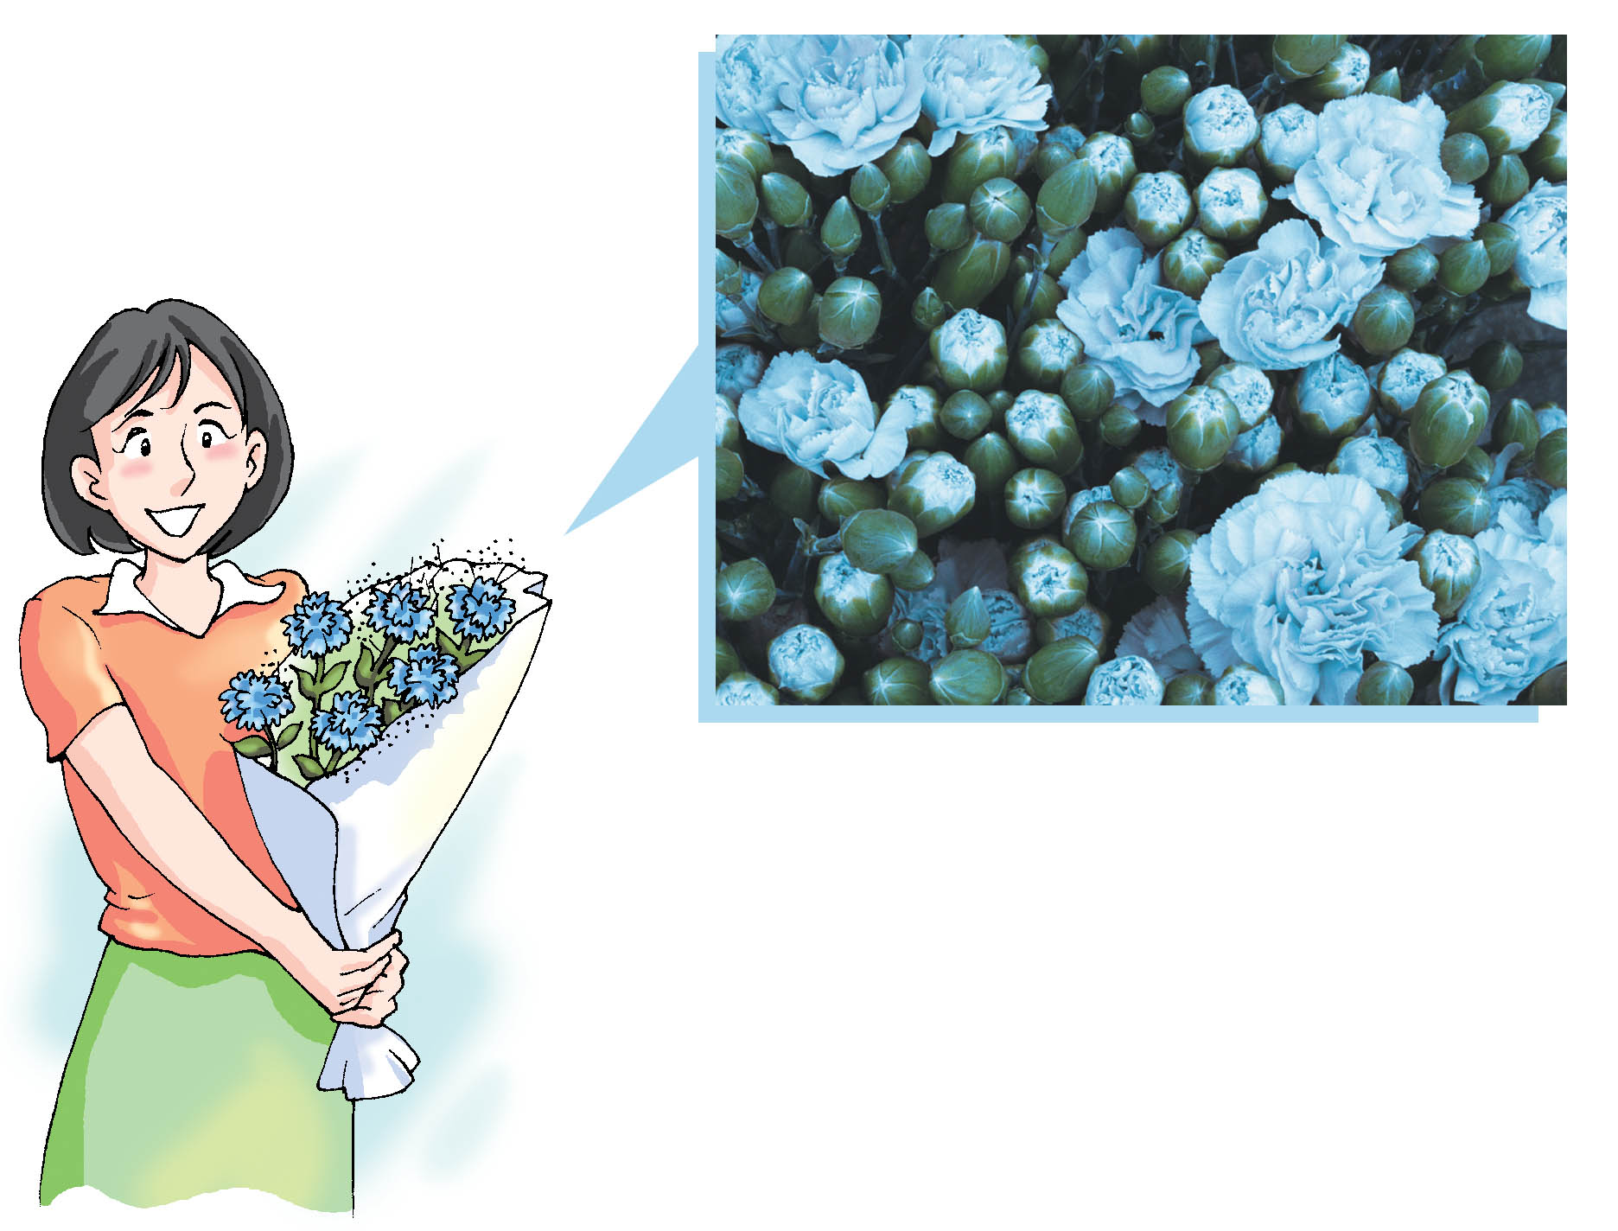
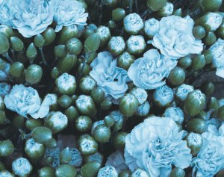
Sally has bought a bunch of coloured flowers.
Have you seen artificially coloured flowers before?

Slide 43
Sally has bought a bunch of coloured flowers.
How are flowers artificially made?

Slide 44

You can make coloured flowers by putting white flowers, e.g. carnations, into a solution of food colouring.
The solution is absorbed and transported to the petals so that they turn to the colour of the food colouring after several days.

Slide 45
How are water, minerals and organic nutrients transported inside plants?
Transport in flowering plants is provided by the vascular tissues. – This is driven by Transpirational pull.
xylem
phloem

Slide 46
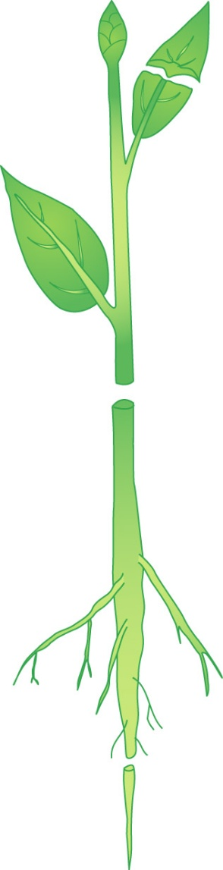

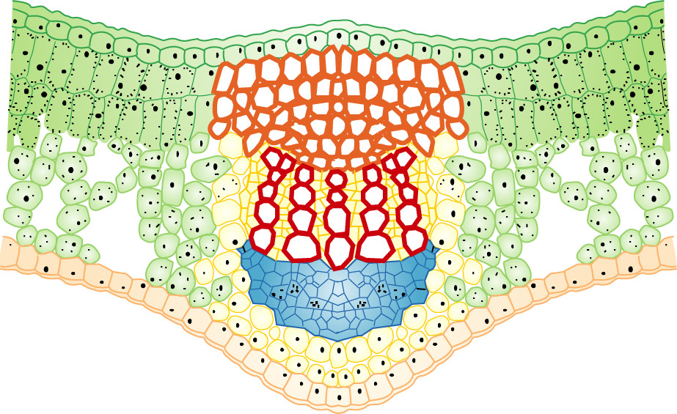
How are water, minerals and organic nutrients transported inside plants?
LEAF
leaf vein
mid-rib vein
xylem
phloem

Slide 47
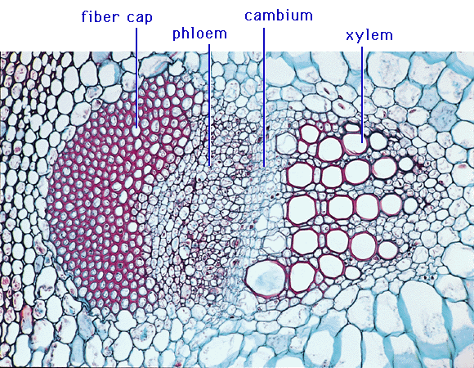
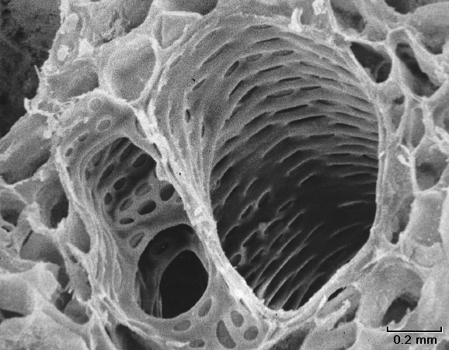
Xylem

Slide 48
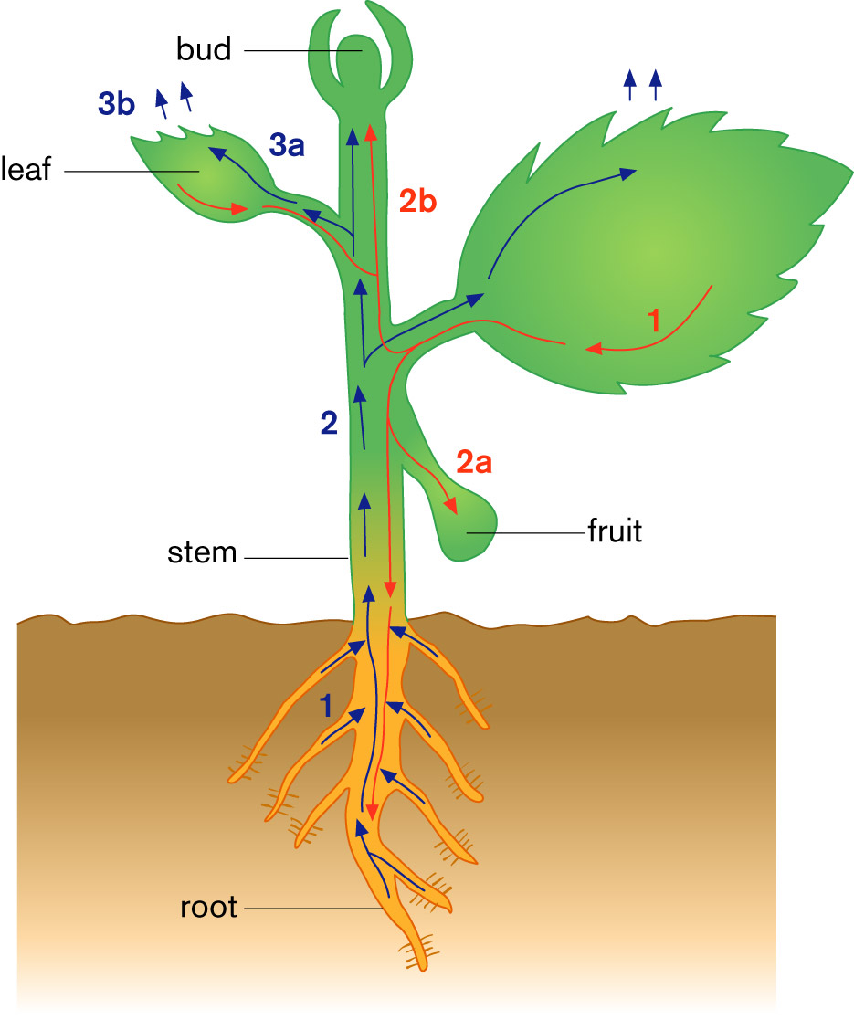
Summary for the transport of water, minerals and organic nutrients in a plant
Transport of water and minerals
1 Water and minerals are absorbed into the roots.

Slide 49
Summary for the transport of water, minerals and organic nutrients in a plant
Transport of water and minerals
2 Water and minerals move up to other parts of the plant.

Slide 50
Summary for the transport of water, minerals and organic nutrients in a plant
Transport of water and minerals
3a Water and minerals are used for metabolism.

Slide 51
Summary for the transport of water, minerals and organic nutrients in a plant
Transport of water and minerals
3b Water is lost in transpiration.

Slide 52
Transport of organic nutrients
Organic nutrients are transported in phloem in 2 ways.
➔ up or down to the growing points for development
➔ down to the roots or other storage organs
The process is called translocation

Slide 53
Summary for the transport of water, minerals and organic nutrients in a plant
Transport of organic nutrients
1 Organic nutrients
are made in photosynthesis.

Slide 54
Summary for the transport of water, minerals and organic nutrients in a plant
Transport of organic nutrients
2a Organic nutrients move down to growing fruit and roots for storage.

Slide 55
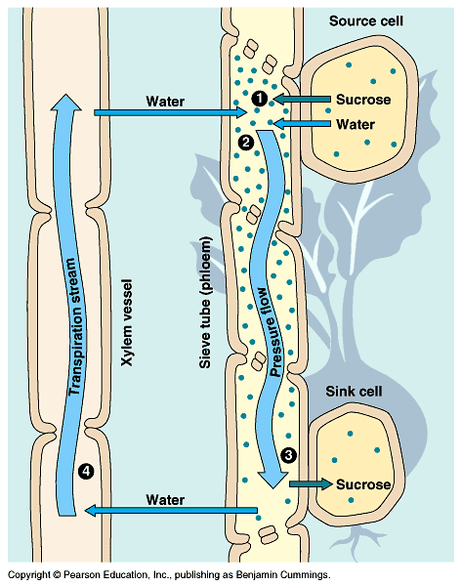
Transport of water, minerals and organic matter in plants.
Phloem moves sugar and water – it always moves it from the source to the sink (from an area where it is produced (high conc.) to an area where it is consumed (low conc.))

Slide 56
Summary concept diagram
transpiration
creates
transpiration pull
affected by
light
intensity
temperature
relative
humidity
air movement

Slide 57
Summary concept diagram
Plants
transport takes place in
vascular tissues
consist of
xylem
phloem
mainly consists of
xylem vessels
transports
transport
organic nutrients
water
minerals

Slide 58
Factors affecting photosynthesis
Temperature
Light intensity
Carbon dioxide concentration

Slide 59
Limiting factors
If any of the factors is less than its optimum level it can slow down or limit the rate of a reaction.
This is the factor on which the rate of the reaction then depends and it is called the limiting factor.
Example:

Slide 60
Try answering
1. A burning fossil fuel can both help and hinder photosynthesis. Explain this statement.
2. What limiting factor is likely to affect photosynthesis:
A) On a cloudy spring day
B)on a bright sunny day in winter
C) in the middle of a crop field on a sunny, warm july day?

