Slide 1
Use of Fertilizers rich in Nitrates and Magnesium in Plants
By Arnav and Abhi

Slide 2
Elements needed by the plants:
Carbon
Produced by the plant by the processes of respiration and photosynthesis
These elements make up carbohydrates
Hydrogen
Oxygen
Nitrogen and Magnesium

Slide 3
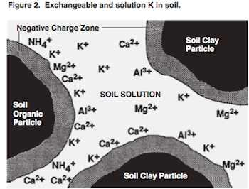
Sources:
Nitrogen and Magnesium unlike the other elements required by plants are not produced through photosynthesis
They are absorbed from the soil through the root hair cells

Slide 4
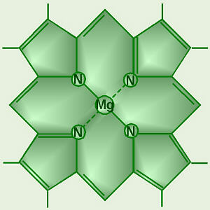
Magnesium and Nitrogen In Plants:
Nitrogen:
Production of amino acids for the synthesis of proteins
Production of Chlorophyll
Magnesium:
Production of Chlorophyll
Chlorophyll

Slide 5
Transport:
Ions taken from the soil through active transport
Transported through Xylem Vessels in the plant.
Through osmosis is transported to where needed in the plant

Slide 6
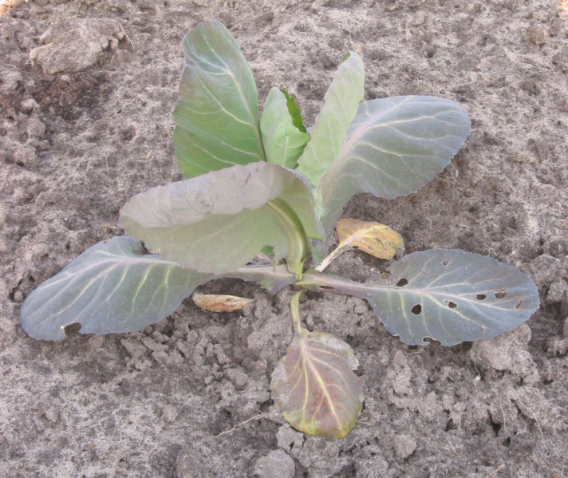
Deficiency of Nitrogen:
Causes:
Adding a carbon rich substance to the soil
Cold weather
Symptoms:
Leaves turning a pale yellow or pale green because they are no longer able to produce chlorophyll
Poor plant growth

Slide 7
Prevention:
Avoid letting plants come in contact with high concentration of Carbon
Add Nitrogen rich fertilizers such as green manures to the soil, especially in the cold seasons

Slide 8
Nitrogen Fixation
Nitrogen fixation is a process which helps replenish the nitrogen concentration in soils
Plants mainly of the Legume family contain bacteria in them which produce nitrogen compounds required by the plant
When The plant dies the nitrogen is released into the soil and the soil gets fertilized
This a process known as Nitrogen fixation

Slide 9
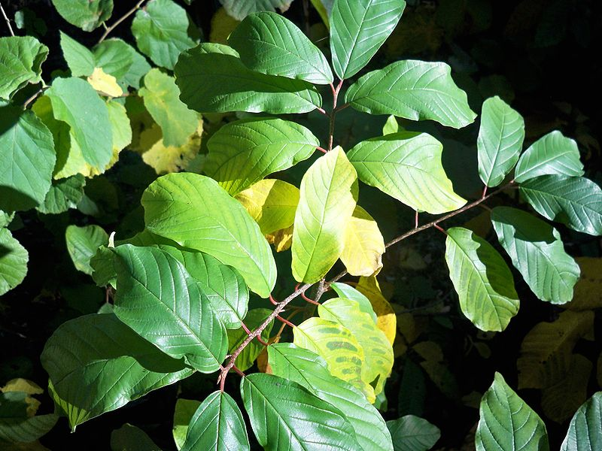
Deficiency of Magnesium:
Causes:
Leaching of Magnesium in the soil
Excess Potassium in the soil aggravates deficiency
Symptoms:
Leaves turning a pale yellow because they are no longer able to produce chlorophyll
Pre-mature aging of plant

Slide 10
Prevention
Avoid putting plants in sandy, acidic soil with little organic matter in them
Add fertilizers such as manure which increase magnesium ion concentration in the soil

Slide 11
Effects of Deficiency:
Deficiency of these minerals prevent the production of chlorophyll and proteins
This prevents the plant from growing
Without chlorophyll the plant cannot photosynthesize and cannot produce sugars (glucose)
Proteins are required for the growth, development and repair of the plant

