Slide 1
CLASSIFICATION What is classification? Sorting out things? Then… What is Taxonomy?

Slide 2
Taxonomy is the science of grouping
and naming organisms.
Classification the grouping of
information or objects based on
similarities.

Slide 3
Why is taxonomy useful?
Helps prevent confusion among scientists
Helps to show how organisms are related
Can be used to find evolutionary histories – of an organism or group

Slide 4
Aristotle
Plant or animal?
If an animal, does it
Fly
Swim
Crawl
Simple classifications
Used common names

Slide 5
5 kingdom classification
E . Whittacker came up with the concept of 5 kingdom classification.according to this living things are broadly grouped as:
Monera-all bacteria
Protista- amoeba
Fungi
Plants
Animals

Slide 6
How many are out there?
Scientists currently estimate that
There are 10 million species worldwide
Over 5 million live in the tropics
Most unnamed species are small or microscopic

Slide 7
We only know about a fraction of the
organisms that exist or have existed on Earth.
Taxonomists give a unique scientific name to
each species they know about whether it’s alive
today or extinct.
The scientific name comes from one of two
“dead” languages – Latin or ancient Greek.
Why use a dead language?

Slide 8
The concept of scientific Nomenclature
Was started by Carolus Linnaeus
Described organisms with two word names
Developed binomial nomenclature
First word = genus name
Second word = species name

Slide 9
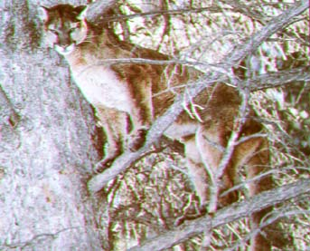
Screaming Cat

Slide 10
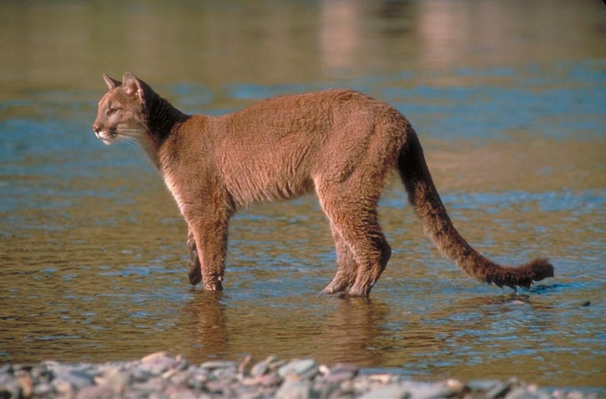
Devil Cat

Slide 11
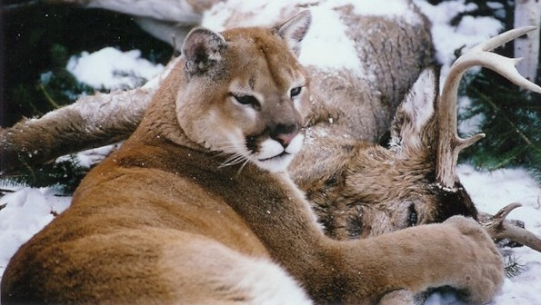
Ghost Cat

Slide 12
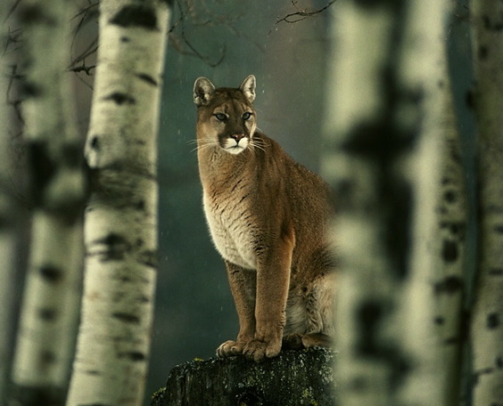
Mountain Lion

Slide 13
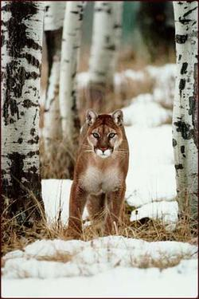
Puma

Slide 14
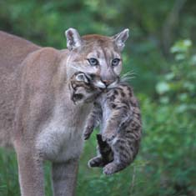
Florida Panther

Slide 15
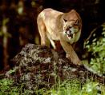
Cougar

Slide 16
There are at least 50 common names for
the animal shown on the previous 7 slides.
Common names vary according to region.
Soooo……why use a scientific name?

Slide 17
Binomial Nomenclature
a two name system for writing scientific names.
The genus name is written first (always Capitalized).
The species name is written second (never capitalized).
Both words are
italicized if typed or underlined if hand written.
Example: Felis concolor or F. concolor
Which is the genus? The species?

Slide 18
Characteristics of Living things
Nutrition
Respiration
Movement
Excretion
Growth
Reproduction
Sensitivity
REMEMBER: –
MRS GREN

Slide 19
Task 1 -
rock, wood, frog, leaf, worm, safety pin, cactus, door, paper, grass, tree, elk, T-shirt, tennis shoe, bicycle, car, human, bacteria, book, and water.
Note down the above mentioned words into your notebook and place an ‘x’ next to the words if you consider it to be a non living thing.

Slide 20
Task 2-
A motor car needs petrol and air in order to move. It produces
waste gases, which is released into the atmosphere.
a) Which characteristics of living organisms are similar to those
of a motor car?
b) Why is a car not a living organism?

Slide 21
Kingdoms are divided into groups called phyla
Phyla are subdivided into classes
Classes are subdivided into orders
Orders are subdivided into families
Families are divided into genera
Genera contain closely related species
Species is unique
Categories within Kingdoms

Slide 22
Remember:-
King Philip Came Over From Great Spain

Slide 23
The Kingdom Animalia
This kingdom consist of 2 phyllum
Vertebrates and
Invertebrates

Slide 24
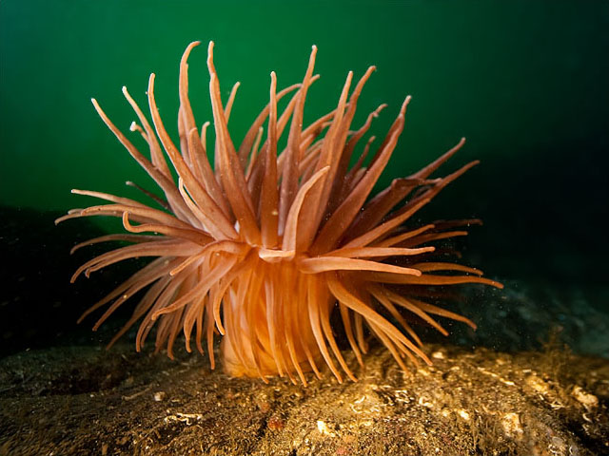
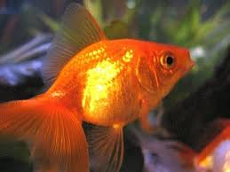
Which is organism is smarter ?

Slide 25
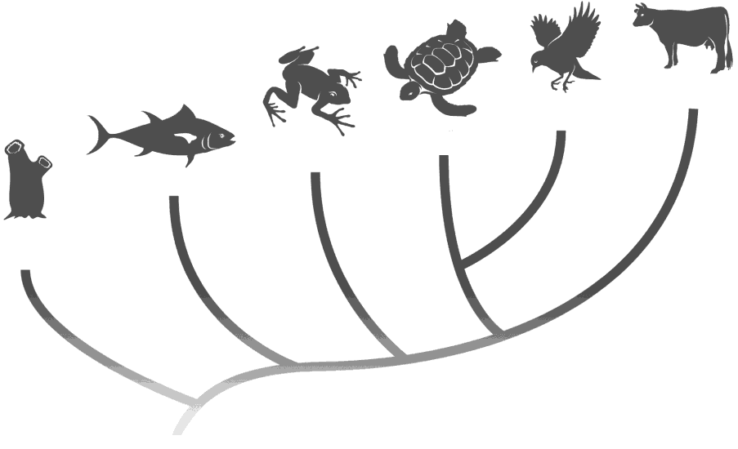
Vertebrates
Animals with backbones can be divided into five more groups:
Mammals
Birds
Reptiles
Amphibians
Fish

Slide 26
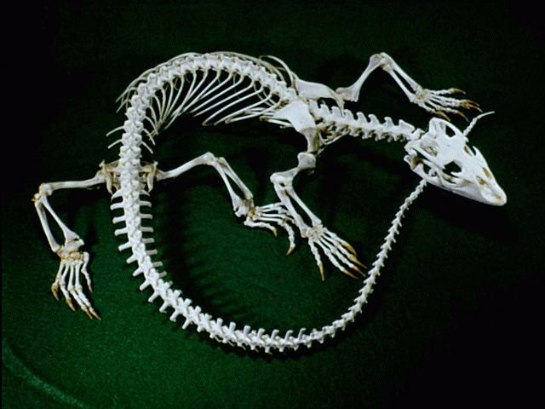
Vertebrates
Animals with a backbone.

Slide 27
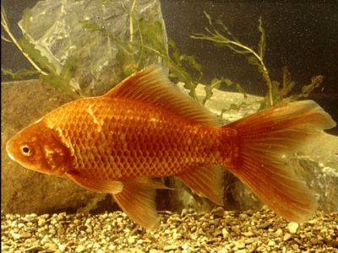
What are the characteristics of this organism?

Slide 28
Fish
Are cold-blooded.
Lay eggs (but some do give birth to live young).
Have a moist skin covered in scales.
Breathe through gills.

Slide 29
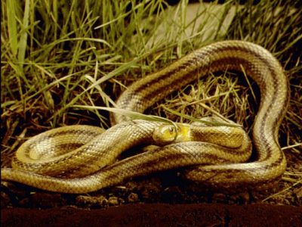
What are the characteristics of this organism?

Slide 30
Reptiles
Are cold-blooded.
Lay eggs.
Have a dry skin covered with scales.

Slide 31
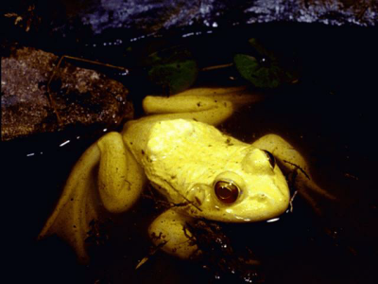
What are the characteristics of this organism?

Slide 32
Amphibians
Are cold-blooded.
Lay eggs.
Have a smooth, moist skin.
Are able to live on land as well as in the water.

Slide 33
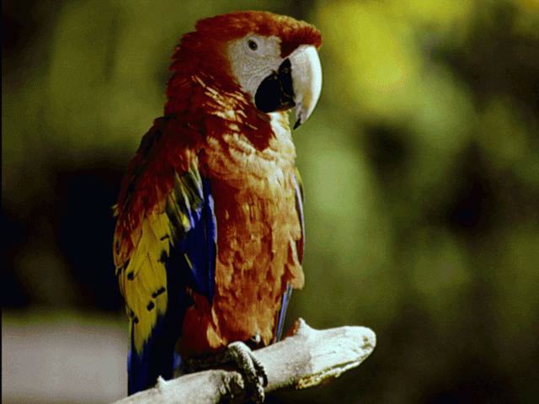
What are the characteristics of this organism?

Slide 34
Birds
Have feathers.
Lay eggs.
Are warm-blooded.

Slide 35
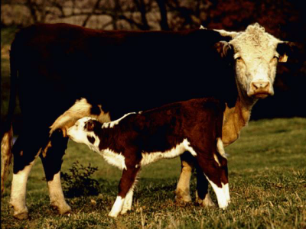
What are the characteristics of this organism?

Slide 36
Mammals
Give birth to live young.
Feed their babies with their own milk.
Are more or less covered with hair.
Are warm-blooded.

Slide 37
Task:
Read pg 48-49 and ans question 10-13 from your text book. (15mins)

Slide 38
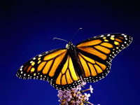
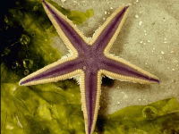
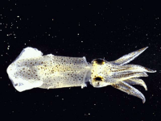
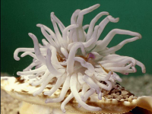
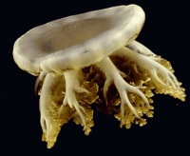
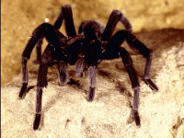
Invertebrates
Animals without a backbone.

Slide 39
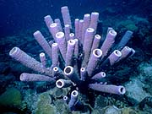
Sponges

Slide 40
Sponges
No mouth, stomachs, or other organs
Feed through a filter system (thousands of pores covering the outside of a sponge)
Most live in oceans
Cannot move
They stink a lot

Slide 41
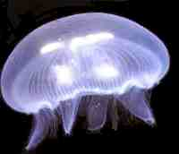
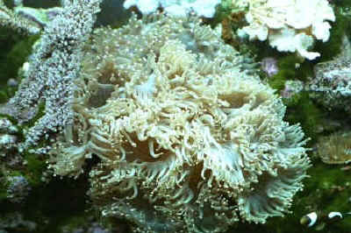
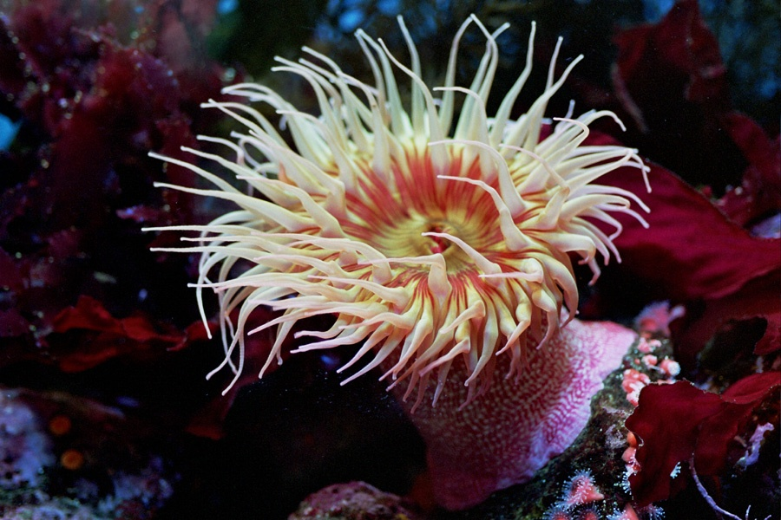
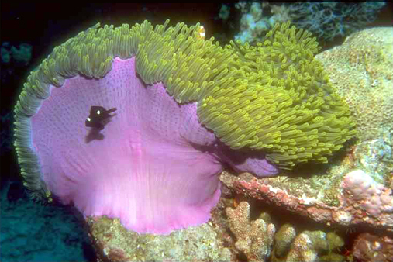
Invertebrates with Stinging Cells
jellyfish
coral
Sea anemone

Slide 42
Invertebrates with Stinging Cells
They have tentacles around their mouth.
Each tentacle is covered with many sting cells.
They live on the ocean floor
They shoot poisonous darts

Slide 43
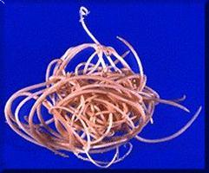
Worms
Flatworm
Roundworms
Segmented

Slide 44
Worms
Some have segmented body like earthworms and some have smooth, flat , unsegmented body like flukes.
They can grow back parts if they lose parts.
Some worms can grow to 30 METERS long
An earthworm has hairs on it to help it go through the dirt!!!

Slide 45
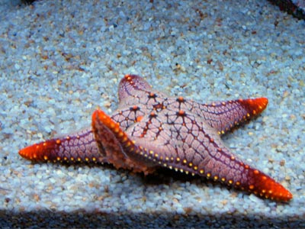
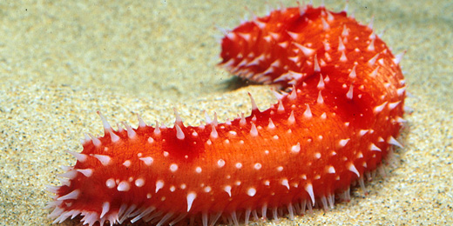
Invertebrates with Spiny Skins

Slide 46
Invertebrates with Spiny Skins
They have bodies with at least 5 sections
Spikes to guard them against predators
They have suction cup feet to walk
Eg: starfish, sea cucumber etc.

Slide 47
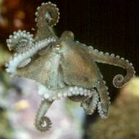
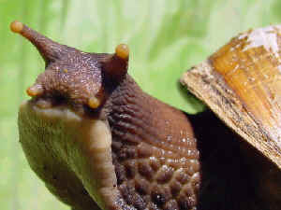
Invertebrates with Soft Bodies

Slide 48
Invertebrates with Soft Bodies
They live on land and fresh water and ocean water.
They make shells from minerals in the water
Shell is present to protect itself from predators.
Two shelled mollusks has a big foot to pull itself along
Eg: slugs, snails , octopus

Slide 49
Arthropods There are 4 groups
They have keen sense organs
They have exoskeletons.
They have two or more segments

Slide 50
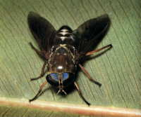
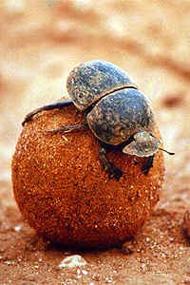
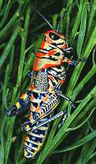
Insects

Slide 51
Insects
Largest group of arthropods
3 pairs of legs
3 main body part sections
2 pairs of eyes
Have mouths

Slide 52
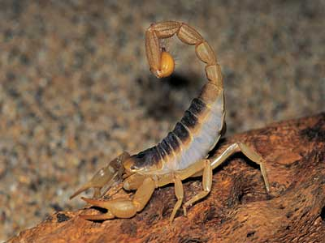
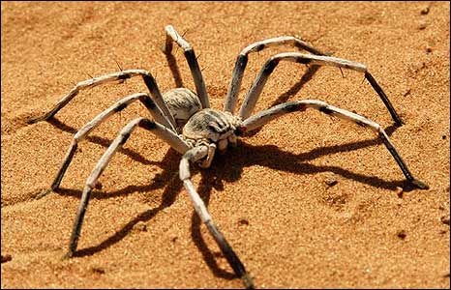
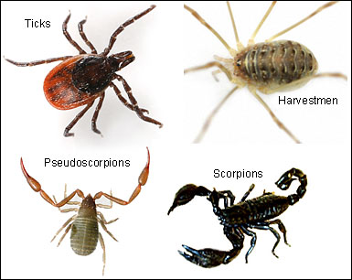
Arachnids

Slide 53
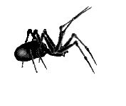
Arachnids
Spiders mites and ticks.
4 pairs of legs
Most live on land.
Some live in fresh water
They are called parasites.

Slide 54
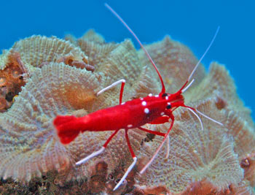
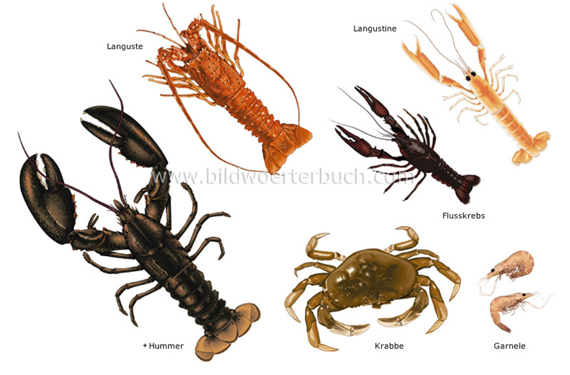
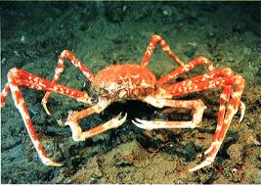
Crustaceans

Slide 55
Crustaceans
They have five pairs of legs
They live near or on the ocean floor
Live on land and water
They have antennae

Slide 56
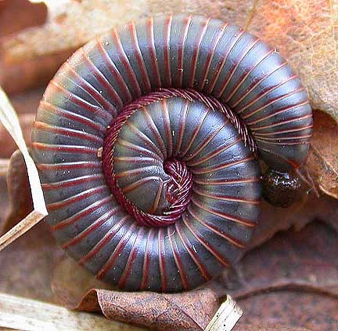
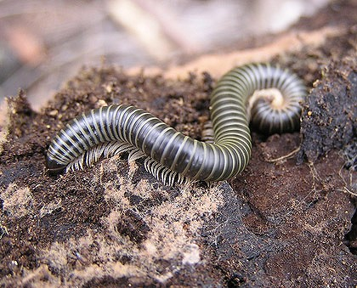
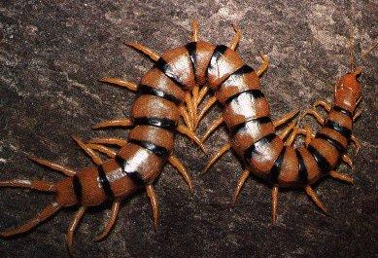
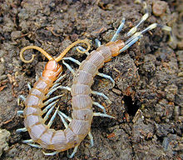
Millipedes & Centipedes

Slide 57
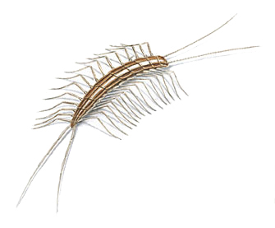
Millipedes & Centipedes
Many body segments
Live under rocks & dark places
Really have less than 100 legs
Protects itself by curling up
Millipedes have 4 legs on each segment
Centipedes have 2 legs on each segment
millipede
centipede

Slide 58
The Dichotomous Key
A key is a device for easily and quickly identifying
an unknown organism.
The dichotomous key is the most widely used type in biological sciences.
The user is presented with a sequence of choices between two statements, couplets, based on characteristics of the organism. By always making the correct choice, the name of the organism will be revealed.

Slide 59
Dichotomous Key
An easy way to sort information
Uses a series of yes or no questions to get to a single description that applies to only one item
How all living things are classified

Slide 60
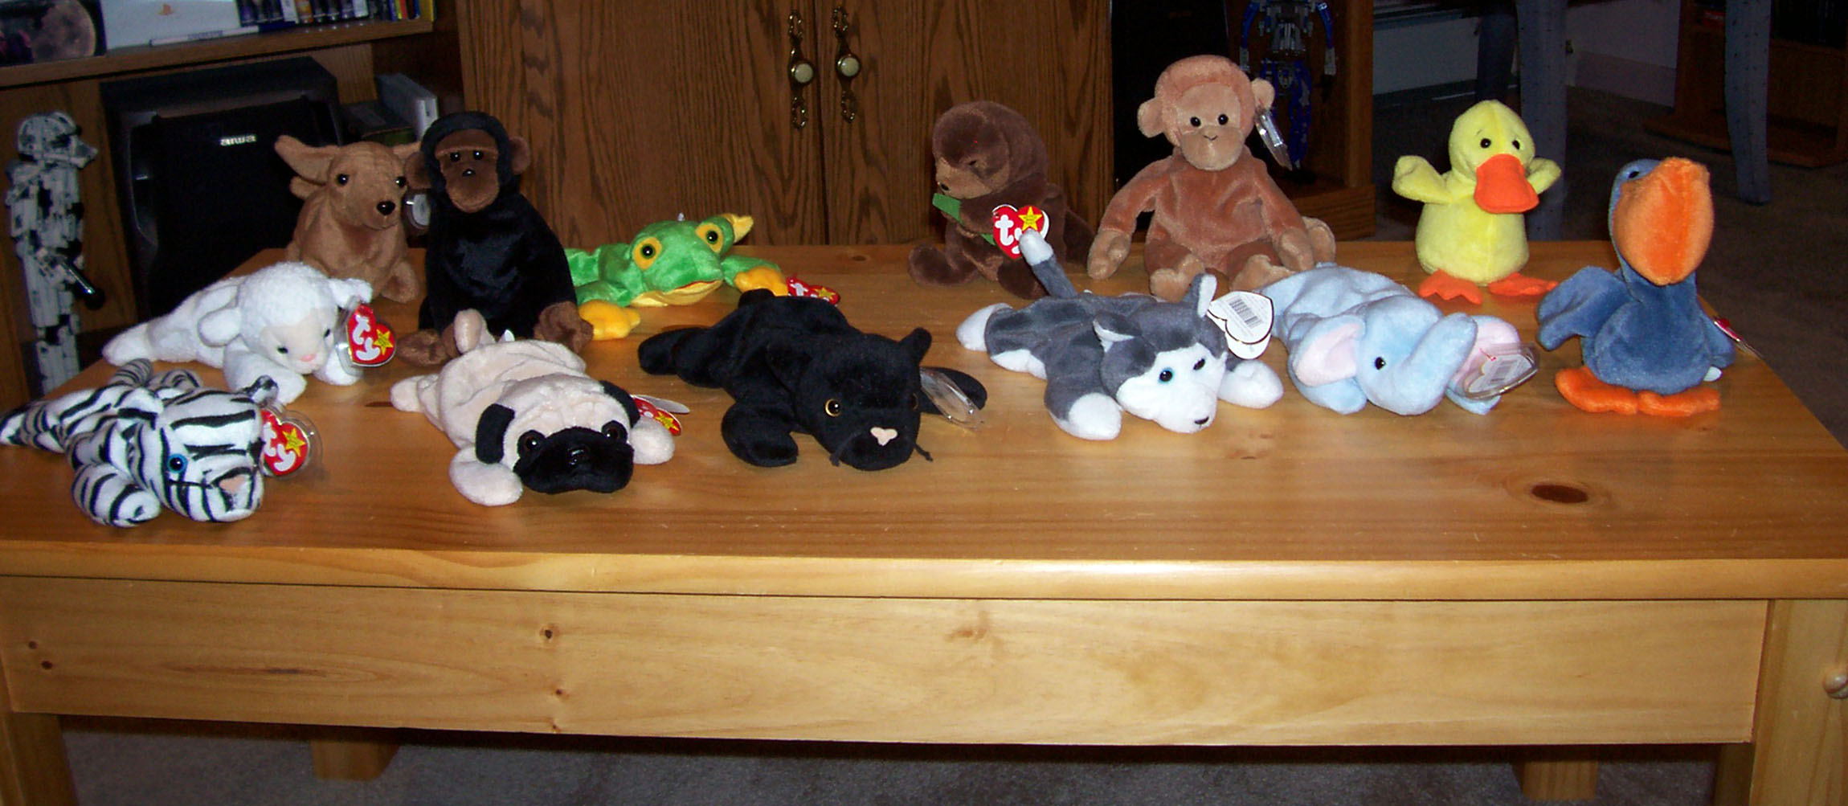
Behold our group

Slide 61
First question: Brown or not brown
Now we sort all of our animals into two groups: brown and not brown

Slide 62
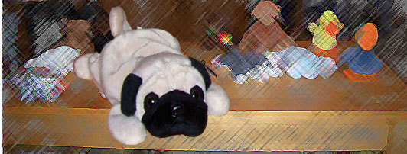
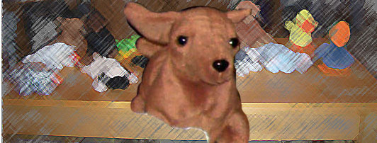
Brown

Slide 63
Not brown

Slide 64
Next we take one of these groups
And make two new groups
So, let’s take our “Not Brown” group
New question: Can fly or Can’t fly

Slide 65
Not brown
Can’t fly

Slide 66
Now try classifying organism in the worksheet provided to you. As home work try creating a dichotomous key all by yourself!

