Slide 1
NERVOUS
SYSTEM

Slide 2
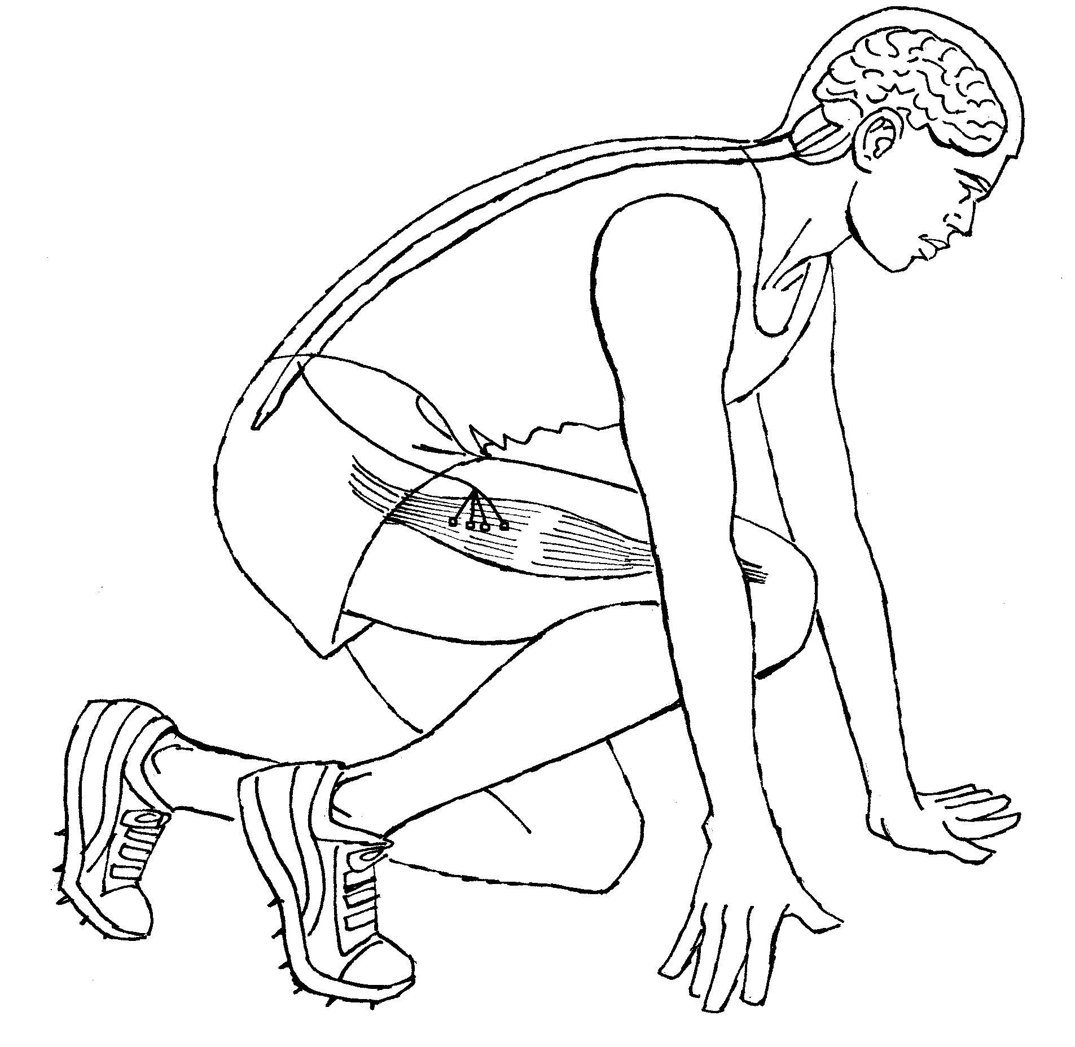
Parts of the nervous system http://www.bbc.co.uk/my-story/stories/tragedy/171642/
The nervous system is made up of three main parts;
The brain
The spinal cord
Nerve fibres
It detects stimuli such as light, sounds, temperature, pressure, pain and co-ordinates the bodies response.

Slide 3

Parts of the nervous system
For example;
If you smell something burning…
Your nose (receptor) detects the stimulus (smell)
Nerve fibres send the message to the brain
Your brain then sends a message to move your body away or to put out the fire!
SIMPLES RIGHT!

Slide 4
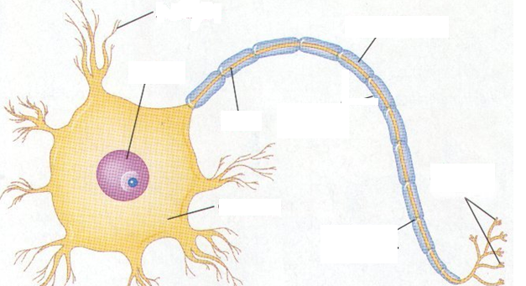
Neuron structure

Slide 5

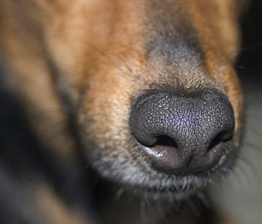
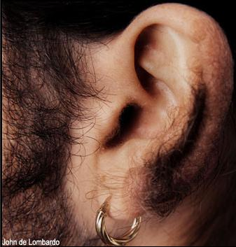
Lets look at some bits more closely
RECEPTORS
Receptors are sensors on the body that detect stimuli
They convert stimuli into electrical signals (messages) called impulses.
Eyes pick up
light waves
through the
retina
Can you think
of any receptors?
Nose picks up
chemical signals
through the
nostrils
Ear picks up
sound waves
through the
eardrum

Slide 6
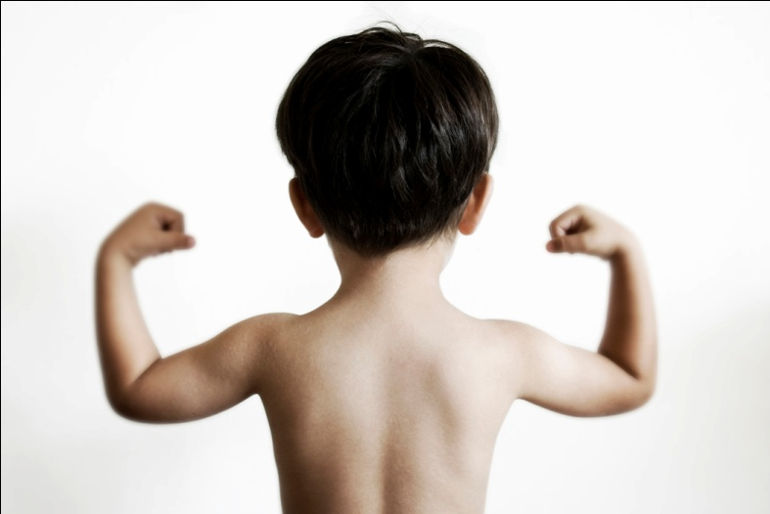
EFFECTORS
An effector is any part of the body that produces the response.
Here are some examples of effectors:
a muscle contracting to move the arm
a muscle squeezing saliva from the salivary gland
a gland releasing a hormone into the blood

Slide 7
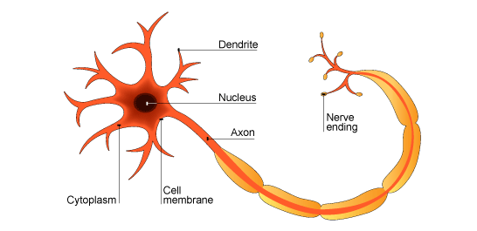
NERVE FIBRES
Nerve fibres are bundles of nerve cells (neurones) that pass on electrical signals (impulses) to the brain.
From the brain, nerve fibres send impulses to effectors (muscles).

Slide 8
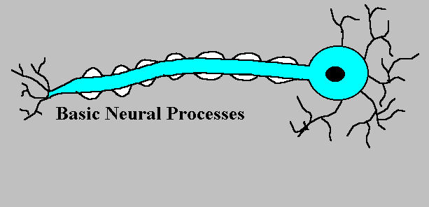
NEURONES
There are three types of neurones
Sensory neurone – carries impulses from the receptors to the spinal cord.
Relay Neurone – carries impulses to and from the spinal cord and the brain
Motor Neurone – carries impulses from the brain to the effector

Slide 9
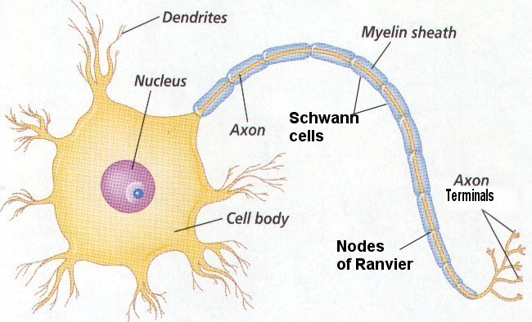

Basic nerve cell structure

Slide 10
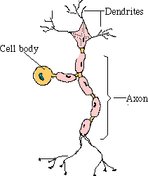
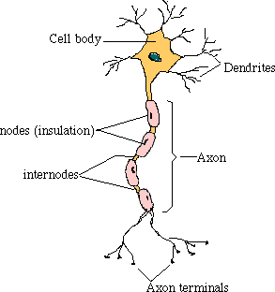
3 main types of nerve cells
sensory neurone
relay neurone
motor neurone

Slide 11
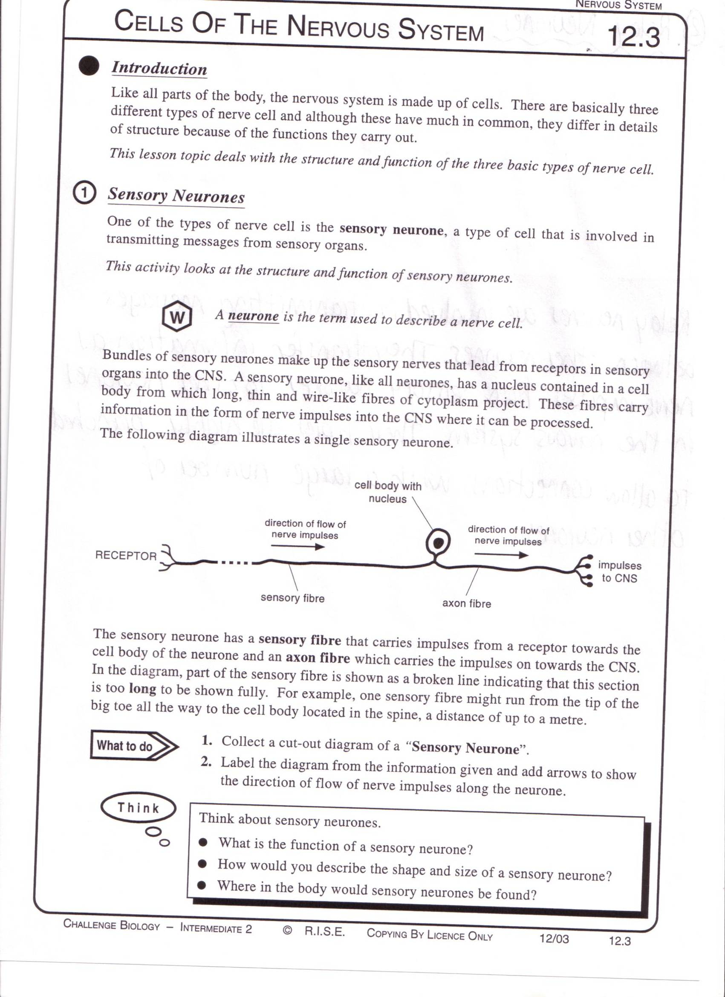
Sensory neurons
Carries impulses from receptors e.g pain receptors in skin to the CNS( brain or spinal cord)

Slide 12
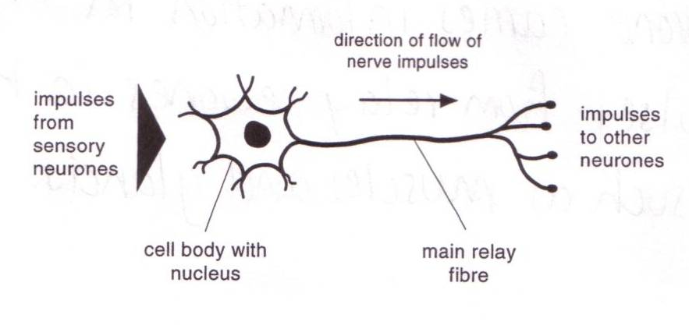
Relay neuron
Carries impulses from sensory nerves to motor nerves.

Slide 13
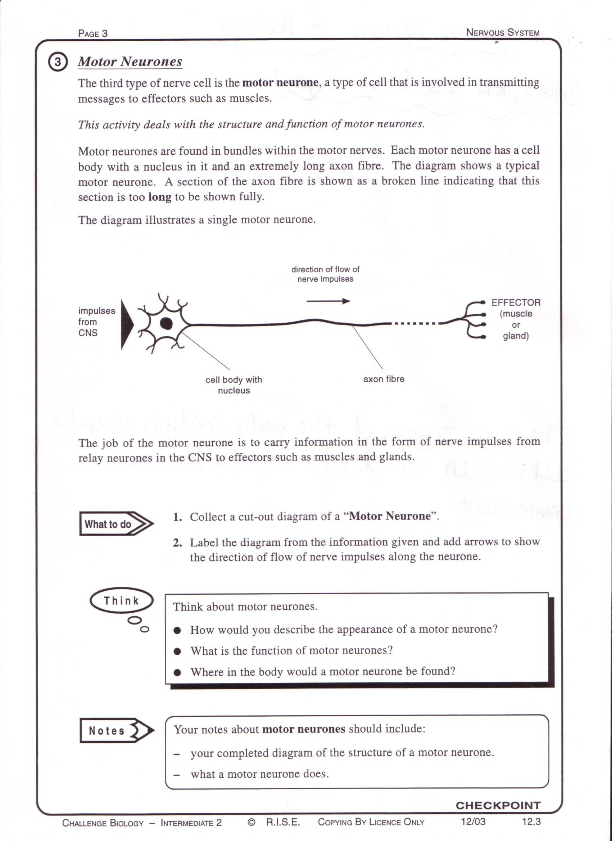
Motor neuron
Carries impulses from CNS to effector e.g. muscle to bring about movement or gland to bring about secretion of hormone .

Slide 14
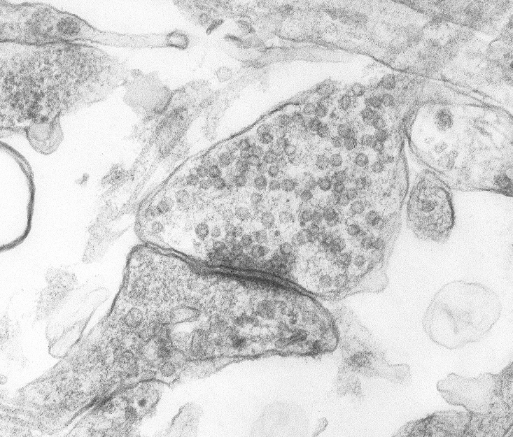
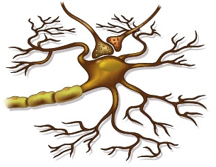
Transmission of signals http://www.bbc.co.uk/my-story/stories/survival/148680/
Multiple sclerosis true stories…

Slide 15


Multiple-choice quiz
Notes:
Teacher notes
This multiple-choice quiz could be used as a plenary activity to assess students’ understanding of electrical signals. The questions can be skipped through without answering by clicking “next”. Students could be asked to complete the questions in their books and the activity could be concluded by the completion on the IWB.

Slide 16
SYNAPSES
Where two neurones meet, there is a tiny gap called a synapse.
Signals cross this gap using chemicals.
One neurone releases the chemical into the gap.
The chemical diffuses across the gap and makes the next neurone transmit an electrical signal.
http://www.bbc.co.uk/schools/gcsebitesize/science/aqa/human/thenervoussystemrev2.shtml
Watch this video on synapses then draw a flow chart of the process

Slide 17
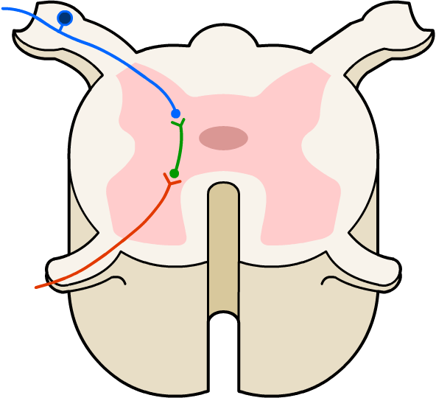
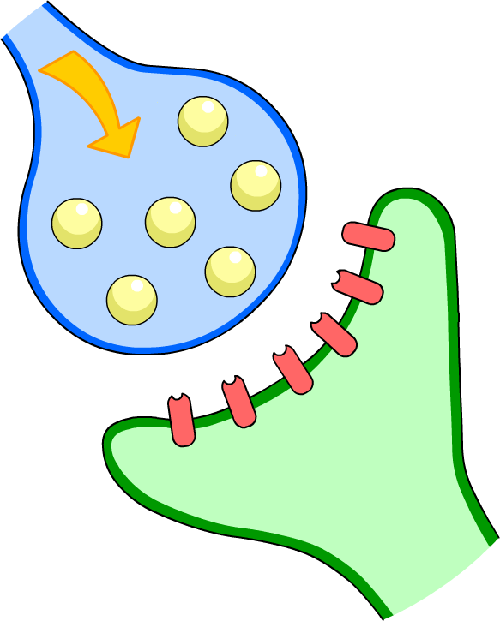

What is a synapse?
A synapse is a junction between two neurones across which electrical signals pass. The human body contains up to 500 trillion synapses.
presynaptic cell
postsynaptic cell

Slide 18

The release of neurotransmitters
When a nerve impulse arrives at the end of one neurone it triggers the release of neurotransmitter molecules from synaptic vesicles.
synaptic vesicle
neurotransmitter molecules

Slide 19
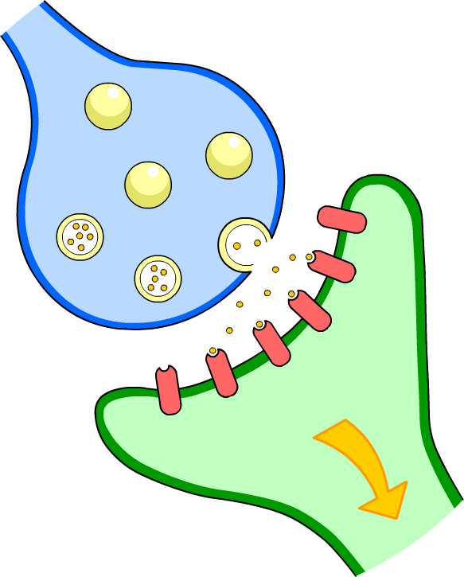
Continuing the impulse
The neurotransmitters diffuse across the synaptic cleft and bind with receptors on the next neurone, triggering another impulse.
synaptic cleft
nerve impulse
receptor

Slide 20
What are?
voluntary, involuntary actions
antagonistic muscles.
http://www.youtube.com/watch?v=FR4S1BqdFG4&feature=related
(start after 1.20)

Slide 21
REFLEX ARC
When your body needs to react to something very quickly (to protect itself) it uses a reflex arc (spinal reflex).
Instead of sending impulses from the receptor
Spinal cord brain spinal cord effector
It sends impulses from the receptor
spinal cord effector…Yup it bypasses the brain!
http://www.bbc.co.uk/schools/gcsebitesize/science/aqa/human/thenervoussystemrev3.shtml

Slide 22
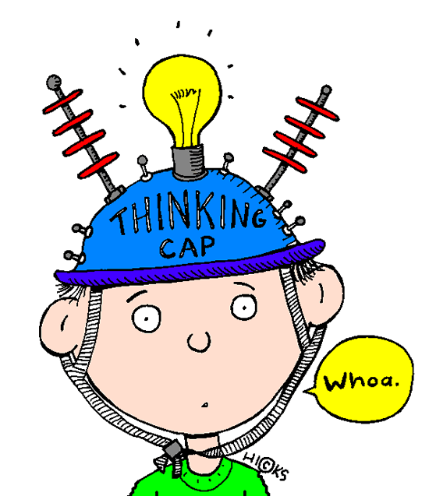
ANSWERS
Electrical impulses along neurones, chemical (neurotransmitters) across the synapse.
The microscopic gap between two neurones.
By chemicals called neurotransmitters.
To pass the impulse onto the correct motor neurone.
Glands or muscle that produce the
effect or make a response.

Slide 23
The sequence of a reflex arc
Notes:
Teacher notes
This ordering activity could be used as a plenary or revision exercise on reflex arcs. Mini-whiteboards could be used to make this a whole-class exercise.

Slide 24
REFLEX ACTION
In bright light | In dim light
Radial muscles of the iris relax. Circular muscles of the iris contract. Less light enters the eye through the contracted pupil. | Radial muscles of the iris contract. Circular muscles of the iris relax. More light enters the eye through the dilated pupil.
The way the iris in our eye adjusts the size of the pupil in response to bright or dim light is also a reflex action.
http://www.bbc.co.uk/schools/gcsebitesize/science/aqa/human/thenervoussystemrev3.shtml

Slide 25
NERVE PATHWAY… answers
SENSE ORGAN/ RECEPTOR
Senses stimuli from our surroundings.
SENSORY NEURONE
Takes impulses from the sense organ to the relay neurone.
SPINAL CORD
Where the relay neurones are found.
RELAY NEURONE
Takes impulses to the brain and from the brain.
BRAIN
Receives impulses from the spinal cord and sends out new impulses.
EFFECTOR
The muscle that receives the impulse from motor neurone.
MOTOR NEURONE
Takes impulses from the relay neurone to the effector.

Slide 26
NERVOUS SYSTEM… answers
REFLEX | PROTECTION GIVEN
BLINKING | To eye
COUGHING | Stops us choking
SNEEZING | Removes blockages from the nose
PUPILS CHANGE SIZE | Protects the retina
4a) 37m
55m/s
= 0.67s
4b) RT = d s
= 20m
40m/s
= 0.5s
4c) sensory receptor in eye – sensory neurone – relay neurone - brain – motor neurone - effector
4d) i) brain, ii) takes too long
iii) Stimulus sensory neurone
relay neurone motor neurone
effector

Slide 27
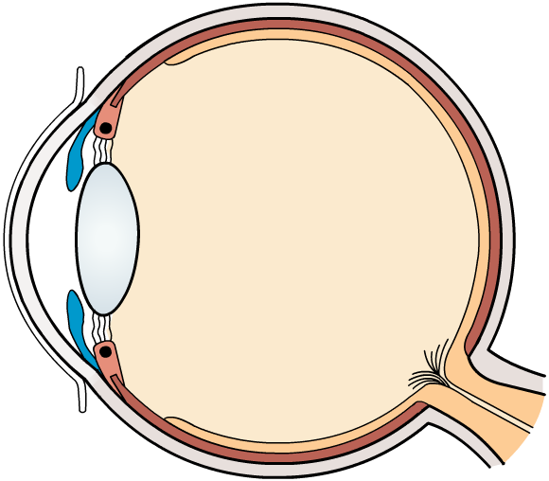
Inside the eye
cornea
protects eye surface and focuses light rays
suspensory ligaments
retina
hold lens in place
senses light
lens
focuses light
on retina
iris
regulates amount
of light entering eye
Fovea/yellowspot: this area has highest density of cones and max.sharpness works only in bright light.
optic nerve
ciliary muscles
transmits impulses to the brain
change shape of the lens

Slide 28
The iris reflex

