Slide 1
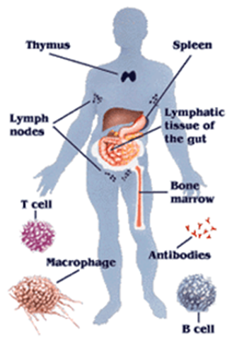
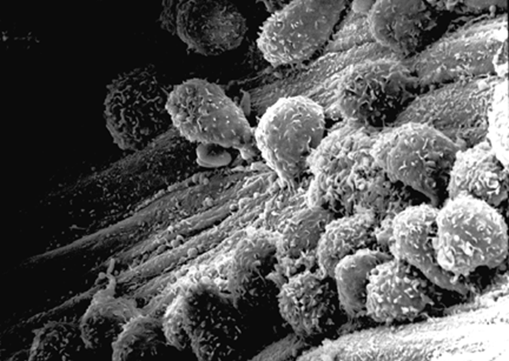

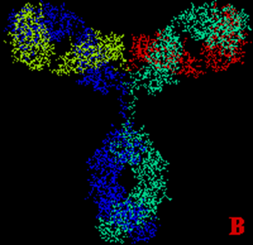
DefenCe against diseases

Slide 2
Objectives
The student understands what a pathogen is and the role of a pathogen in causing disease
The student lists out the different types of pathogens and diseases caused by them; (Malaria, measles, chicken pox, small pox, typhoid, polio, hepatitis B, tuberculosis, cholera, H1N1, dangue)
The student appreciates the role of skin and mucous membranes as first line of defence and their mechanism of defense against pathogens.(just an overview)
The student analyses the role of WBC in protecting the body against pathogens(types of WBCs and their role)

Slide 3
What are pathogens?
They are disease causing micro-organisms
When is a micro organism considered as a pathogen to a particular disease?

Slide 4
Koch’s Postulates
Support Classes
( exercises will be provided to students)
A specific organism can always be found in
association with a given disease
The organism can be isolated and grown in a laboratory
This culture grown in lab will produce the disease when inoculated into a susceptible animal
It is possible to recover the organism from the experimentally infected animal

Slide 5
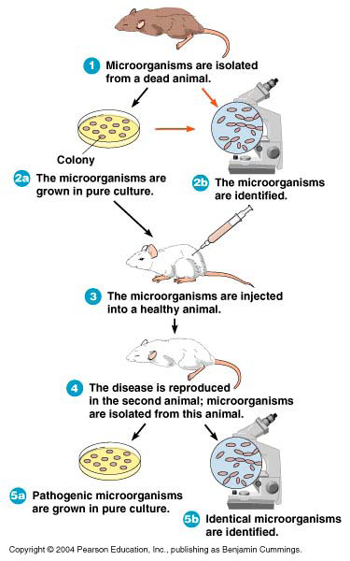
Koch’s postulates

Slide 6
Micro- organisms
Micro-organisms
Micro- very small
Organism- a living thing.
Bacteria, fungi, protozoa, algae.
They may be single / multi cellular.
Habitat? Formation of colonies?
So Micro-organisms are very
small living things!
N.B Viruses are often classed as micro-
organisms but technically they are NON-Living
so call them Microbes instead!
☺

Slide 7
Microorganisms: The good side
Decompose organic waste
Are producers in the ecosystem by photosynthesis
Produce industrial chemicals such as ethyl alcohol and acetone
Produce fermented foods such as vinegar, cheese,curd
and bread
Production of antibiotics, vaccines.
Increasing soil fertility.
Cleaning the environment.

Slide 8
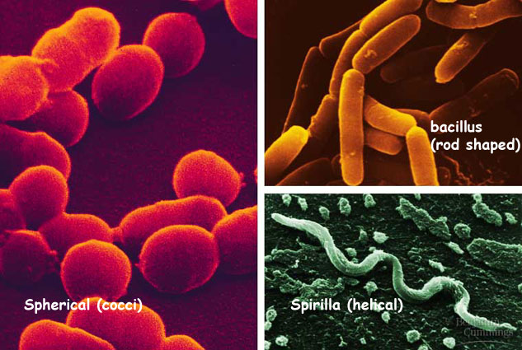
Bacteria
Bacteria are small living single celled
organisms that can come in good
(beneficial) forms and bad (pathogenic)
forms that cause disease.
☺
Some different shapes of bacteria

Slide 9
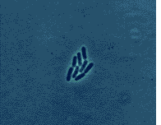
Bacteria divide and double in number every 20 minutes !!!

Slide 10
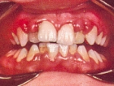
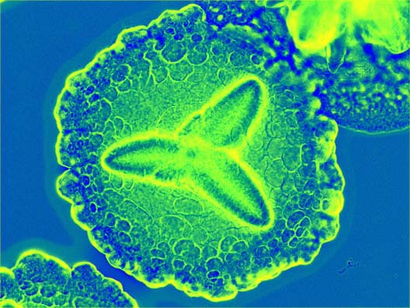
Bad bacteria in the mouth cause teeth to rot.
Mouth bacteria
Mouth bacterium

Slide 11
Viruses
Viruses are extremely small
(much smaller than bacteria)
NON-LIVING microbes that need
a host cell so that they can
reproduce and survive.
☺

Slide 12
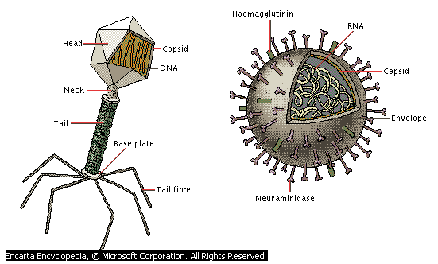
Structure of viruses

Slide 13
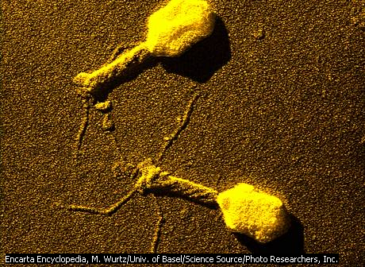
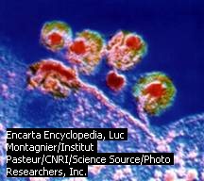
Examples of viruses
A T4 bacteriophage. This infects only bacterial cells, in this case only E. coli
The HIV virus. This attacks T4 lymphocytes. It is responsible for AIDS.

Slide 14
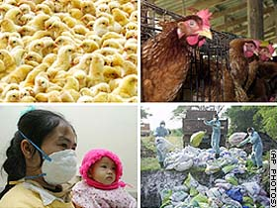
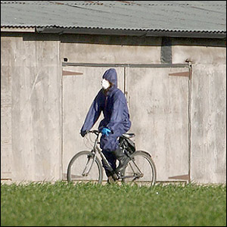
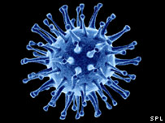
Avian Flu
Virus virus
☺

Slide 15
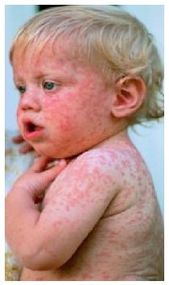
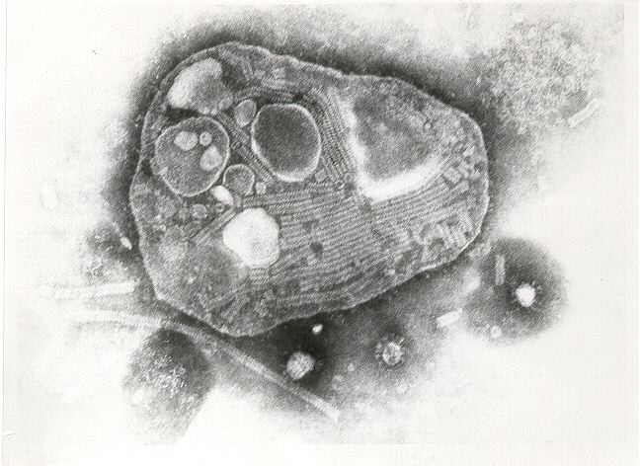
Measles virus
Electron microscope picture of the measles virus
Boy with measles

Slide 16
Fungi
Fungi are organisms that produce spores
and come in the form of moulds, yeasts,
Mushrooms.
They also help things to rot and breakdown
which is an essential process in the cycle of life.
☺

Slide 17
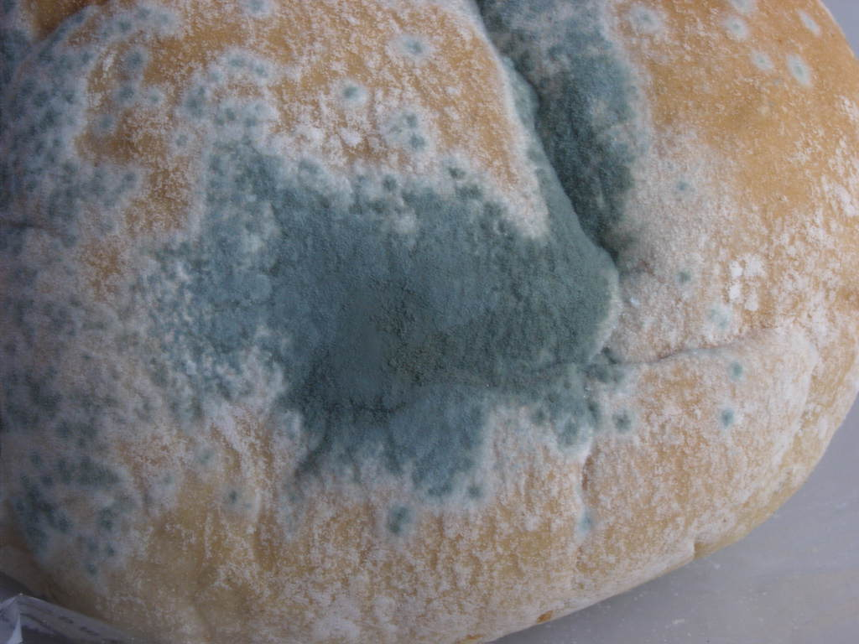
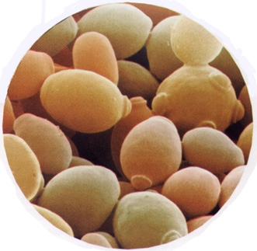
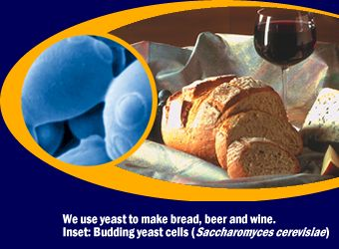
Examples of fungi
Mould growing a bread bun
There can be good forms of
fungus (used to make
bread/beer) and bad forms
(Mould, Athletes foot and thrush).
Yeast cells budding

Slide 18
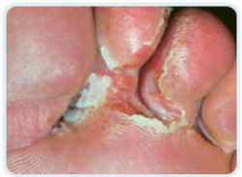
Athletes foot

Slide 19
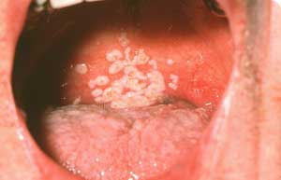
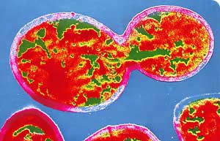
Oral thrush
Thrush yeast cells

Slide 20
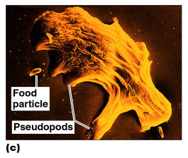
Protozoa
Eukaryotes
Absorb or ingest organic chemicals
May be motile via pseudopods, cilia, or flagella
Figure 1.1c

Slide 21
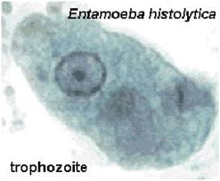
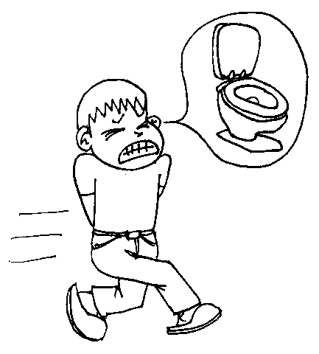
Amoebiasis
Entamoeba histolytica

Slide 22
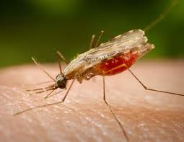
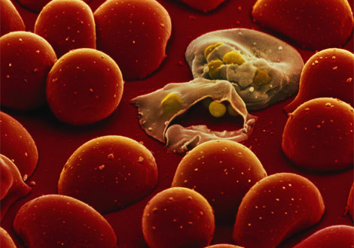
Malaria

Slide 23
Link !!
http://www.bbc.co.uk/schools/gcsebitesize/science/edexcel/health/defendingagainstinfectionrev1.shtml
Additional Information on Microbes

Slide 24
Task-2.1
Sl.no: | Human disease | Causative microorganism | Mode of transmission | Preventive measures
 | Malaria, measles, chicken pox, small pox, typhoid, polio, hepatitis B, tuberculosis, cholera, H1N1, dangue,+3

Slide 25
OUR IMMUNE
SYSTEM

Slide 26
The first line of defence: Skin and Mucous membranes
http://www.textbookofbacteriology.net/innate_2.html
information for mixed grouping

Slide 27
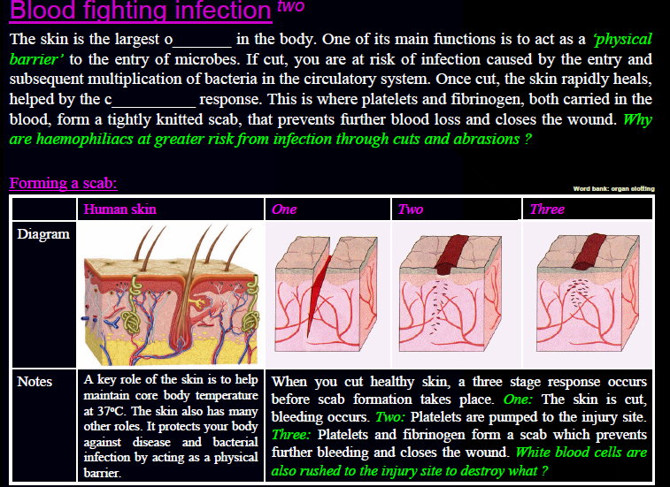

Slide 28
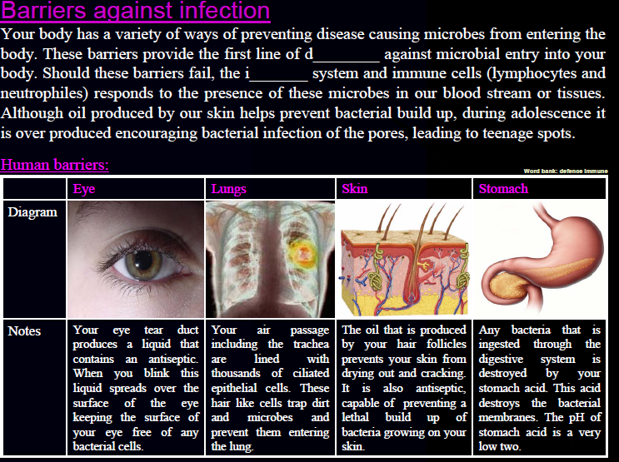

Slide 29
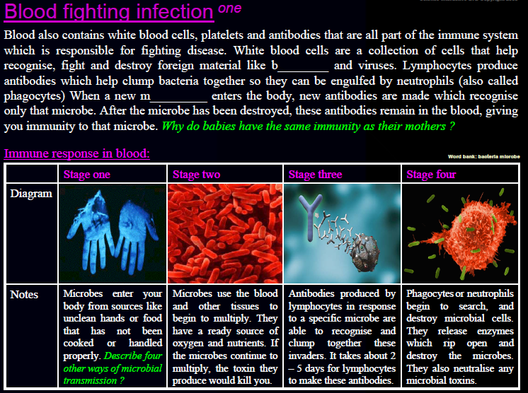

Slide 30
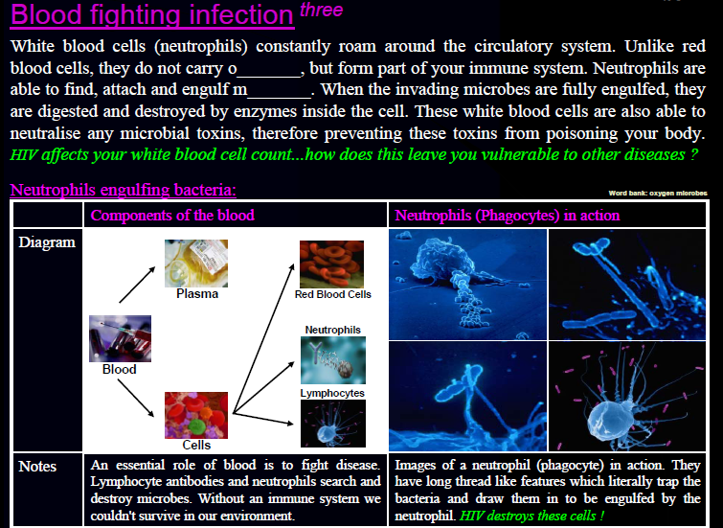
Second line of defence:
Blood

Slide 31
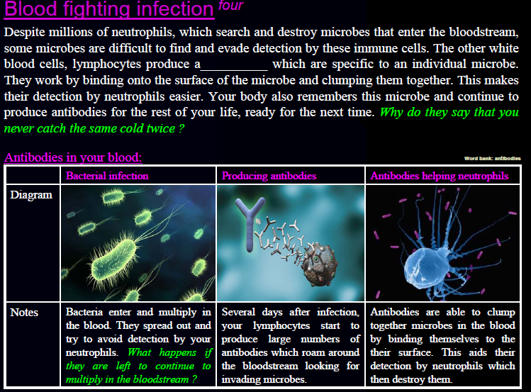

Slide 32
Task 2.2
In groups of 4 make a poster titled, ‘My story…’ in the charts given to you
Choose a pathogen of your choice and using images (illustrations) describe its journey in the human body, the ‘people’ it meets, the ‘places’ it goes or is taken to…
The ending can be whatever you chose: the body may succumb to the pathogen or the body soldiers defeat the pathogen
P.S: you should use all the scientific terms used while discussing the immune mechanism.

Slide 33
Cells of the Immune System
White Blood Cells Lymphocytes
Phagocytes

Slide 34
Phagocytes
Produced throughout life by the bone marrow.
Scavengers – remove dead cells and microorganisms.

Slide 35
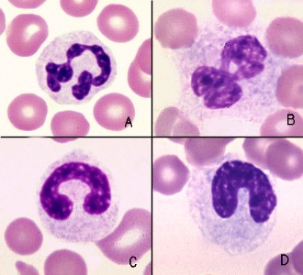
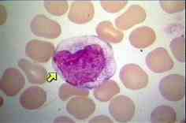
Phagocytes(only for reference)
Neutrophiles
Macrophages
6O% of WBCs
‘Patrol tissues’ as they squeeze out of the capillaries.
Large numbers are released during infections
Short lived – die after digesting bacteria
Dead neutrophils make up a large proportion of puss.
Larger than neutrophils.
Found in the organs, not the blood.
Made in bone
Long lived
Initiate immune responses as they display antigens from the pathogens to the lymphocytes.

Slide 36
LYMPHOCYTES
T lymphocytes
B lymphocytes
T-cells mature in thymus
T-cells have T cell receptors
very similar to antibodies and are specific to 1 antigen.
Produce cytokines.
Produces helper T cells and killer T cells
B-cells mature in bone marrow then concentrate in lymph nodes and spleen

Slide 37
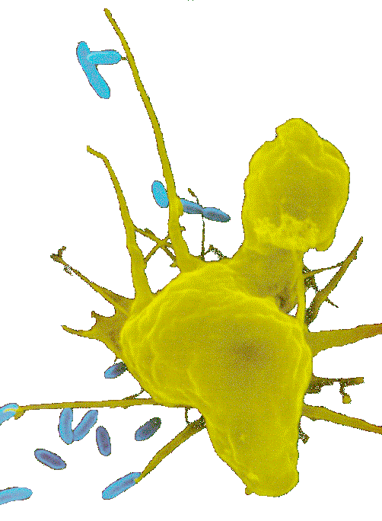
The Immune System in Action
Macrophages
1. The first cell to defend is the macrophage. The macrophage tears apart a virus and brings it to a helper T cell. If the fragments of the torn virus are recognized by the T cell, they become united.
Macrophage=Blue cells

Slide 38
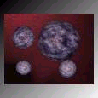
T Cells
Once the macrophage and the T cell are untied, the T cells let off a chemical.
This chemical stimulates the production of other T cell.

Slide 39
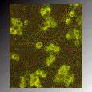
B Cells
The new T cells send for B cells. The B cells then produce millions of antibodies.

Slide 40
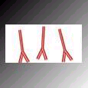
Antibodies
Antibodies are tiny protein structures that B cells produce. The antibodies act like little flags for the other cells. They latch onto a virus and the macrophages attack wherever the antibodies tell them to.

Slide 41
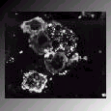
Result
After a few days of this, assuming that the virus does not overpower , the fighting will be over, and the person will no longer be sick.

Slide 42
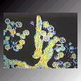
More Results
After a battle like this, the number of antibodies, B cells, T cells, and macrophages are greatly reduced.

Slide 43
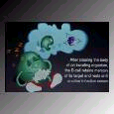
Memory Cells
Even though most of the other cells have been destroyed, memory T and B cells are left over. It is their job to make sure the next time that this virus enters the body they remember how to defeat it.

Slide 44
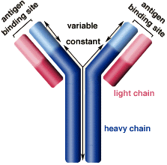
How Abs work
Some act as labels to identify
antigens for phagocytes
Some work as antitoxins i.e. they block toxins for e.g. those causing diphtheria and tetanus
Some attach to bacterial flagella making them less active and easier for phagocytes to engulf
Some cause agglutination (clumping together) of bacteria making them less likely to spread

Slide 45
Immune response
Phagocyte ( Consumes Pathogen)
Presents Ag to Specific T cell
T cell secretes Cytokines
Specific B cells Memory B Cell Rapid response
Activated Plasma B Cell Antibodies

Slide 46
Game on the immune system
http://nobelprize.org/educational/medicine/immunity/game/index.html

Slide 47
Task 2.3
Report on AIDS
What is it ?
How does it spread?
How does it affect the immune system?
Preventive measures
Design a brochure on AIDS awareness

Slide 48
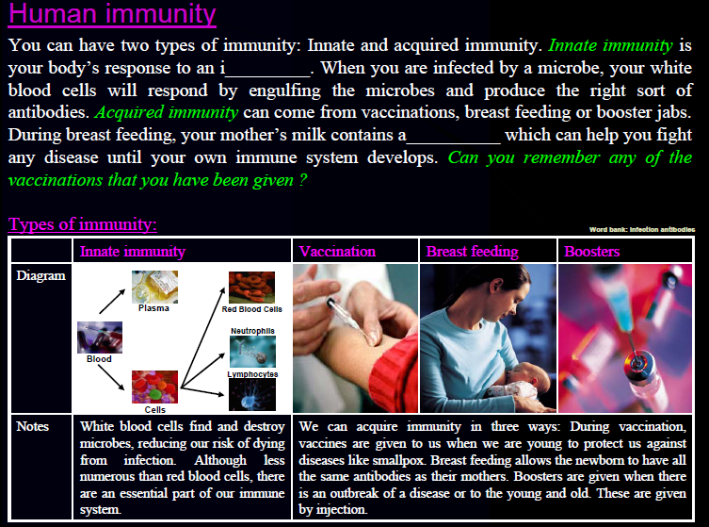

Slide 49
Active and Passive Immunity
Active immunity
Lymphocytes are activated by antigens on the surface of pathogens
Natural active immunity - acquired due to infection
Artificial active immunity – vaccination
Takes time for enough B and T cells to be produced to mount an effective response.

Slide 50
Active and Passive Immunity
Passive immunity
B and T cells are not activated and plasma cells have not produced antibodies.
The antigen doesn’t have to be encountered for the body to make the antibodies.
Antibodies appear immediately in blood but protection is only temporary.

Slide 51
Active and Passive Immunity
Artificial passive immunity
Used when a very rapid immune response is needed e.g. after infection with tetanus.
Human antibodies are injected. In the case of tetanus these are antitoxin antibodies.
Antibodies come from blood donors who have recently had the tetanus vaccination.
Only provides short term protection as abs destroyed by phagocytes in spleen and liver.

Slide 52
Active and Passive Immunity
Natural passive immunity
A mother’s antibodies pass across the placenta to the foetus and remain for several months.
Colostrum (the first breast milk) contains lots of IgA which remain on surface of the baby’s gut wall and pass into blood

Slide 53
Active and Passive Immunity
Natural passive immunity
A mother’s antibodies pass across the placenta to the foetus and remain for several months.
Colostrum (the first breast milk) contains lots of IgA which remain on surface of the baby’s gut wall and pass into blood

Slide 54
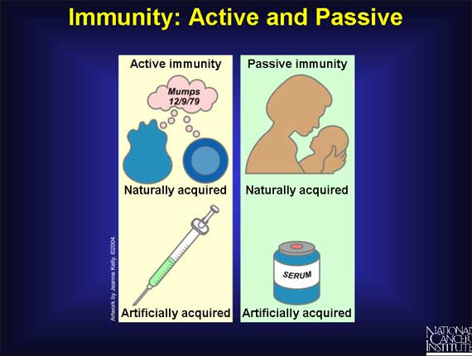

Slide 55
Vaccines
What are vaccines?
Vaccines are any preparation used as a preventative inoculation.
A vaccine is the weakened form of the disease or virus. This helps the body make antibodies.

Slide 56
Vaccines
How are vaccines made?
Scientists grow the influenza (flu) vaccine in chicken eggs. The egg incubates the virus and then scientists heat kill the virus and gives it to the patients in a weakened form.

Slide 57
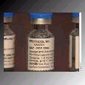
Vaccines
How do vaccines work?
The vaccine is a small weakened or dead dose of the certain virus or disease. The body identifies it and the body makes anti-bodies so it knows how to beat the real virus.

Slide 58
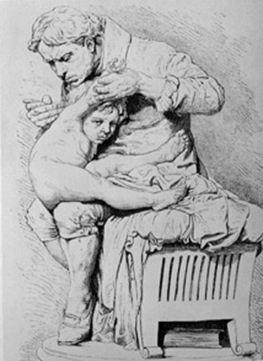
Vaccination
A preparation containing antigenic
material:
Dead microorganism
Attenuated (harmless) microorganism
Toxoid (harmless form of toxin)
Preparation of harmless ags

Slide 59
Vaccination
Why aren’t they always effective?
Natural infections persist within the body for a long time so the immune system has time to develop an effective response, vaccinations from dead microbes do not do this.
Less effective vaccines need booster injections to stimulate secondary responses
Malnutrition particularly protein

Slide 60
Vaccination
Why aren’t they always effective?
No vaccines against protoctists (malaria and sleeping sickness)
Many stages to Plasmodium life cycle with many antigens so vaccinations would have to be effective against all stages (or be effective just against infective stage but given in very small time period).

Slide 61
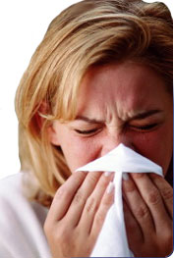
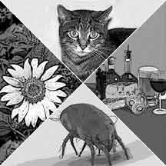
Allergies
When the immune system responds to harmless substances
Allergens – antigenic substances which do no real harm
Allergens include house dust, animal skin, pollen, house dust mite and its faeces

Slide 62
Allergies
Histamine causes blood vessels to widen and become leaky.
Fluid and white blood cells leave capillaries.
The area of leakage becomes hot, red and inflamed

Slide 63
Summary and quiz
http://resources.schoolscience.co.uk/abpi/immune/immune2.html

