Slide 1
Objective-2
Types of variation
Continuous and discontinuous variation
Factors affecting variation
Environmental and genetic

Slide 2
Student activity
Write down similarities and differences between you and your pet.
Now get into pairs and write down the similarities and differences between you and your partner.
Where is the difference more ?

Slide 3
Types of variation
Inter specific variations
Intra specific variations
Differences between organisms belonging to different species/ group .
Eg: Differences between a water lily and a cat.
Differences between organisms belonging to the same group/ species
Eg: differences between a cat and tiger

Slide 4
Remember the differences between you and your pet were more than you and your friend
Inter specific variations are always more than
Intra specific variations

Slide 5
Student activity
Make a list of characteristics in which organisms differ ( it includes you too)
Eg: height, mass, no: of fingers , eye color, shoe size etc

Slide 6
Types of variation
Discontinuous variations
Continuous Variation
Cut and dried characteristics there are no in-betweens.
Always caused by genes.
Examples :- Natural hair colour, blood groups.
Gradual or not so clear-cut variation
Bell shaped graph
The classes are artificial and have been decided upon by us to make it easier to draw a graph.
May be caused by genes or environment or both.
Examples :- weight, leaf length, height, skin colour.

Slide 7
Discontinuous and Continuous Variation
Number
of
people
Hair colour
only a few options
Height
varies over a continuous
range

Slide 8
Variation
Variation can come about for two reasons:
Some features can be inherited. That means that you get them from your parents
Other features are affected by the environment ( acquired).
Lots of features are a combination
of both
Examples?

Slide 9
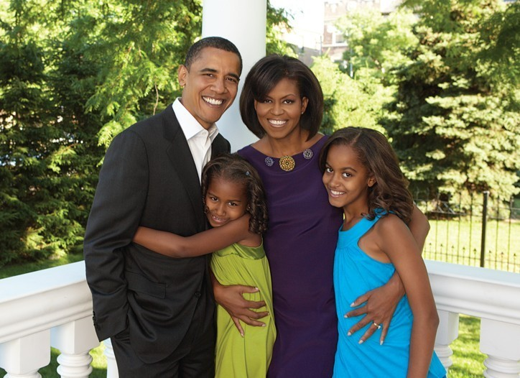
Identify the similarities and differences among the members of this family !
Look at the picture and identify 5
similarities between the parents and the children.

Slide 10
Get into groups and discuss whether these features are Inherited, environmental or both?
Example | Cause | Example | Cause
Sex |  | Weight
Height |  | Dyed blonde hair
Strength |  | Beard
Cut on face |  | Intelligence
Got a bad cold |  | Blood group
Eye colour

Slide 11


So why are Identical twins not identical ?
Twins have identical genes in their bodies…….
Yet they do not have identical characteristics.

Slide 12
Why aren’t fruits from the same plant identical ?

Slide 13
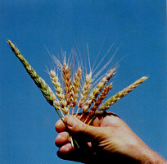
What about this wheat grown in the same field from the same parent plants ?

Slide 14
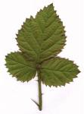
Environmental factors
The features that an organism develops to adapt to a certain environment can be referred to as variations created by the environment.
E.g.: if these are leaves of plants that are in normal environment the following slide shows leaves of plants in extreme environment.

Slide 15
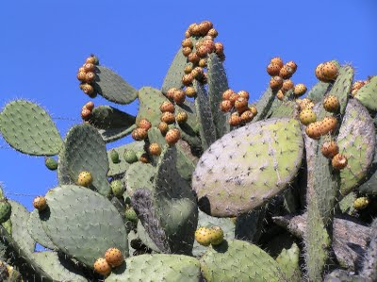
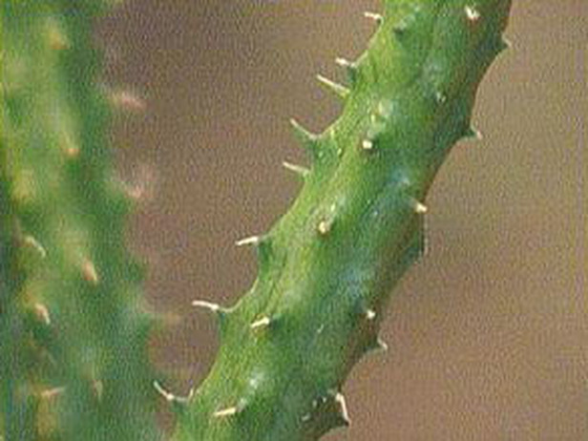
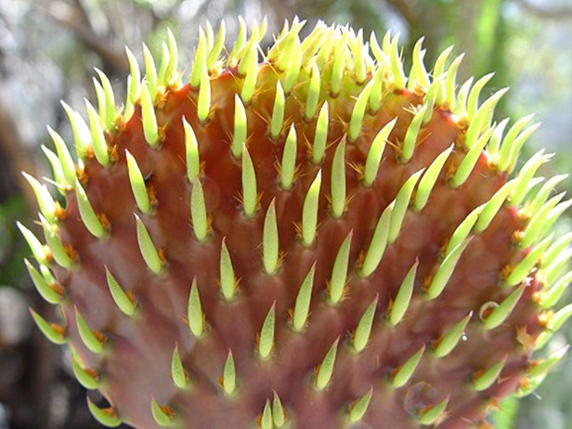

Slide 16
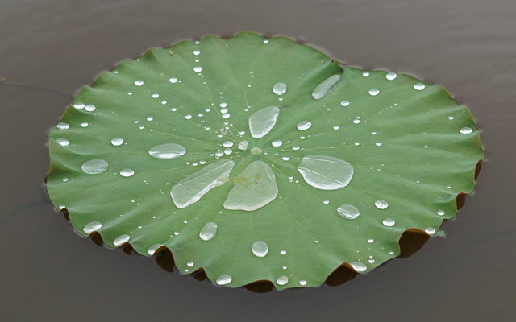

Slide 17
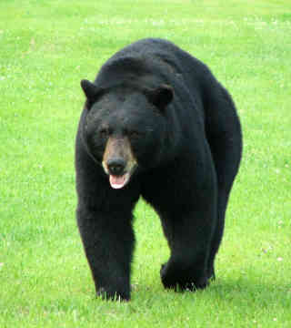
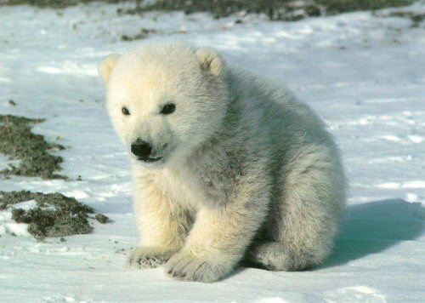
Why are they the same yet so different…?

Slide 18
Student activity
List down few other examples where in differences in environment have brought about variations in organisms.

Slide 19
Measuring variation
Types of averages
mean
Median
Mode
What is correlation?
When we try to figure out if 2 variables are linked in some way
E.g. height & shoe size
Determined through scatter graph.

Slide 20
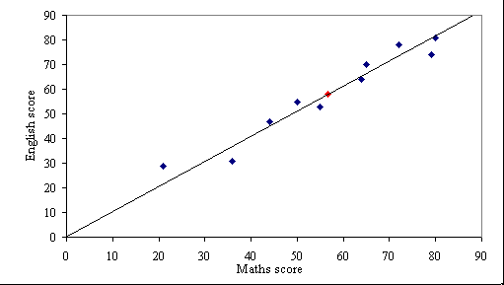
Positive correlation

Slide 21
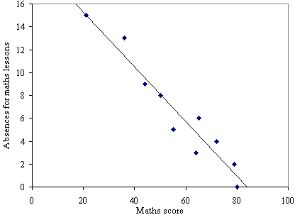
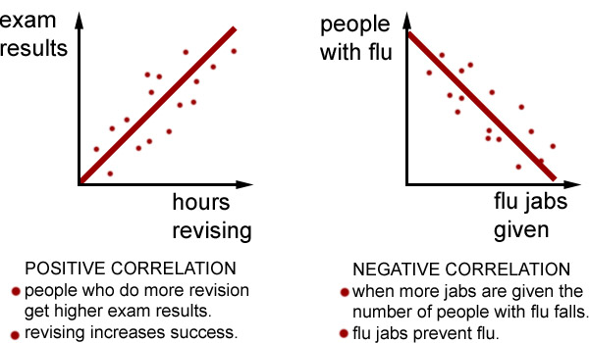
negative correlation

Slide 22
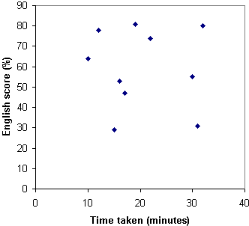
No correlation

